Slide 1

Enable Simultaneous DNN Services Based on Deterministic Operator Overlap and Precise Latency Prediction
October 8, 2021• Shanghai
Notes:
Hello everyone, I am very glad to be here to share our recent work at SC twenty one.

Slide 2



Enable Simultaneous DNN Services Based on Deterministic Operator Overlap and Precise Latency Prediction
Weihao Cui¹, Han Zhao¹, Quan Chen^{1,2}, Ningxin Zheng³, Jingwen Leng^{1,2}, Jieru Zhao^{1,2}, Zhuo Song⁴, Tao Ma⁴, Yong Yang⁴, Chao Li^{1,2}, and Minyi Guo^{1,2}
¹Shanghai Jiao Tong University, Emerging Parallel Computing Center,
²Shanghai Qi Zhi Institute, ³Microsoft Research Asia, ⁴Alibaba Cloud
Notes:
The title of our work is Enable Simultaneous DNN Services Based on Deterministic Operator Overlap and Precise Latency Prediction. This work is about co-locating multiple DNN services on a single GPU.
I am Weihao Cui from Shanghai Jiao Tong University.
My supervisor is Prof. Quan Chen.
I am a second-year Ph.D. Student, my major is computer science, and I am interested in high-performance computing and cloud computing.

Slide 3
Outline
1
Background&Motivation
2
Methodology
3
Evaluation
4
Conclusion
Notes:
I will give my presentation from four sections. Let me start from the background and motivations.

Slide 4
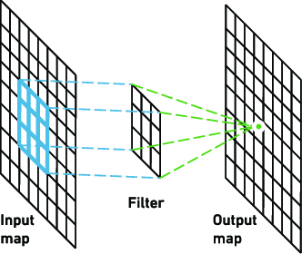

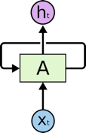


Background: Deploying DNN-based Services on GPUs
DNN-based Services
Cluster with GPUs
Deploy
CNN
Image Classification
Execution
RNN
Speech Recognition
Processing a DNN query
GNN
Recommendation System
Notes:
Nowadays, many online services are DNN based, e.g., CNN for image classification, RNN for speech recognition, GNN for recommendation system.
The cloud vendors are deploying DNN-based services on GPUs.
DNN serving systems like Triton, Clipper are also proposed to process the DNN queries.
Because DNN requires high computing capability, the cluster is equipped with GPUs to support the deployment.
When processing a DNN query on GPUs, we are executing a DNN model.
Commonly, a DNN model is expressed to be a data flow graph.
Instead of invoking a single huge function, the DNN query is processed by executing a series of operators sequentially.
The execution order is the topological order of the original DFG.

Slide 5
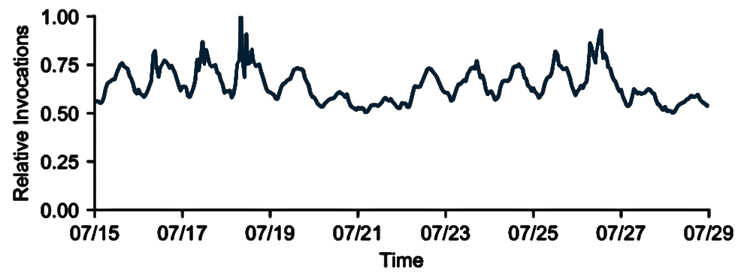
Background: Co-location is Needed for Improving Hardware Utilization
Peak Performance of A100
Workload of Real-world Trace
Precision | TFLOPS
FP64 | 9.7
FP32 | 19.5
Half | 312
Bfload16 | 312
Rich resources
Workload fluctuates
Prema,Nexus,ClockWork
Co-locating multiple DNN services on single GPU improves throughput
Notes:
We already know GPUs are used for providing high computation demand.
Here we can see the peak performance of the new Nvidia GPU Ampere one hundred in the table.
Its computing capability is much higher than a CPU.
However, at the same time, in a real-world trace , the workload fluctuates over time. GPUs will suffer from low utilization while the load is low.
Therefore, in many prior works like prema, nexus, clockwork, while the single service cannot saturate the hardware, multiple DNN services are co-located on single GPU to improve the throughput.
Here the trace in the right figure is from Microsoft Azure Functions. Later, we will also use this to evaluate our design at large scale.

Slide 6
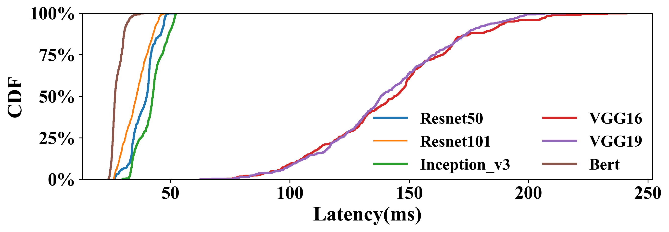
Motivation: Latency Increase is Tolerable, Non-determinism Matters
✗
Prior works do not maximize the throughput.
  Allow multiple services on the same GPU.
  Process queries sequentially.
  Disable operator overlap.
We try to:
  Allow multiple services on the same GPU.
  Process queries simultaneously.
  Enable operator overlap.
Unstable latency increase of different co-location Pairs
Unstable workload of online services
Non-determinism causes QoS violation
QoS Violation
QoS target: 100ms
Solo-run: 24ms
Notes:
The prior works have already deployed multiple services on a GPU.
However, their runtime serving system sequentially processes the operators of the user queries.
Then the operators are executed in (FCFS), (SJF), or (EDF) manner.
In this case, the operators are actually not overlapped at all.
In our work, we try to be more radical. We process queries simultaneously and enable the operator overlap.
Before achieving the goal, we first wanna dig out why prior works do not maximize the throughput in this way.
Therefore, we conduct a simple co-location experiment on a single GPU with MPS enabled. MPS is a technique provided by nvidia for sharing a gpu between multiple processes spatially.
In this experiment, we run a DNN service with Resnet one hundred and fifity two with six DNN services on an Nvidia A one hundred GPU. We report the CDF of latency in this figure.
As we can see in the figure, while the solo-run latency is twenty four milliseconds, the latencies range from twenty four milliseconds to more than two hundred and fourty one milliseconds.
The latency increase of different co-location pairs is unstable
If we set the QoS target to 100 milliseconds.
Many queries suffer from QoS violation.
Furthermore taking the unstable workload into consideration, the non-determinism of latency will cause more QoS violation.
Hence it is not safe to directly run multiple DNN services on a GPU using MPS. The Latency Increase is tolerable while serving, however non-determinism matters.

Slide 7
Motivation : Root Causes of Non-derterminism
Characterizing the Co-location on GPU
No strict and efficient isolation techniques.
No perception between co-located services.
The workload of services varies over time.
Co-location with MPS Enabled
Non-derterminism of Query
❶
❶
Queries have different queuing time.
❷
Queries have different inputs and batch sizes.
❷
❸
Concurrent queries have non-deterministic overlap.
❸
Notes:
What are the root causes of non-determinism?
We characterize the co-location through MPS on GPU and summarize as follows:
Firstly, No strict and efficient isolation techniques.
On CPU intel provides tools like intel-cmt-cat for isolating computation resources.
Hardware resources can be easily and quickly managed through tools like cgroup in linux.
On GPU, tools provided by NVIDIA such as MPS, MIG
they all require to wipe out the running program before reconfiguring the hardware resources.
Secondly, No perception between co-located services.
Services deployed by kubernetes are scheduled independently.
Thirdly, the workload of services varies over time in production.
The Interference between co-located services is not determined.
To be more specific, we take a pair-wise co-location as an example as shown in the figure.
The non-determinism of a query comes from three aspects:
Firstly, Queries have different queuing time.
The query may queue up for the hardware resources or contend for PCI-E, NVLink to transfer data.
The queuing time and data transfer time are affected by loads of the simultaneous DNN services.
When the load is high, the queuing and data transfer time is longer.
Queries have different inputs and batch sizes.
The input size determines the processing time of a query, and DNN services often accept queries with inputs of different sizes.
For instance, the input image can be of different resolutions for Service-A, and the sequence length also varies for Service-B.
Besides, the batch size of query processing is determined by the upper-level load balancer at runtime.
Both different inputs and batch sizes result in different processing time.
Thirdly, Concurrent queries have non-deterministic overlap.
As shown in the figure The operators 1-5 of the current query of Service-A are overlapped with the operators 2-6 of the current query of Service-B.
The overlap increases the response latencies, as the overlapped operators share and contend for the resources in the GPU.
However, previous and later queries may have totally different overlaps, because queries arrive in irregular time intervals.
The non-deterministic overlap results in the different latency increases of the queries.

Slide 8
Challenges: Run Operators Simultaneously and Predict Latency Precisely
How to make the operator overlap deterministic?
How to predict the latency increase due to the overlap?
How to guarantee the QoS of all the simultaneous DNN services?
Notes:
Therefore, if we want to run Operators simultaneously and predict Latency Precisely in our work.
We have three challenges
operator overlap deterministic?
A mechanism is required to configure the operator co-location at runtime instead of allowing the operators to overlap randomly.
In this way, we are able to control the response latencies of the queries for QoS.
How to predict the latency increase due to the overlap?
The operators that run simultaneously contend for shared resources (e.g., global memory bandwidth on GPU)
but they have different sensitivities to the contention
How to guarantee the QoS of all the simultaneous DNN services?
All the user queries of the simultaneous DNN services have QoS requirements.
A low overhead online scheduling policy is required to carefully manage the operators of all the queries to ensure the QoS of all the services.

Slide 9
Outline
1
Background & Motivation
2
Methodology
3
Evaluation
4
Conclusion
Notes:
Now, I will talk about our methodology, and how we resolve the three challenges.

Slide 10
Methodology: Introducing Abcus: a Runtime Operator Management System
Philosophy of Abacus
Abacus
Exploiting the runtime operator scheduling of DNN frameworks.
Easily Being used with existing cluster-level schedulers.
Notes:
We introduce Abacus, a runtime operator management system for resolving the problem mentioned above.
This picture presents the Layered software stack of DNN Serving.
The philosophy of Abacus is different from many prior works.
Prior workss schedule multiple DNN services for a cluster by exploiting cluster-level query routing.
On the contrary, we design and implement Abacus to manage queries in the lower framework level.
This feature makes Abacus easy to be used with existing cluster-level schedulers like Kubernetes for large-scale in-production deployment.

Slide 11
Methodology: Design of Abacus
Determined Operator Group
Overview
Consist of operators from multiple queries.
Exclusive execution without interference.
Deterministic and predictable.
❷
❹
❶
❸
Notes:
For conquering the non-determinism, we bring in the determined operator group in Abacus.
An operator group consists of operators from several queries.
It is executed exclusively without the interference of other operators.
A operator group is deterministic and predictable.
The right figure presents the overview of the Abacus runtime system.
It has three modules: An Overlap-aware latency predictor, a headroom-based query controller, and a segmental model executor.
The serving process is as follows.
Before online serving, we first profile the involved DNN services to build the predictor.
Then the query controller accepts the queries from the upper-level load balancer.
The controller generates the operator group with the help of the predictor.
Finally, the operator group is scheduled onto the model executor for execution.

Slide 12
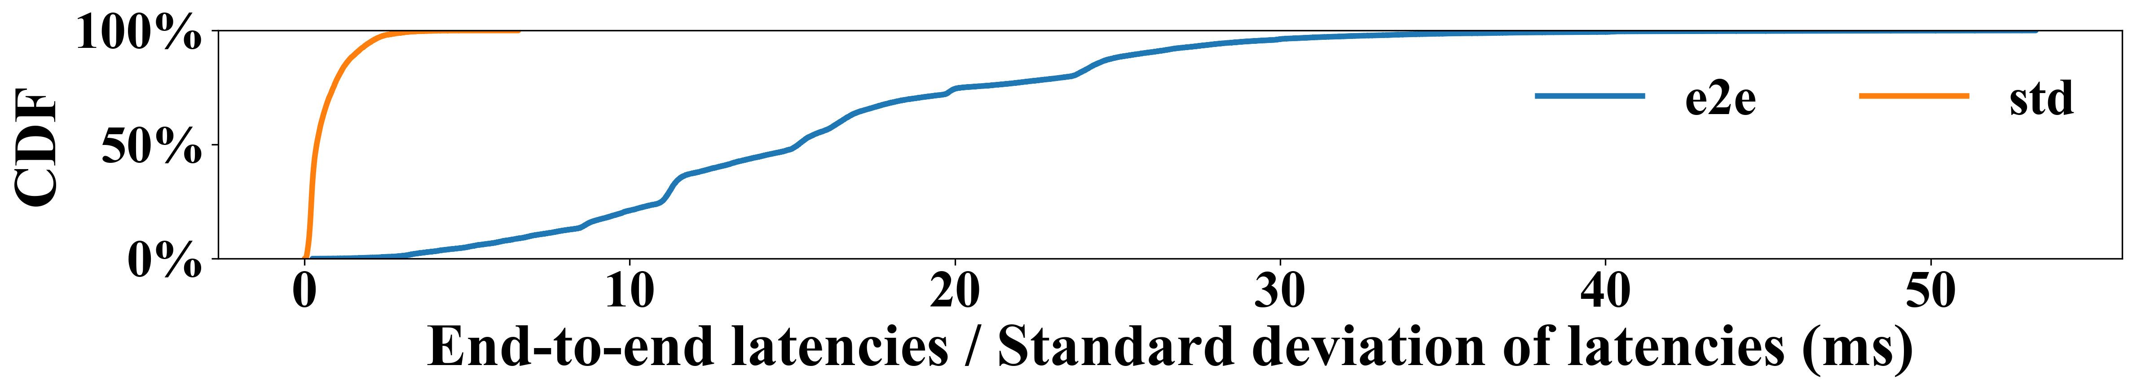
Latency Predictor: Latency Determinism of Operator Group
CDF of the Profiled Operator Group
Statistics of the profiled latency data
The average of the end-to-end latencies: 15.9 𝑚𝑠.
The 90%-ile of the end-to-end latency: 25.8 𝑚𝑠.
The standard deviations are shorter than: 1 𝑚𝑠.
Operator group is deterministic and predictable.
Notes:
Before modeling the operator group, we still have a doubt whether the operator group is deterministic. Therefore we profile many operator groups and plot the CDF of their statistics here.
The average standard deviations are shorter than 1 𝑚𝑠. It is much smaller compared with the end-to-end latency.
Therefore, we can conclude that the operator group is deterministic and predictable.

Slide 13
Latency Predictor: Prior Prediction Techniques
Kernel-level Prediction
Why these techniques are not applicable in real systems?
Sequential prediction: disabling the kernel overlap.
Sync-based prediction: the throughput is not maximized.
Sync-free prediction: relying on hardware metrics and posteriori methods.
Notes:
Before introducing our predictor, let me talk about the prior prediction techniques.
Prior works are kernel-level prediction, which can be catagorized into three kinds. Sequential prediction, sync-based prediction and sync-free prediction.
The sequential prediction disables the kernel overlap.
The sync-based prediction adds synchronization fence between kernel pairs, which leaves slack. The throughput is not maximized.
The sync-free prediction relies on hadware metrics and is done on simulator. It is posteriori method and cannot be used in real system.
Therefore, all these methods can not be applied to predict the latency of operator group.

Slide 14
Latency Predictor: Determining Representative Features
Numerous operators inside a DNN model.
Large input feature
Input Features of an Operator Group
A 𝑁-bit bitmap is used to indicate what models are co-running
For each of the co-running queries:
  the start operator 𝑜𝑝_{𝑠}
  the end operator 𝑜𝑝_{𝑒}
  the batch size 𝑏𝑠
  the sequence length 𝑠𝑒𝑞𝑙𝑒𝑛
Notes:
There are many operators in DNN models (e.g., 241 operators for Resnet101). A large input feature will be generated if Abacus selects the information of all operators as the input.
This figure shows an example input feature in Abacus for training a duration model for operator groups when two of the 𝑁 models co-run.
In the input feature vector, a 𝑁 -bit bitmap is used to indicate which two models co-run.
Besides, for each of the co-running models, the feature vector also indicates the start operator, the end operator, the batch size, and the sequence length.

Slide 15

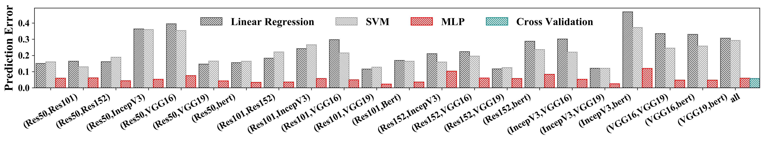
Latency Predictor: Modeling the Operator Group
exponentialincrease
Instance-based Sampling
Sample space
Improving sampling efficiency
Involved models
MLP
Predition Errors of Linear Regression, SVM, and MLP
Notes:
For collecting the latency dataset, we use 6 CV models and 1 NLP model to collect the training samples.
The sample space increases exponentially as the involved models increase.
We analyze the creation of operator groups in Abacus.
There are two principles when Abacus builds operator groups.
First of all, in an operator group, at least a query completes.
Second, a new query may be received, and its operators may be added to the current operator group.
Hence, we adopt instance-based sampling [45] to improve the sampling efficiency.
We first randomly choose the number of models to complete in the operator group.
Then, we randomly choose the number of the newly arrived models that are processed from the first operator.
After the above two steps, the others are randomized.
We evaluate three widely-used prediction methods, Linear Regression, Support Vector Machines, and Multilayer Perceptron, in training the duration model. This figure reports the prediction errors. Finally, we select MLP to provide the latency prediction.

Slide 16
Segmental Executor: Flexible Model Execution
Supporting the Execution of Operator Group
  Deployed in separate process for the purpose of privacy and avoiding the crash.
  Executing the operator group using MPS for enabling the overlap.
  Sync operation for determinism guaranteeing.
  Loading the intermediate results from the prior scheduling round.
  Saving the intermediate results for the next scheduling round.
Notes:
For supporting the execution of the operator group, we design the segmental model executor.
In the model executor, each service is deployed in the separate process for the purpose of privacy and avoiding the crash.
The executor executes the operator group using MPS for enabling the overlap.
For each operator group, a synchronization operation is needed to guarantee the determinism.
The executor has two more features.
Firstly, it loads the intermediate results from the prior scheduling round.
Secondly, it saves the intermediate results for the next scheduling round.

Slide 17
Query Controller: Headroom-based QoS Guaranteeing
Data transfer through PCI-E or NVLink
QoS target
Queue time
Duration of completed operators
Headroom Definition
𝑇headroom = 𝑇𝑄𝑜𝑆 −𝑇𝑞𝑢𝑒𝑢𝑒 − 𝑇𝑐𝑜𝑚𝑚unicate − 𝑇𝑐𝑜𝑚𝑝𝑙𝑒𝑡𝑒𝑑
= 𝑇𝑄𝑜𝑆 − (𝑇𝑐𝑢𝑟rent − 𝑇𝑠𝑡𝑎𝑟𝑡)
Current timestamp
Start timestamp
Performing Headroom-based Scheduling
Guarantee the QoS for the query with the smallest headroom for single round.
Ensure the QoS for all co-located services over time.
Sort all queries according to 𝑇headroom in ascending order.
Determine the QoS headroom for the whole operator group.
Search for the operator group and schedule it
Notes:
Now, I will introduce how we schedule all the co-located DNN services. Inside the query controller, we perform a headroom-based scheduling for QoS guaranteeing.
We first define the headroom. It is the time remained before the deadline arrives of a query.
Theoretically, it can be caculated using the equation here for each query. We need to know the qos target, the queue time, the time for data transfer, the duration of completed operators.
In real system, it can be directly calculated through the second line here.
Based on the queries’ headroom, we perform a scheduling for QoS guaranteeing.
While we schedule, we only guarantee the QoS for the query with the smallest headroom for single round.
However in general, we guarantee the QoS for all services over time.
The process of a single scheduling round is as follows:
We first sort all queries according to headroom in ascending order.
We then determine the QoS headroom for current scheduling round.
At last we search for the operator group and schedule it.

Slide 18
Query Controller: Scheduling Process
Example of Scheduling
Multi-way search for generating the operator goup
Pipelining the scheduling and computation
• • •
Notes:
Here, we use a flow chart to show an example of scheduling three queries by the query controller.
At first, q3 has the least headroom,
Therefore, The headroom (25𝑚𝑠) of 𝑞3 is the headroom for QoS guaranteeing in this round of scheduling.
Then the controller directly adds the operators of 𝑞3 into the operator group, and leaves the QoS headroom of 15𝑚𝑠, predicted by the latency predictor.
Because 𝑞2’s headroom is smaller than that of 𝑞1, the controller first considers adding operators of 𝑞2 to the operator group, and only 10𝑚𝑠 of headroom is left for 𝑞1.
After adding the first two operators of 𝑞1, none of the QoS headroom is left.
Finally, the operator schedule group is generated and ready for execution.
The operators of 𝑞1 that did not enter the operator group will be scheduled in the next round of headroom-based scheduling.
we also have optimizations while scheduling like
multi-way search for generating the operator group.
pipelining the scheduling and computation.

Slide 19
Outline
1
Background & Motivation
2
Methodology
3
Evaluation
4
Conclusion
Notes:
Now we will evaluate Abacus in terms of QoS guaranteeing, throughput improvement, and other aspects.

Slide 20
Evaluation: Hardware and Software
Evaluation Environment
DNN Models for Services
CPU | Intel(R) Xeon(R) Silver 4210R (2.4GHz)
GPU | Nvidia A100 (128 SMs)
OS | Ubuntu 20.04.1 (kernel 5.8.0)
Software | GPU Driver Version: 460.39; CUDA Version: 11.2, CUDNN Version: 8.1
Models | Random Parameters
Resnet50; Resnet101; Resnet152; Inception_V3; VGG16 ; VGG19 | Batch Size: [4, 8, 16, 32]
Bert | Batch Size: [4, 8, 16, 32] Seq Length: [8, 16, 32, 64]
  The arrival time pattern of DNN query satisfies the Poisson distribution.
  Compared with commonly used sequential scheduling: FCFS, SJF, and EDF.
    Pair-wise, Beyond pair-wise, Integrate with MIG.
  Compared with ClockWork at large scale.
Notes:
This is our evaluation environment and the involved DNN models.
The arrival time pattern satisfies the poisson distribution as many prior works. We compare Abacus with FCFS, SJF, EDF scheduling, we also compare Abacus with SOTA cluster-level solutions.

Slide 21
Evaluation: Ensuring QoS and Improve Peak Throughput
Normalized 99%-ile latency
Peak Supported QPS under Extremely High Load
Notes:
Firstly we evaluate the how Abacus ensures the QoS and improve the peak supported throughput for pair-wise co-location.
For QoS guaranteeing, we report the normalized 99%-ile latency for all involved co-location pairs.
While evaluating the throughput, we saturate the hardware with extremely high load and report the number of successfully processed queries as the peak throughput
Abacus reduces the 99%-ile latency by twenty seven percentage on average, improves the peak throughput by twenty nine percentage on average..

Slide 22
Evaluation: Beyond Pair-wise Co-location
Normalized 99%-ile Latency
Peak Supported QPS
No reduction in throughput while co-located models increase ⇒ Well controlled scheduling overhead
Notes:
Beyond pair-wise co-location, we also evaluate Abacus in triplet-wise and quadruplet-wise co-location.
Abacus shows consistent peformance improvement.
While we increase the number of co-located models, the throughput does not reduce. This indicates that our scheduling overhead is well controlled.

Slide 23
Evaluation: Integrating with MIGs
Mig Setup in Nvidia A100
Compared with hardware supported resource
sharing, Abacus is more flexible.
Performance: quadruplet-wise ≈ pair-wise
  Pair-wise is enough
  Limit Profiling to pair-wise co-location for reducing overhead
Profile Name | Fraction of Memory | Fraction of SMs | Co-location Cases
MIG 1g.5gb | 1/8 | 1/7 | Full isolate
MIG 2g.10gb | 1/4 | 2/7 | Pair-wise isolate
MIG 4g.20gb | 1/2 | 4/7 | No isolate
Normalized 99%-ile Latency
Peak Supported QPS
Notes:
We also integrate Abacus with MIG. The SOTA GPU supports MIG that divides a GPU into several isolated GPU instances. The GPU instances have separate and isolated paths through the entire memory system and other resources.
Three GPU instance specifications used in this experiment are shown in Table.
In this experiment, we compare three cases: fully isolated, pair-wise isolated, and no isolation.
As for the full isolate case, we create four instances with MIG 1g and deploy each model onto a single instance.
As for the pair-wise isolate case, we create two instances with MIG 2g and perform the pair-wise deployment.
As for the no isolate case, we create one instance with MIG 4g and deploy the four models on this large instance.
The bottom two figures show the corresponding results. The pair-wise isolate and the no isolate case with Abacus perform better than the full isolate case. Abacus shows its flexibility.
We also can see that quadruplet-wise deployment in no isolation case shows similar performance with pair-wise deployment in pair-wise isolation case.
Pair-wise deployment is enough in most cases. The profiling of Abacus for building the latency predictor can be limited to pair-wise deployment with the help of MIG.

Slide 24
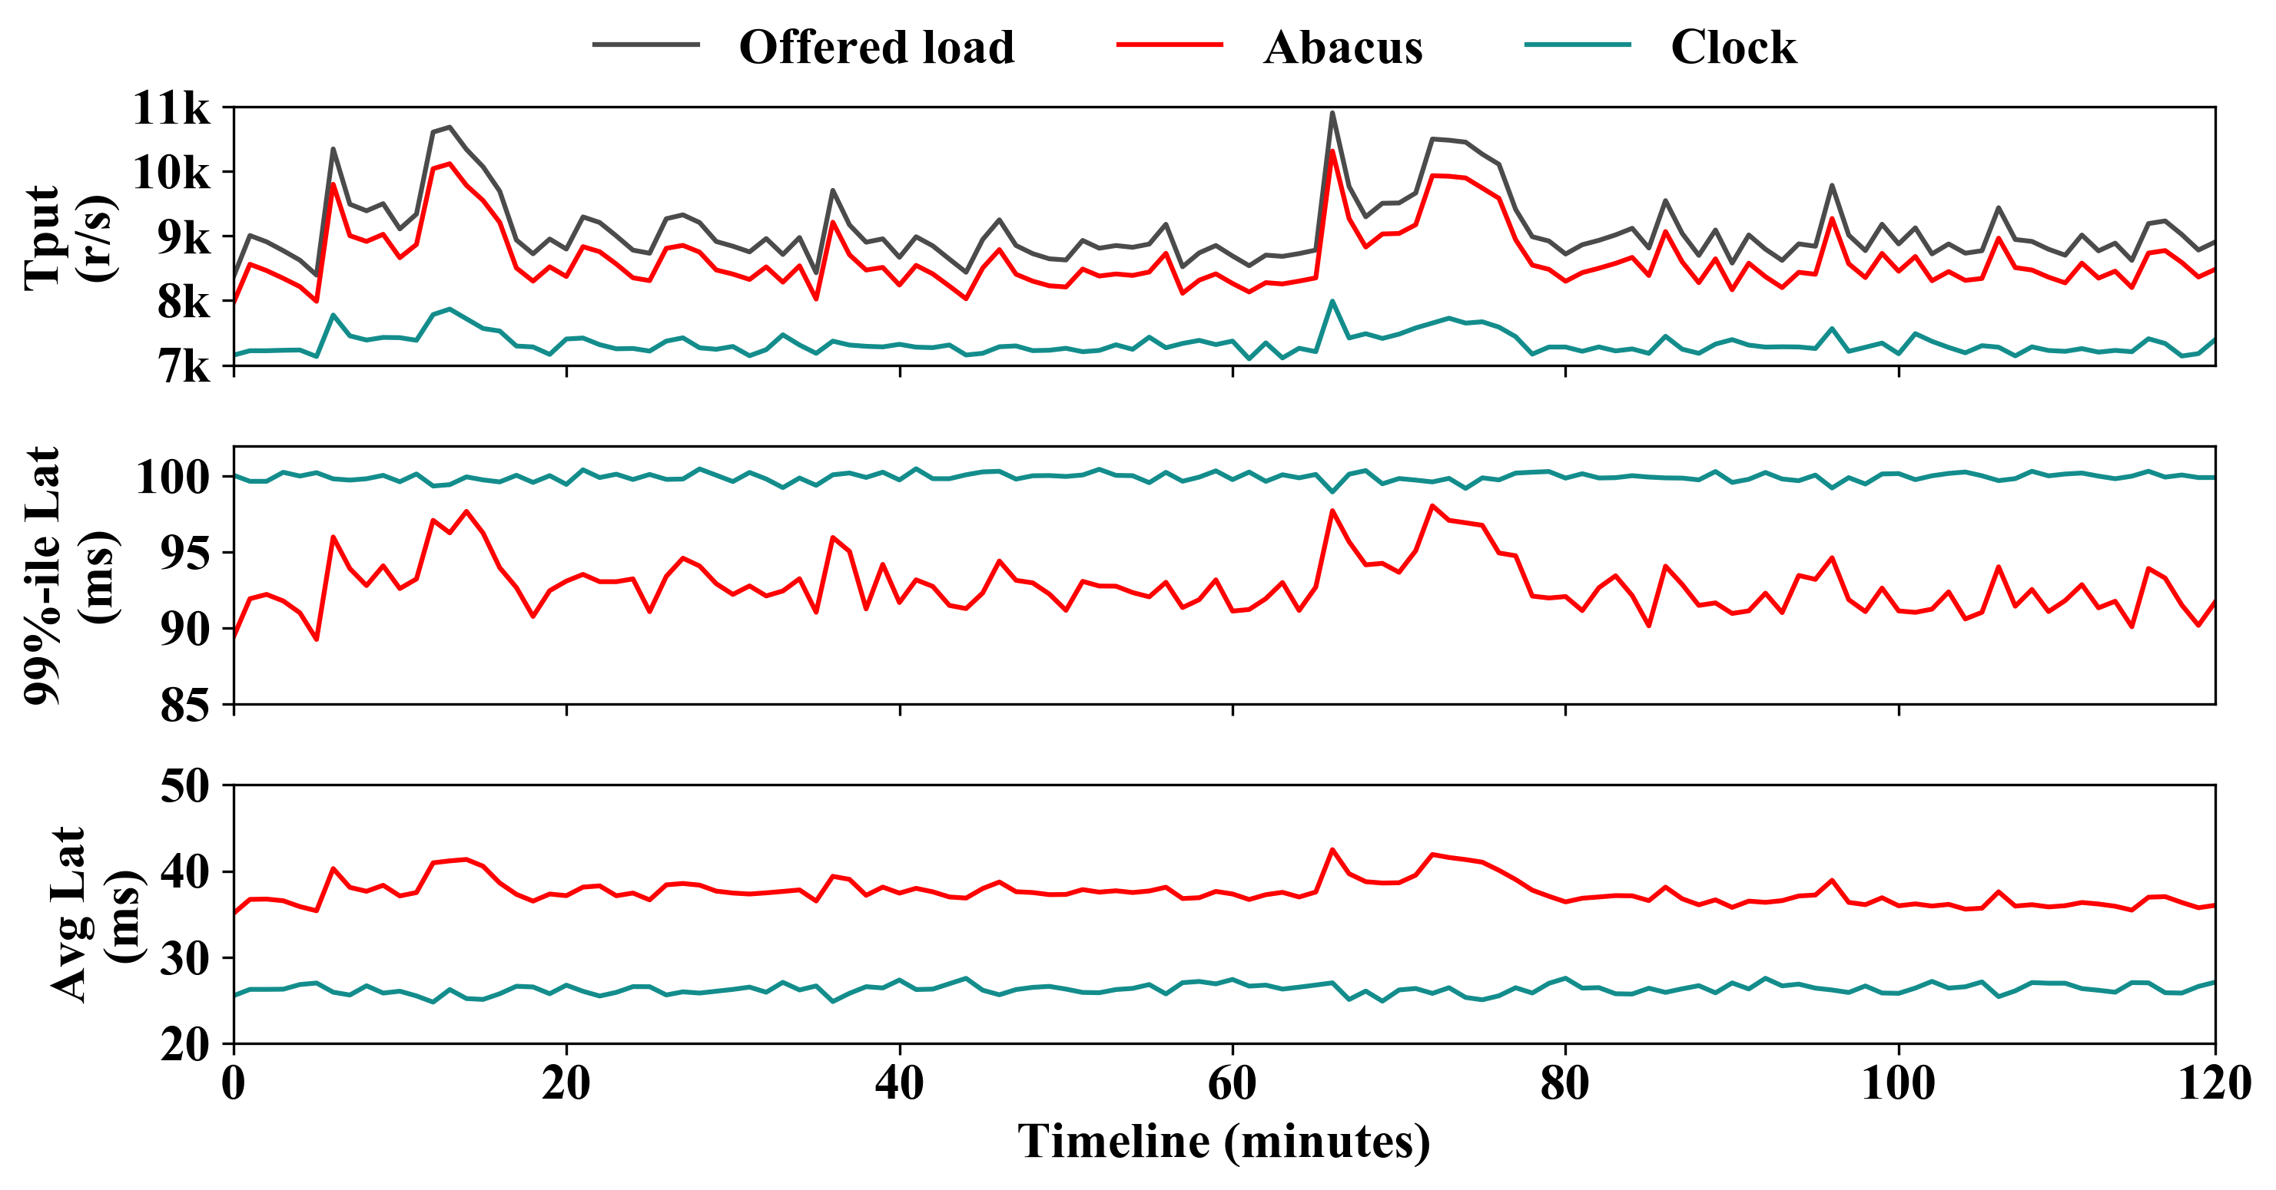
Evaluation: Applying in a DNN Serving Cluster
Results at Large Scale
Evaluation method:
  Evaluated with ClockWork using MAF workload trace
  4 Nodes, each with 4 Nvidia V100 GPUs
Abacus supports 17.8% higher throughput
Both provide QoS guarantee
Notes:
We also evaluate Abacus with ClockWork at a large scale using the MAF workload trace.
Clockwork performs EDF scheduling for accepted queries at the cluster level, and processes the queries in the manner of FCFS on every single GPU.
We perform the experiment on a cluster with 4 nodes (each node is equipped with four Nvidia V100 GPUs).
The right figure shows the results.
Both Abacus and ClockWork provide the QoS guarantee.
However, Abacus supports higher throughput.
At the same time, Abacus has shorter 99%-ile latency and longer average latency.

Slide 25
Evaluation: Overhead
Offline Profiling
Online Scheduling
  For a pair of co-location, we sample 2,000 operator groups and run each group 100 times, done in 2 hours.
  Given 𝑁 DNNs, Abacus divides them into service groups of size 𝑘. The profiling complexity is reduced to 𝑂(𝑁).
  The model of predictor occupies some main memory (14kB).
  With the help of multi-way search, the prediction latency is 0.26𝑚𝑠.
  The global memory used for storing intermediate results (20MB).
Notes:
Finally, we analyze the overhead of Abacus. There are two aspects in terms of overhead.
During offline profiling, for a pair of co-location, we sample 2,000 operator groups and run each group 100 times, done in 2 hours.
However, Given 𝑁 DNNs, Abacus divides them into service groups of size 𝑘. The profiling complexity is reduced to 𝑂(𝑁).
During online scheduling, the The model of predictor occupies some main memory (approximately 14kB).
With the help of multi-way search, the prediction latency is 0.26𝑚𝑠.
Some global memory is also used for storing intermediate results (20MB).

Slide 26
Outline
1
Background & Motivation
2
Methodology
3
Evaluation
4
Conclusion
Notes:
Now we get to the conclusion.

Slide 27
Conclusion & Future Work
Conclusion
Compared with sequential scheduling: improving the system throughput.
Compared with hardware isolation: showing more flexibility.
Easily being integrated in popular cluster-level scheduler.
Future Work
Cluster-level Orchestration: Identify the DNN models that are suitable to be co-located for maximizing cluster utilization.
Notes:
Compared with sequential scheduling, Abacus improves the sytem throughput.
Compared with the hardware isolation, Abacus also shows more flexibility.
Abacus can be also easily integrated in popular cluster-level scheduler.
As for the future work, we will extend Abacus with cluster-level management.
Abacus relies on Kubernetes to perform cluster-level scheduling.
Abacus should identify that what DNN models are suitable to be co-located for maximizing cluster utilization.

Slide 28
Thank you for listening!!!

Slide 29
Thanks
Q&A
Notes:
Anybody have any questions?

Slide 30
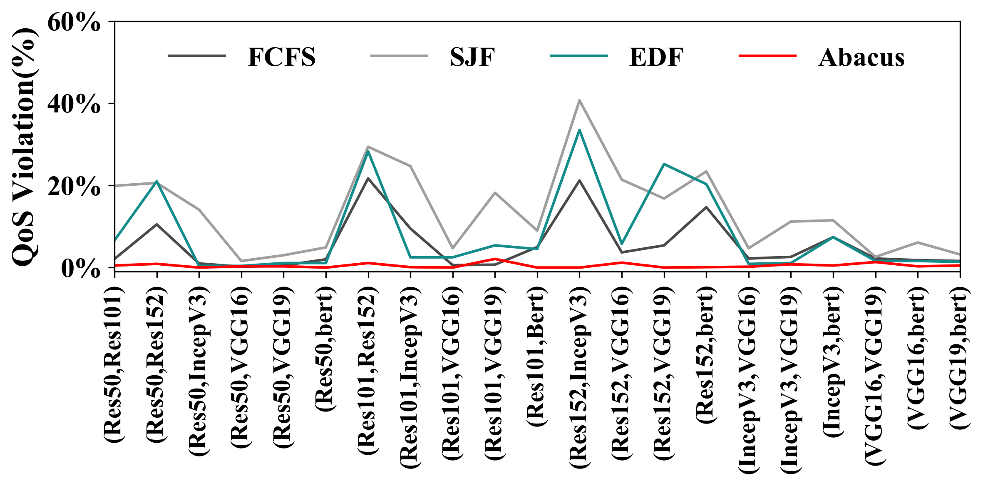
Evaluation: Ensuring QoS
Normalized 99%-ile latency
Reducing the 99%-ile latency on average by
    23.1% (FCFS), 34.1% (SJF), and 23.8% (EDF)
Reducing the QoS violation ratio on average by
    38.8% (FCFS), 71.0 % (SJF), and 44.0% (EDF)
Most QoS violations for (Res152, IncepV3)
    Most operators with small kernels, most overlap potential
QoS Violation Ratio
Notes:
Firstly we evaluate the how Abacus ensures the QoS for pair-wise co-location.
We report the normalized 99%-ile latency and the corrsponding QoS violation ratio for all involved co-location pairs.
Analyzing these results, we also observe that the sequential scheduling results in the most QoS violations for the pairs of Resnet152 and InceptionV3. This is because Res152 and IncepV3 have the most operators and they are small kernels.
While these operators cannot saturate the GPUs, sequential scheduling causes unnecessary queuing.
On the contrary, Abacus is effective through scheduling the adaptive operator groups.

Slide 31
Evaluation: Improving Peak Throughput
Evaluation method:
    Saturate the hardware with extremely high load (100QPS).
    Report the number of successfully processed queries as the peak throughput.
Throughput improvement:
    25.7% (FCFS), 38.1% (SJF), and 25.7% (EDF).
Reducing QoS violation:
    55.7% (FCFS), 63.2% (SJF), and 54.3% (EDF).
Peak Supported QPS under Extremely High Load
Notes:
We also evaluate the peak throughput of each scheduling method.
Here we saturate the hardware with extremely high load and report the number of successfully processed queries as the peak throughput
Abacus improves the system throughput and reduces the QoS violation both.

Slide 32

Motivation : Root Causes of Non-derterminism
Characterizing the Co-location on GPU
No strict isolation techniques like intel-cmt-cat for isolating computation resources.
No perception between co-located services. Services are scheduled independently.
The workload of services varies over time. The Interference is not determined.
Co-location with MPS Enabled
Non-derterminism of Query
01
Queries queue up for the hardware resources or contend for PCI-E, NVLink to transfer data.
01
01
Queue
Process
02
Queries have different inputs and batch sizes
03
02
0 2
Overlap
0 3
03
Concurrent queries have non-deterministic overlap.

