Slide 1



Liangfeng Cheng¹, Yuchong Hu¹, Zhaokang Ke¹, Jia Xu¹,
Qiaori Yao¹, Dan Feng¹, Weichun Wang², Wei Chen²
¹Huazhong University of Science and Technology
²HIKVISION
LogECMem: Coupling Erasure-Coded
In-Memory Key-Value Stores with
Parity Logging

Slide 2


Erasure Coding
Multi-way replication for data availability
  Traditional storage systems, e.g., Dynamo [SOSP’07], GFS [SOSP’03], HDFS
  High redundancy overhead for storing multiple replicas
Erasure coding is a promising low-cost redundancy technique
  e.g., Reed-Solomon (RS) code
  ($k$,𝑟) code: $k$ data chunks are encoded into $r$parity chunks
  Stripe: $k$+ $r$ chunks are stored in $k$+ $r$ nodes
  Any 𝑘 out of the 𝑘 + 𝑟 chunks can rebuild the original 𝑘 data chunks
  Redundancy: $\frac{k+r}{k}$
$$\left[\begin{aligned}1 0 0 \\ 0 1 0 \\ 0 0 1 \\ 1 1 1 \\ 1 2 3 \\ 1 22 32\end{aligned}\right]\left[\begin{aligned}D1 \\ D2 \\ D3\end{aligned}\right]=\left[\begin{aligned}D1 \\ D2 \\ D3 \\ P1 \\ P2\end{aligned}\right]$$
D₁
D₁
D₁
D₂
D₂
D₂
encode
D₃
D₃
D₃
P₁
P₁
P₂
P₂
(k, r) = (3, 2)

Slide 3
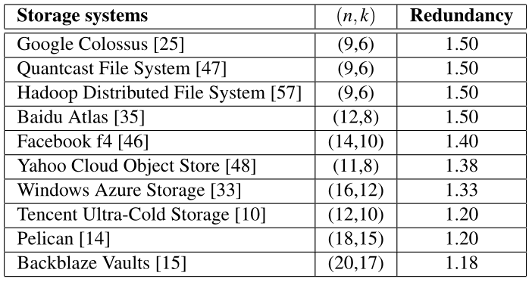
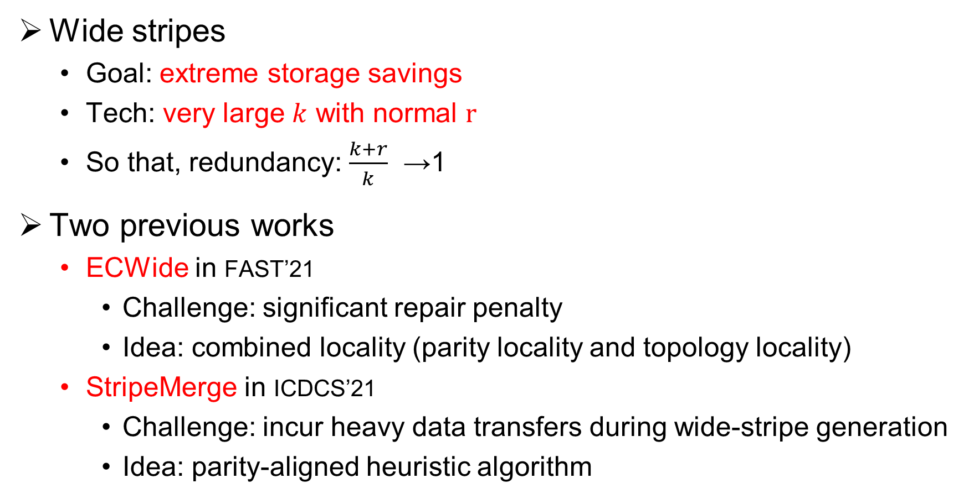
Wide-Stripe Erasure Coding
Wide stripes
  Goal: extreme storage savings
  Tech: very large $k$ with normal $r$
  So that, redundancy: $\frac{k+r}{k}$ →1
Two previous works
  ECWide in FAST’21
    Challenge: significant repair penalty
    Idea: combined locality (parity locality and topology locality)
  StripeMerge in ICDCS’21
    Challenge: incur heavy data transfers during wide-stripe generation
    Idea: parity-aligned heuristic algorithm

Slide 4
HPC Erasure-coded In-Memory KV Stores
HPC clusters often reply on In-memory KV Stores
  High-performance data analytics
  e.g., Memcached, Redis, RAMCloud
Erasure-coded In-Memory KV Stores
  Many related works
    Cocytus [FAST’16], EC-Cache [OSDI’16], f4 [OSDI’14], ECHash [SoCC’19], MemEC [Systor’17], BCStore [MSST’17], Ring [Eurosys’18], Giza [ATC’17] …
  Many hot topics
    Memory overhead, degraded reads, scaling, node repair, data update, and consistency…

Slide 5
Updates
Update can be frequent in in-memory KV stores
  Many workloads are read-dominated, e.g., Nishtala et al. [NSDI’13] and Atikoglu et al. [Sigmertics’12]
  Existing update-intensive workloads, e.g., Cocytus [FAST’16], yang et al. [OSDI’20]
  Even read/update = 50%:50% in Jia et.al. [TPDS’17]
Update is not easy in erasure-coded systems
  Straightforward way: Direct reconstruction
    Write D₁’ into D₁’s position
    Read all data chunks D₂ ~ D₆ with D₁’
    Re-compute new parity chunks P₁’ ~ P₃’
    Write them into P₁ ~ P₃’ s positions
D₁
D₂
D₃
D₄
D₅
D₆
P₁
P₂
P₃
Issue: incur heavy data transfers
D₁’
P₁’
P₂’
P₃’

Slide 6
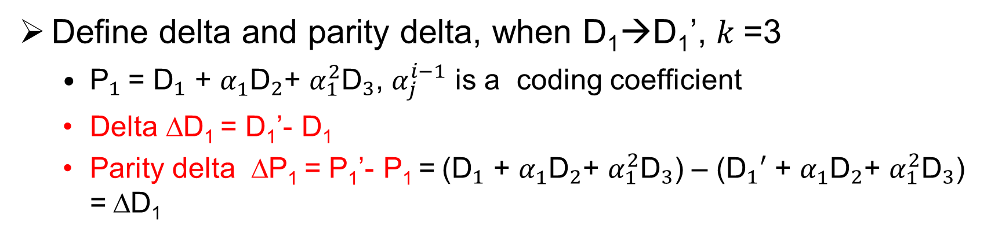
Existing Updates Methods (In-place)
Define delta and parity delta, when D₁→D₁’, $k$=3
  ${\text{P}}_{1}^{ }$= ${\text{D}}_{1}^{ }$ + ${\text{α}}_{1}^{ }{\text{D}}_{2}^{ }$+ ${\text{α}}_{1}^{2}{\text{D}}_{3}^{ }$, ${\text{α}}_{j}^{i−1}$ is a coding coefficient
  Delta ∆D₁ = D₁’- D₁
  Parity delta ∆P₁ = P₁’- P₁ = (${\text{D}}_{1}^{ }$ + ${\text{α}}_{1}^{ }{\text{D}}_{2}^{ }$+ ${\text{α}}_{1}^{2}{\text{D}}_{3}^{ }$) – (${\text{D}}_{1}^{ }′$ + ${\text{α}}_{1}^{ }{\text{D}}_{2}^{ }$+ ${\text{α}}_{1}^{2}{\text{D}}_{3}^{ }$) = ∆D₁
In-place update
  Read D₁, compute delta ∆D₁ = D₁’- D₁
  Read P₁, P₂, P₃ back, compute new parity chunks P₁’, P₂’, P₃’
  Write P₁’, P₂’, P₃’ back
D₁
D₂
D₃
D₄
D₅
D₆
P₁
P₂
P₃
∆D₁= D₁’- D₁
Read
Read
Read
D₁’
P₁’
P₂’
P₃’
Issue: incur additional parity reads

Slide 7
Eliminating Parity Reads (Full-stripe)
Full-stripe update, BCStore [MSST’17]
  Treat updated data as new data chunks and encode them into new stripes
  GC and re-computation
    Mark the old data chunks as invalid, and release them via garbage collection (GC)
    Re-compute for the remaining active unchanged data chunks
D₁
D₂
D₃
D₄
D₅
D₆
P₁
P₂
P₃
For GC
D₁’
D₂’
D₃’
D₄’
D₅’
D₆’
P₄
P₅
P₆
D₁
D₂
D₃
D₄
D₅
D₆
P₁
P₂
P₃
Re-compute
P₇
P₈
P₉
D₁’
…
Issue: incur additional memory overhead and re-computation (See Observations)

Slide 8
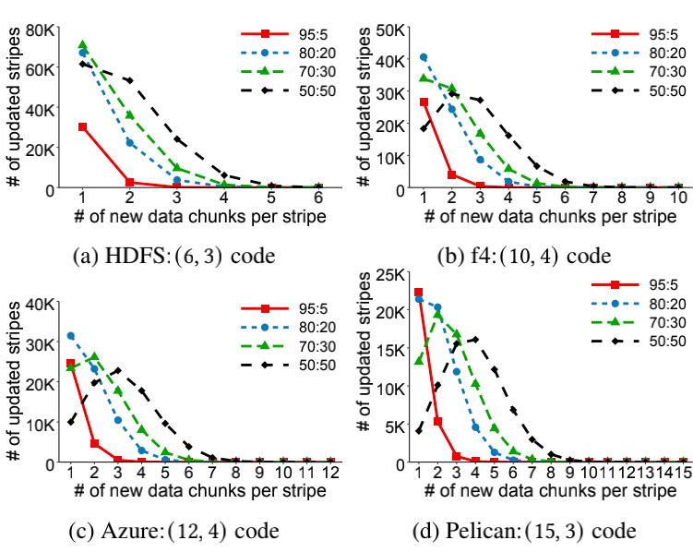
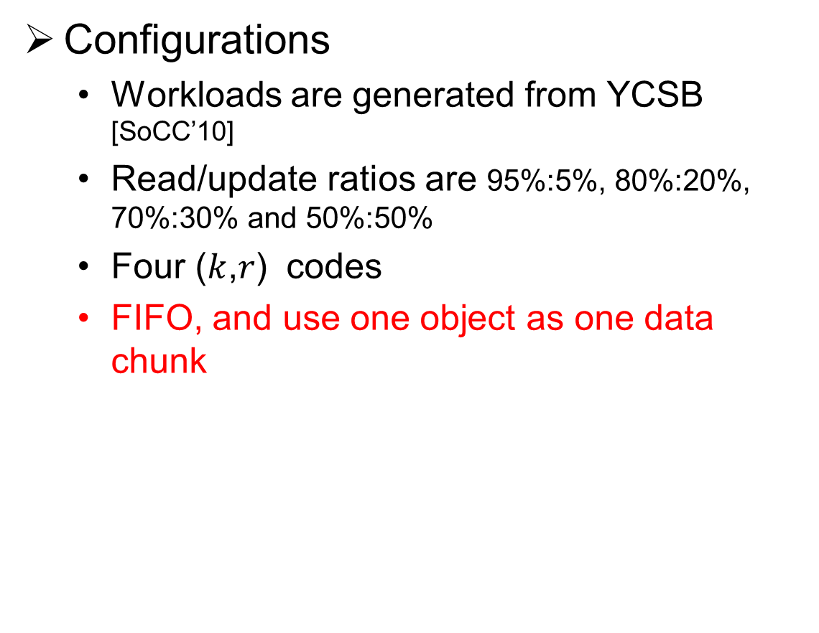
Observation 1 (Re-computation)
Configurations
  Workloads are generated from YCSB [SoCC’10]
  Read/update ratios are 95%:5%, 80%:20%, 70%:30% and 50%:50%
  Four ($k$,𝑟) codes
  FIFO, and use one object as one data chunk
Results
  Most of the updated stripes have only one new data chunk, Full-stripe update will incur heavy data transfers and re-computation
  It will be more serious in wide stripes

Slide 9
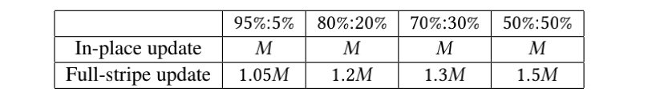
Observation 2 (Memory Overhead)
Configurations
  Workloads are same with Observation 1
  Assume the total size of all objects is M
Results
  Full-stripe update will incur additional memory overhead, while In-place does not
  The additional memory increases when the workload becomes more update-heavy

Slide 10
Eliminating Parity Reads (Parity logging)
Parity logging (PL), CodFS [FAST’14]
  Read D₁, compute delta ∆D₁ = D₁’- D₁
  Compute parity deltas ∆ P1, ∆ P2, ∆ P3
  Write ∆ P₁, ∆ P₂, ∆ P₃ into logs
D₁
D₂
D₃
D₄
D₅
D₆
P₁
P₂
P₃
∆D₁= D₁’- D₁
D₁’
∆ P₁
∆ P₂
∆ P₃
In logs

Slide 11
Our Insights and Main idea
Insights from existing update methods
  In-place update has to read old parity chunks
  Full-stripe update has significant re-computation and memory overhead under different read/update ratios
  Parity logging does not need to read old parity chunks
Main idea
  Introduce parity logging to in-memory KV stores
    Challenge: disk-based parity logging maybe degrade the repair efficiency

Slide 12
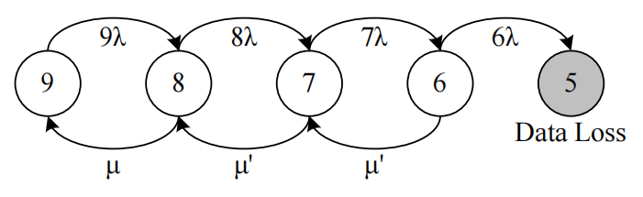
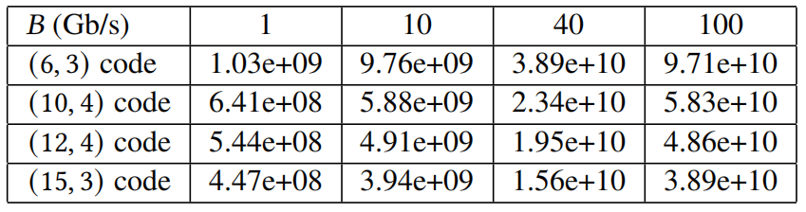
Reliability Analysis
Mean-time-to-data-loss (MTTDL)
  Markov model
  𝜆 → the failure rate of each node
  𝜇 → the single-failure repair rate
  𝐵 → data transfer rate of node
  Find: the MTTDL increases significantly with 𝐵
  Markov model for (6,3) code
MTTDLs (in years) for varying 𝐵 (Gb/s) under different codes and 1/𝜆 = 4 years
  Select one of parity chunks into DRAM node
  → HybridPL Architecture

Slide 13
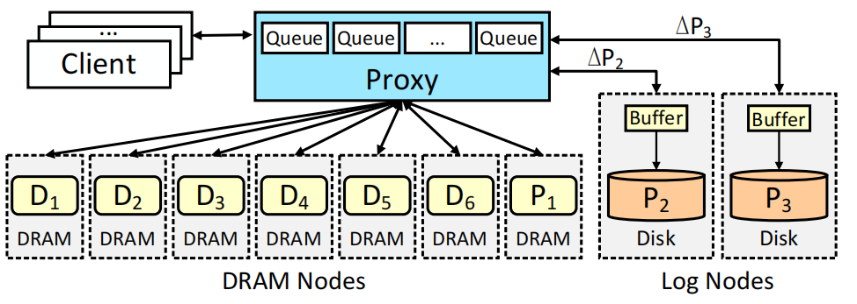
HybridPL Architecture
Four modules
  Multiple clients
  One proxy
  Multiple DRAM nodes
  Multiple log nodes
Proxy details
  Organize multiple objects to form fixed-size data chunks for encoding via Queues
  Maintain metadata Object Index and Stripe Index

Slide 14
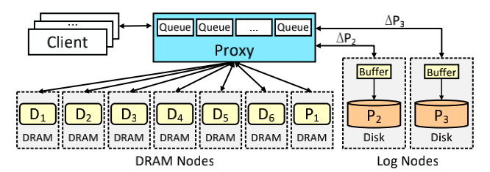
HybridPL Architecture
Data chunks and XOR parity chunks In-place update
  Select one of parity chunks
    XOR parity chunk
  Goals
    Low memory overhead: In-place update for data chunks
    Efficient single-failure repair: RAM-based XOR parity chunks
XOR parity chunk

Slide 15
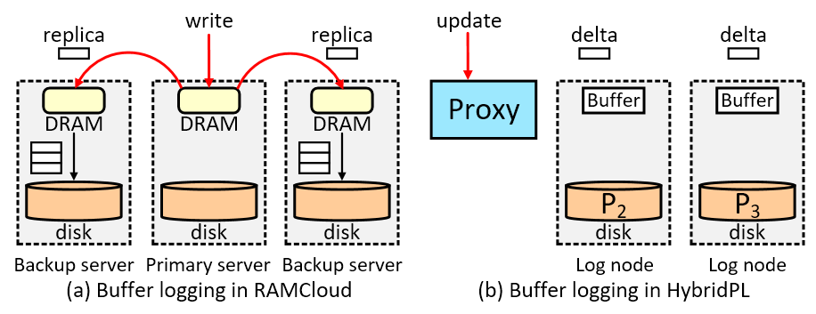
HybridPL Architecture
Non XOR parity chunks parity logging
  Goals
    Efficient updates: parity logging for non XOR parity chunks
  Buffer logging, RAMCloud [SOSP’10]
    Using buffers to cache multiple parity deltas and flush them into disks in batch
    The parity deltas are stored into the log nodes as soon as they are stored in the buffer

Slide 16
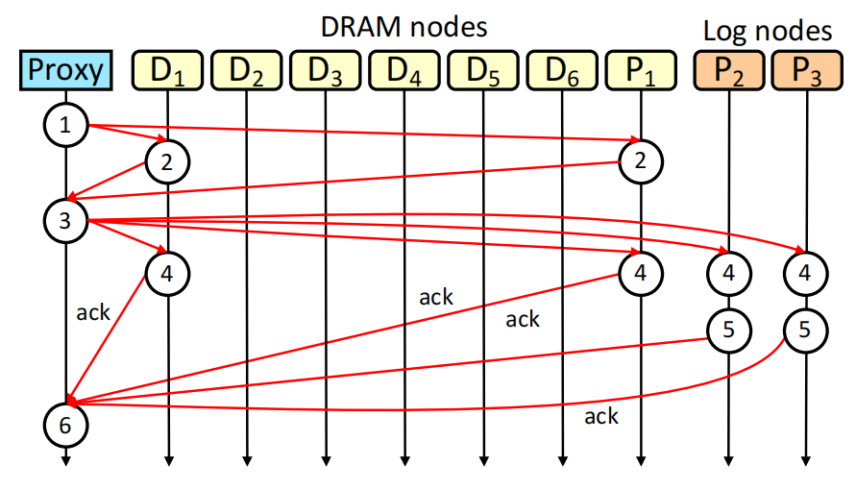
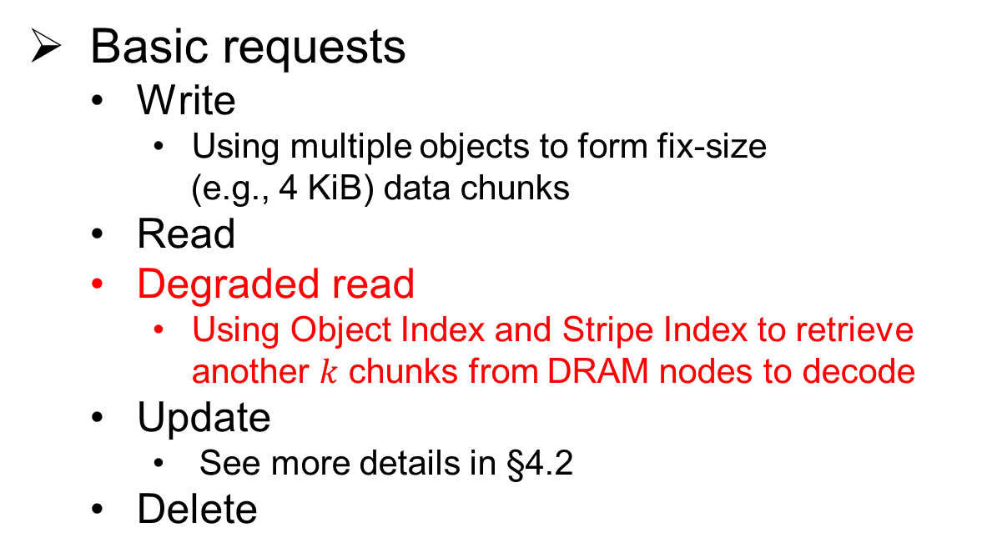
Basic requests
LogECMem
  Based on HybridPL Architecture
  Atop Memcached and Libmemcached
Basic requests
  Write
    Using multiple objects to form fix-size
    (e.g., 4 KiB) data chunks
  Read
  Degraded read
    Using Object Index and Stripe Index to retrieve another $k$ chunks from DRAM nodes to decode
  Update
    See more details in §4.2
  Delete
Workflow of the update from D₁ to D₁’ in (6, 3) code

Slide 17
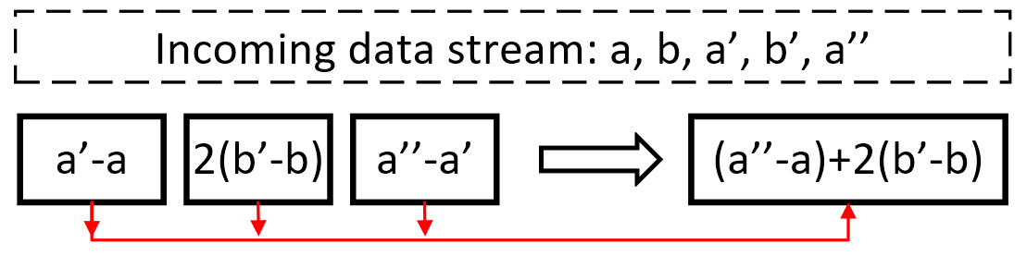
Merge-based Buffer Logging
Erasure coding property
  Multiple data chunk updates of the same stripe, the parity delta can be reduced to one delta
Merging parity deltas
  Reducing the number of disk writes
  e.g., incoming data stream 𝑎, 𝑏, 𝑎′, 𝑏′, 𝑎′′

Slide 18
Multiple Chunk Failure Repair
Single chunk failure
  Degraded reads (full DRAM nodes)
Multiple Chunk Failure Repair
  Read parity chunks and deltas from log nodes
  Issues?
    The old parity chunk is out-of-date
    Up-to-date parity chunk
    = old parity chunk + all parity deltas
      Multiple parity chunks and deltas
      Random accesses due to storing them discontinuously
Parity A
Parity B
A’s delta₁
Parity C
A’s delta₂
Log node

Slide 19
Multiple Chunk Failure Repair
A state-of-the-art parity logging optimization
  Parity logging with reserved space (PLR) in FAST’14
  Idea: keep parity deltas next to the old parity chunks to mitigate disk seeks when computing up-to-date parity chunks
  Issue: incur many random disks writes during flushing into logs
Optimization
    PLR-m, with merging optimization in buffer

Slide 20
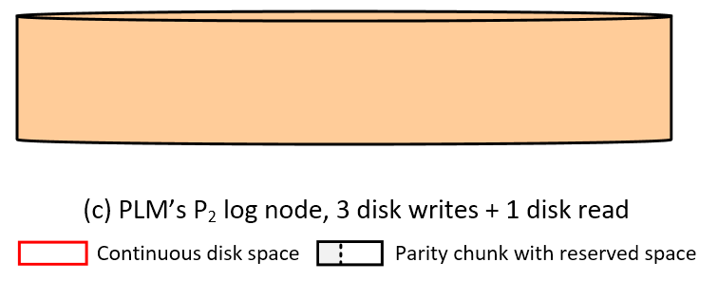
Multiple Chunk Failure Repair (PLM)
Parity Logging with Merge (PLM)
  Write parity deltas into an extra continuous disk space sequentially
  Read them back for merging deltas of the same stripes
  Write merged deltas into specific parity chunks’ reserved spaces

Slide 21
Single node Repair
Straightforward way
  Multiples degraded reads from DRAM nodes
Log-assist node repair
  Find: the bandwidth of disk nodes is only served for writes and updates of parity chunks, which may not be fully utilized
  Idea: use log node to assist node repair
  e.g., D1’ node fails, P2’s node helps repair
Retrieving any k-1 chunks
Helping provide P₂
Decoding the failed chunk of this stripe

Slide 22
Implementations
LogECMem
  Based on Memcached protocol with 1000 SLoC in C++ on Linux
  Extended LibMemcached as the Proxy
  Reed-Solomon (RS) code, from (6,3) code to (128,4) code
  Intel-isal APIs
Comparisons
  IPMem: In-place update
  FSMem: Full-stripe update
  (r+1)-way replication: 𝑟 replicas to ensure data availability
  Vanilla: without erasure coding or replication

Slide 23
Experiments: Setup and Workloads
Testbed and Configurations
  Amazon EC2 in US-West (North California)，m5d.2xlarge instance
  Ten runs for average result with the variance
Workloads
  Generated from YCSB [SoCC’10]
  The size of the value of an object as 1 KiB, 4 KiB and 16 KiB
  Read/update (or write) ratios are 95%:5%, 80%:20%, 70%:30% and 50%:50%
  Load one million objects and test one million requests
  Requests follow the default Zipf distribution

Slide 24
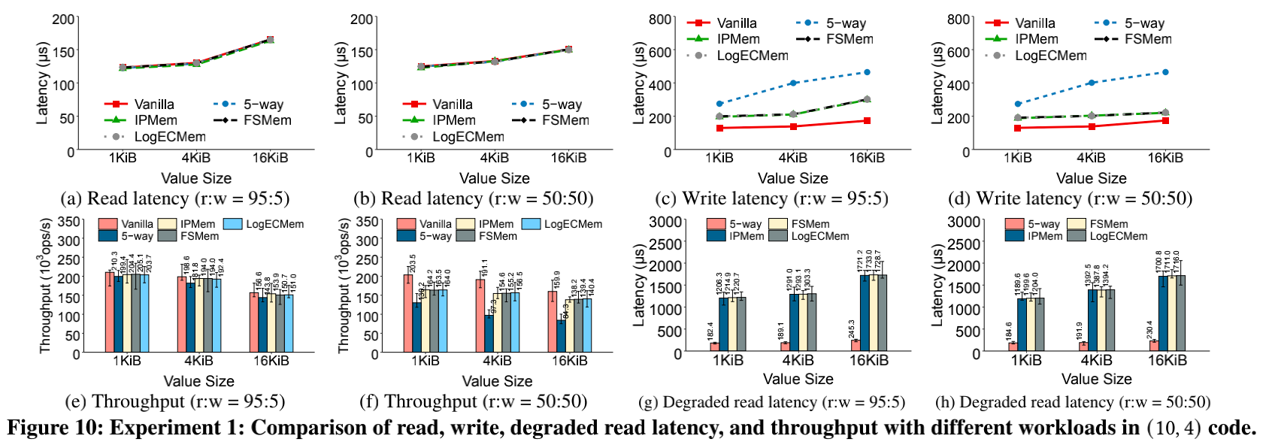
Experiments: Basic IO Performance
LogECMem maintains a decent basic IO performance
  LogECMem, IPMem and FSMem have similar read latency with Vanilla and 5-way replication
  LogECMem, IPMem and FSMem have similar write latency
  The throughput of LogECMem, IPMem, FSMem and 5-way replication have a small degradation compared to Vanilla
  LogECMem keeps the similar degraded read latency with IPMem and FSMem

Slide 25
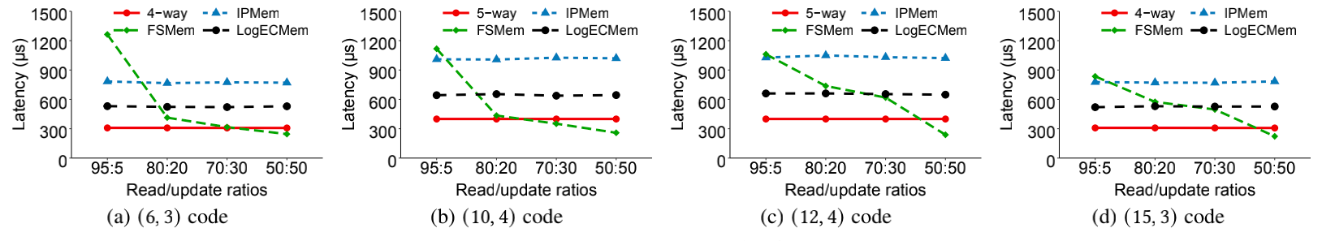
Experiments: Update Performance
LogECMem reduces up to 37.8% (when 𝑟:𝑢 = 70%:30%) compared to IPMem
LogECMem outperforms FSMem in update light scenarios up to 58.0%
  FSMem may outperform LogECMem in update heavy scenarios
  For a larger k, LogECMem’s advantage will be more obvious (See wide-stripe tradeoff analysis)

Slide 26
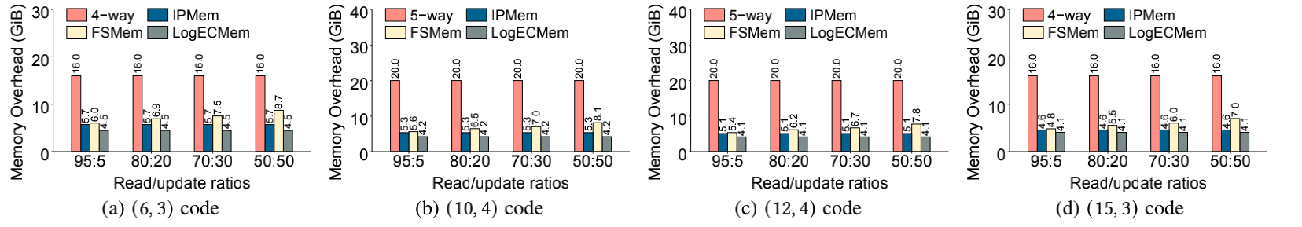
Experiments: Memory Overhead
LogECMem reduces memory overhead up to 22.2% compared to IPMem (when in (6, 3) code)
LogECMem reduces memory overhead up to 49.0% compared to FSMem (when in (6, 3) code)
  Full-stripe update has multiple versions of data chunks in the memory

Slide 27
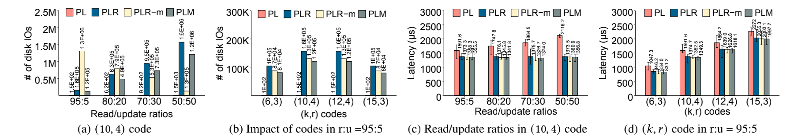
Experiments: Disk IOs during update
PLM can reduce disk IOs compared to PLR up to 23.7%
PLR, PLM have the similar degraded read performance but outperform PL

Slide 28
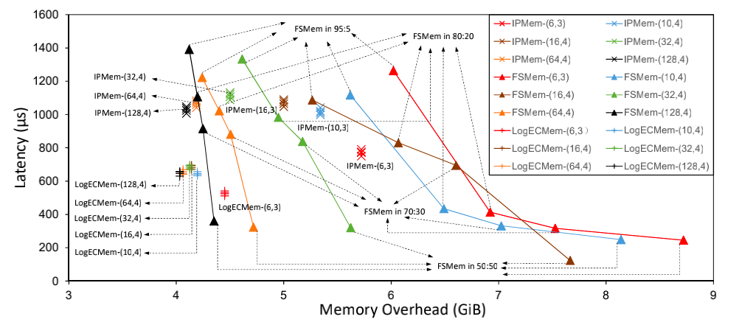
Experiments: Trade-offs in Wide-stripe
LogECMem
LogECMem has a better trade-off between update latency and memory overhead than IPMem and FSMem
  Closer to the origin, the trade-off is better
LogECMen’s advantage will be more significant with a larger k

Slide 29
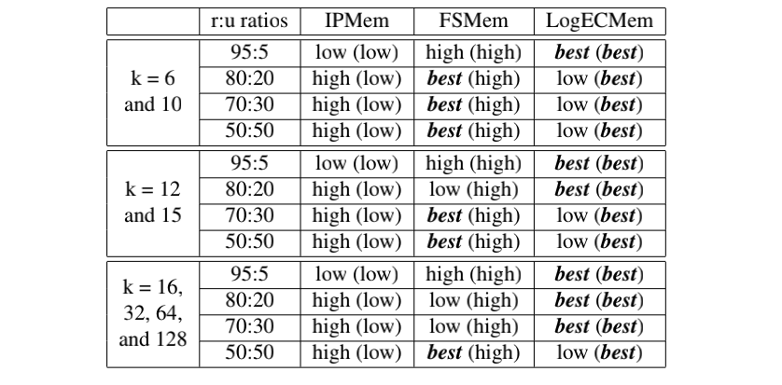
Experiments: Trade-offs in Wide-stripe
Update latency
Memory overhead
When 𝑘 ≥ 16, LogECMem has more cases with the best update performance
LogECMem always has the lowest memory overhead

Slide 30
Conclusions
How to optimize update in erasure-coded in-memory KV stores?
Contributions
  HybridPL architecture (hybrid of DRAM-based in-place update and disk-based parity logging)
  LogECMem (further design merge-based buffer logging, PLM and log-assist node repair)
  Cloud experiments demonstrate LogECMem’s efficiency
Prototype
  https://github.com/yuchonghu/logecmem
Contacts
  yuchonghu@hust.edu.cn and lenfungcheng@hust.edu.cn

Slide 31
Thanks!

