Slide 1



Peppa-X: Finding Program Test Inputs to
Bound Silent Data Corruption
Vulnerability in HPC Applications
Md Hasanur Rahman, Aabid Shamji, Shengjiang Guo, Guanpeng Li

Slide 2
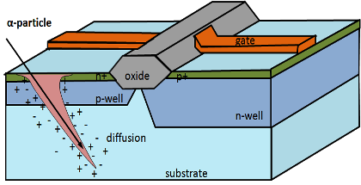

Motivation: Soft Error
A
A
Soft errors becoming more
common in processors!
B
M = 0001
B
M = 0101
C
C
D
D
S
S

Slide 3
Silent Data Corruption (SDC)
Incorrect Output
Fault
SDC
Crash
Exceptions,
No Output
Benign
Correct Output
Normal Execution
Error Propagation

Slide 4
Software Solutions
Software protection techniques are more flexible and cost-effective!
Application Level
Operating System Level
Increasing
Protection Overhead
Architectural Level
Device/Circuit Level
Soft Error
Impactful Errors

Slide 5
Existing Works
Pruning FI space
  Use various heuristics to reduce the number of FI samples
  e.g., Relyzer [ASPLOS’12]
Heuristics-based error estimation
  e.g., [DSN’12]
Systematic modeling of error propagation
  e.g., PVF [HPCA’09], Shoestring [ASPLOS'10], Trident [DSN'18]
Problem
They all focus on single input of a program!
  Default reference input
Challenge
State space explosion in the program input space

Slide 6
Our Goal
Bound SDC probability of a program across multiple inputs
  High accuracy
  High efficiency
  In an automated way
SDC-bound input
Find the program input with highest SDC probability
Input space of a program

Slide 7
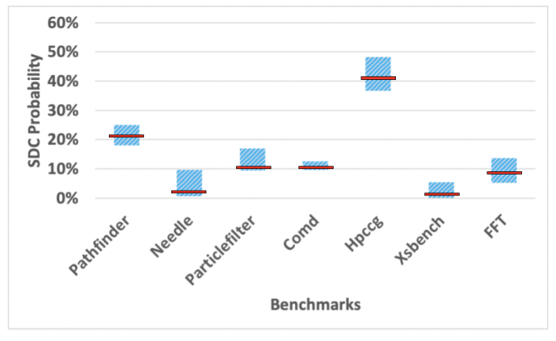
Initial Study
SDC probability of a program across multiple inputs
  Vary in a large range
  Range up to 11.45% for Hpccg
Insight
Code coverage
  Researchers use it for testing software vulnerabilities
  No correlation
Range of Overall SDC prob. Across Multiple Inputs
Red bars indicates SDC Prob. of default reference input
Some instructions are always vulnerable to SDCs regardless of input changes
Correlation between Code Coverage and Program SDC Prob. across Multiple Inputs
SDC probabilities of individual instructions
  Though vary, the ranking is stable
Correlation between Rankings of Per-Instruction SDC Prob. across Multiple Inputs

Slide 8
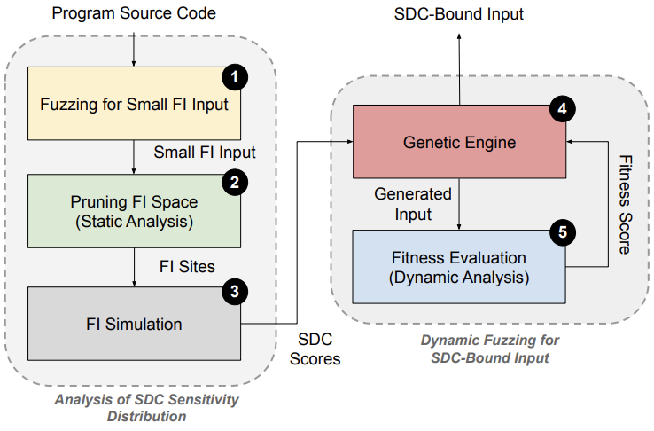
Our Approach: Overview
Find the program input that executes the vulnerable parts of the program more often, thus obtaining higher SDC probability
  Assign SDC vulnerability score to each instruction
  Use Genetic algorithm (GA) to fuzz the program
  Find the SDC-bound input!
Challenge #1
Need to conduct extensive fault injection simulations for every instruction to assign the score
Challenge #2
Need to know SDC probability to compare candidate inputs to make optimization decisions by GA
Peppa-X Workflow

Slide 9
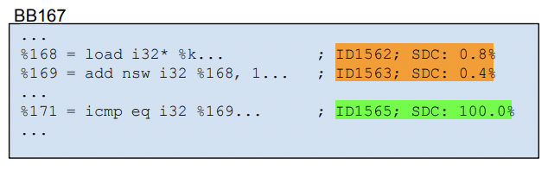
Challenge #1: Deriving SDC Score
Fuzz for small FI input
  Small workload yet equal code coverage
  FI simulations becomes fast
Avoid FI simulations for all instructions
  Reduce FI space by applying pruning
    Use static dataflow dependency analysis
Peppa-X Workflow
Static dataflow dependency analysis
  Instructions within same static data dependency shows similar SDC probabilities
Code Example of Pruning FI space in CoMD
  e.g., avg FI space reduced to 49%
FI-space pruning ratios

Slide 10
Challenge #2: Fitness Function in Fuzzing
Avoid repetitive statistical FIs to rank each generated candidate input by GA
  Assign score to each static instruction
    Conduct FI simulations to only those instructions from pruned FI space.
  Accumulate scores of executed instructions during program execution
    An estimate for SDC probability of a program input
Peppa-X Workflow

Slide 11
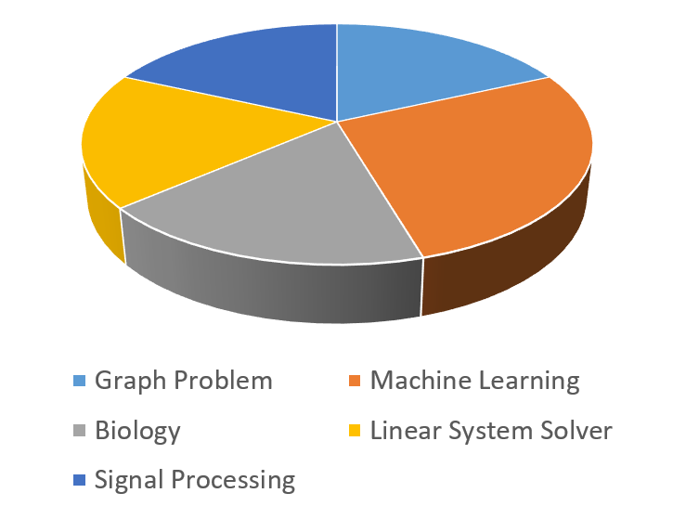
Experimental Setup
Fault Model
  Faults in processor pipelines
LLFI – fault injection tool
  Random single bit-flip
  Accurate to simulate soft error and evaluate SDCs [DSN’17]
  1000 random faults to evaluate SDC for each given input
Benchmarks
  7 open-source benchmarks from different HPC domains
Baseline
Generate random input to find SDC-bound input
Inject faults to calculate SDC probability of each random input
Metrics
Accuracy
Efficiency
Benchmark Application Domains

Slide 12
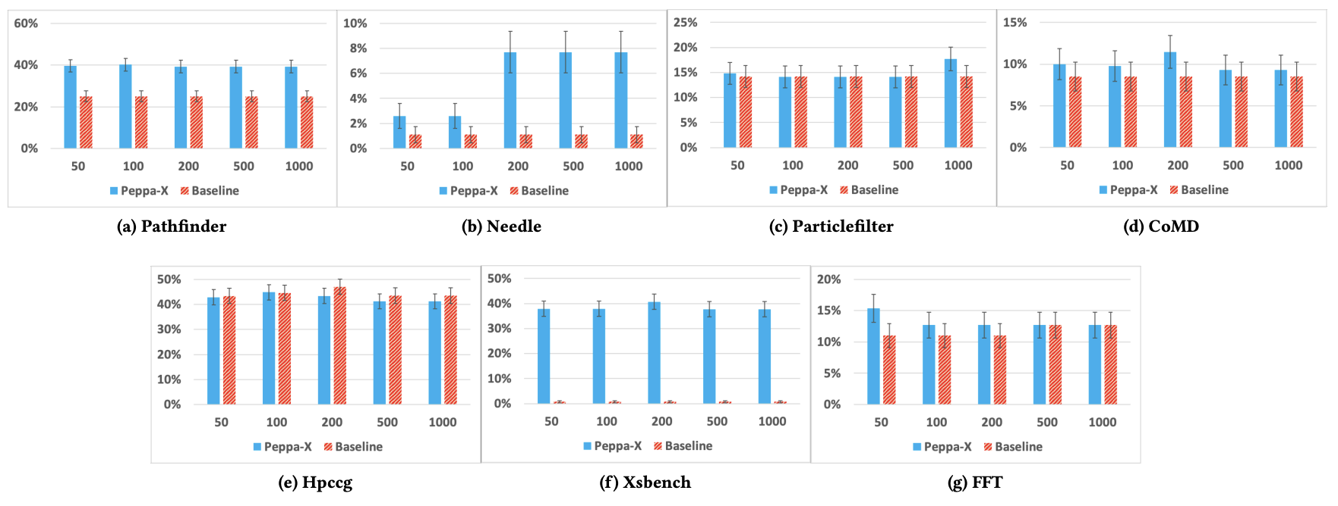
Evaluation: Accuracy
Conclusion
Result of bounding SDC Probability (Y-Axis: SDC probability, X-Axis: No. of Generation in GA)
Peppa-X finds inputs that have much higher SDC probabilities than Baseline at the time budgets of selected generations
  e.g., Xsbench: 37.9% by Peppa-X while only 0.7% by Baseline

Slide 13

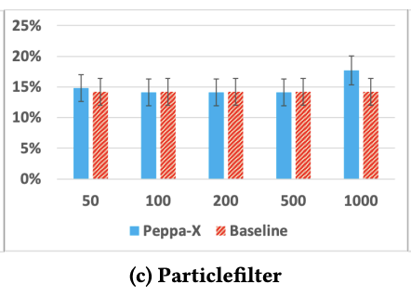
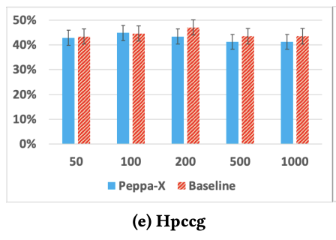
Evaluation: Accuracy
Baseline performs as good as Peppa-X for few cases!

Slide 14
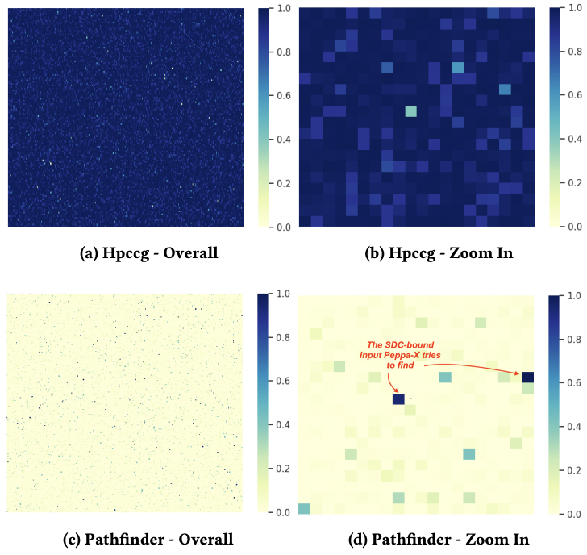
Evaluation: Accuracy
Each dot represents an input
The darker the color, the higher the SDC Probability
Most colors are dark for Hpccg
  A randomly sampled input leads to higher SDC probability
    Easy task for Baseline!
Most colors are light for Pathfinder
  Difficult for Baseline to find SDC-bound inputs
Heat Maps of SDC vulnerability distribution in the input space of Hpccg and Pathfinder

Slide 15
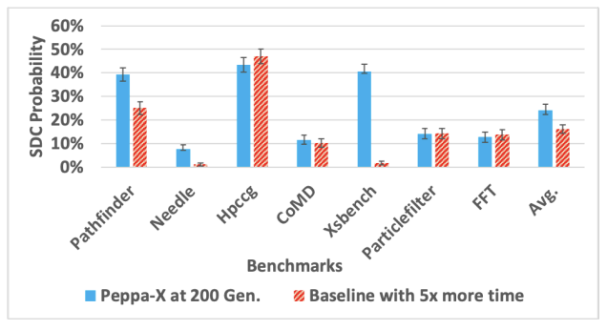
Evaluation: Efficiency
What if we let baseline run for 5x more time than Peppa-X at 200 generations?
Why to choose 200 generations?
  Program SDC probabilities are mostly saturated after 200 generations
Program SDC probabilities bound by Peppa-X at 200 Generation and Baseline
with 5x More Search Time (Y-Axis: SDC Prob. , X-Axis: Benchmarks)
Conclusion
Baseline is still unable to perform as good as Peppa-X

Slide 16
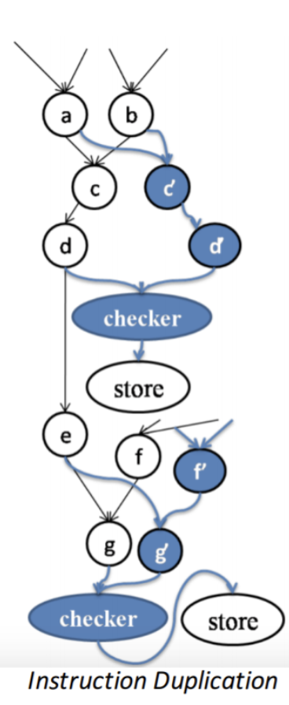
Use Case: Stress Test Selective Inst. Duplication
Only a small amount of instructions being responsible for majority of SDCs
Duplicate only those instructions by applying 0-1 knapsack
  Cost → performance overhead of an instruction if duplicated
  Benefit → SDC coverage by that duplicated instruction

Slide 17
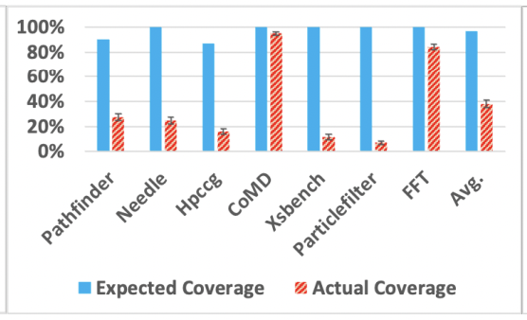
Use Case: Stress Test Selective Inst. Duplication
Run the protection with default reference input and get expected SDC coverage
Run the protected program with SDC-bound input
  Inject faults with SDC-bound input
  Measure actual SDC coverage
Conclusion
Protection is compromised!
  Avg expected coverage is 96.63%
  Avg actual coverage is only 38.02%
Stress test at 50% protection level (Y-Axis: SDC Coverage,
X-Axis: Benchmarks)

Slide 18

Conclusion
Peppa-X is both accurate and efficient to identify SDC-bound inputs
  Only one time cost for FI simulations
  Leveraging static and dynamic analysis
Baseline cannot find such SDC-bound inputs even with 5x more search time
  Need extensive FI simulations to evaluate each random input
  Not practical as FI takes long time!
Our tool is open-sourced: https://github.com/hasanur-rahman/Peppa-X
Md Hasanur Rahman (Hasan)
University of Iowa
mdhasanur-rahman@uiowa.edu
https://hasanur-rahman.github.io/

