Slide 1

Temporal Vectorization for Stencils
Liang Yuan, Hang Cao, Yunquan Zhang, Kun Li, Pengqi Lu, Yue Yue
SKL of Computer Architecture, Institute of Computing Technology, Chinese Academy of Sciences

Slide 2
Outline
Introduction
Background
Temporal vectorization
Result
Summary

Slide 3
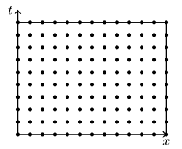
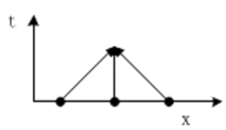

Introduction
Stencil
  update each point in a d-dimensional space (data space) with a pre-defined pattern of neighbor points
  time-iterated updates (iteration space)
1d3p stencil
Data space
Iteration space

Slide 4
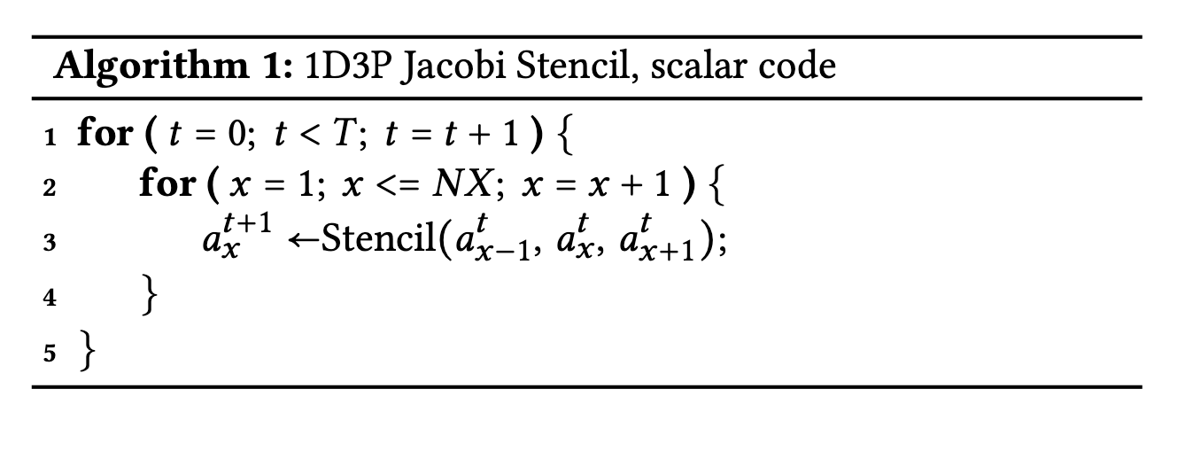
Background
Scalar Implementation
  In each iteration of the inner space loop
  load 𝑎^{t}_{x+1} , reuses in-register data 𝑎^{t}_{x-1} and 𝑎^{t}_{x}
  write 𝑎_{x}^{t+1}
  similar to a common array copy algorithm

Slide 5
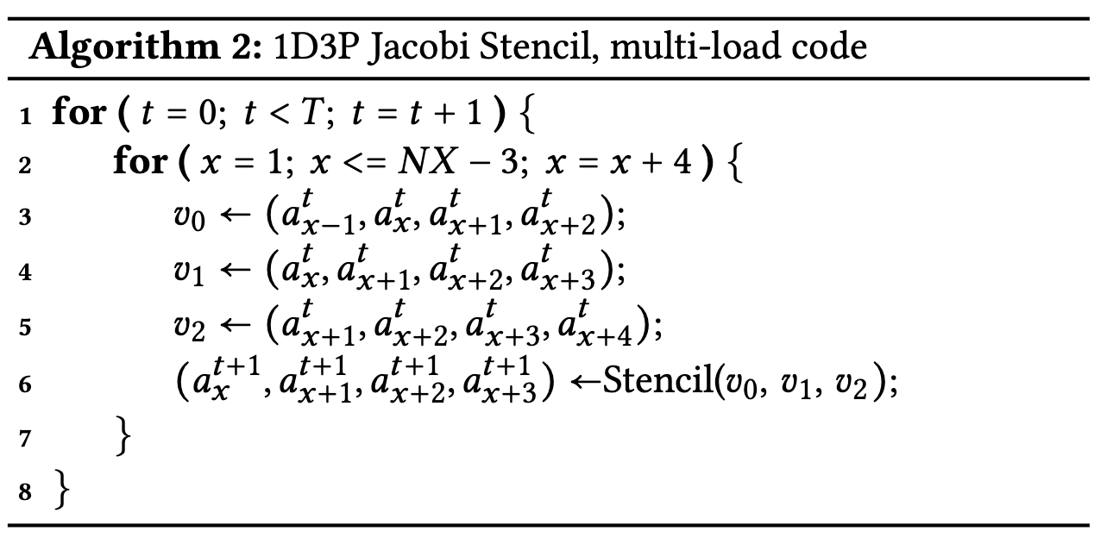
Background
Vector Implementation (multi-load)
  computes contiguous elements in the output array
input data alignment conflicts
  𝑎^{t}_{x+2} appears in all these vector registers but at different positions.
Disadvantage
  redundant data loads
  unaligned memory references
Notes:
The implementation of 1d3p stencil is listed in Algorithm 1.
𝑎𝑡𝑥 represents the value at the point (𝑡 , 𝑥 ) in the iteration space where 𝑥 and 𝑡 are the coordinates in the time and space dimension.
In each iteration
of the inner space loop, it loads 𝑎 , reuses in-register data 𝑎 𝑡𝑥 + 1
𝑡𝑥 − 1 and 𝑎𝑡 referenced by the previous calculation and writes the result
𝑡+1 𝑥
𝑎𝑥 to memory. Observing the CPU-memory data transfer, one
iteration of the inner loop is exactly similar to a common array copy algorithm.

Slide 6
Background
Solution 1 ：Data reorganization
  In each iteration of the inner space loop
  Load next contiguous elements in the input array
  Assemble the needed vector through vector organization instructions
Disadvantage
  reorganization overhead increases with
    Stencil order
    Vector length
    Stencil dimensionality

Slide 7
Background
Solution 2 ： Dimension-Lifting Transpose (DLT)
  original one-dimensional array of length 𝑁 is viewed as a matrix of size 𝑣𝑙 ∗ (𝑁/𝑣𝑙).
  matrix transpose
  𝑣𝑙 independent stencils
  assemble input vectors at boundaries
Disadvantage
  data reuse decreases 𝑣𝑙 times
  explicit out-place transpose overhead
  fails to apply to Gauss-Seidel stencils.

Slide 8

Temporal vectorization
Extend the vectorization scope from the data space to the iteration space
The general form of a vector in our scheme for a one-dimensional stencil is
Common vectorization in the naïve implementation (multi-load) and data reorganization approaches when t_{𝑖+1} = t_{𝑖} and 𝑠 = 1
DLT when t_{𝑖+1} = t_{𝑖} and 𝑠 = 𝑁𝑋/4
Temporal vectorization: t_{𝑖+1} = t_{𝑖} + 1, space stride 𝑠 = 𝑥_{𝑖} − 𝑥_{𝑖+1}

Slide 9
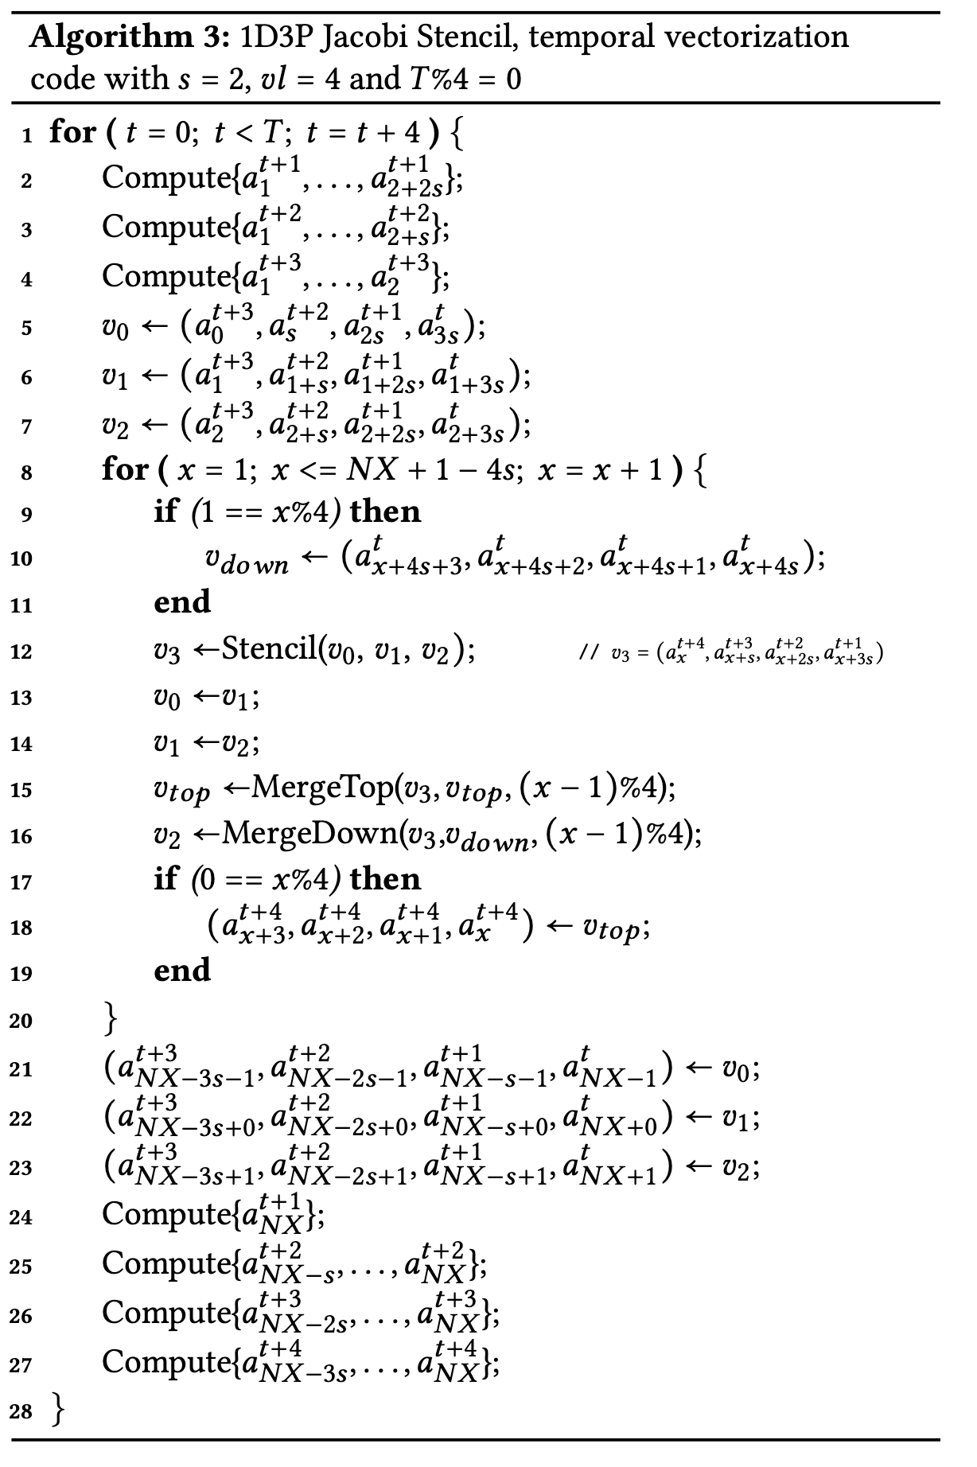
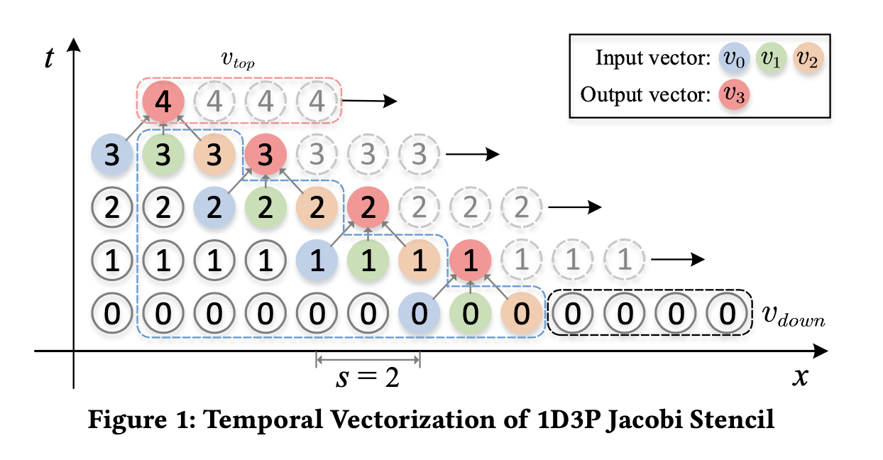
Algorithm

Slide 10
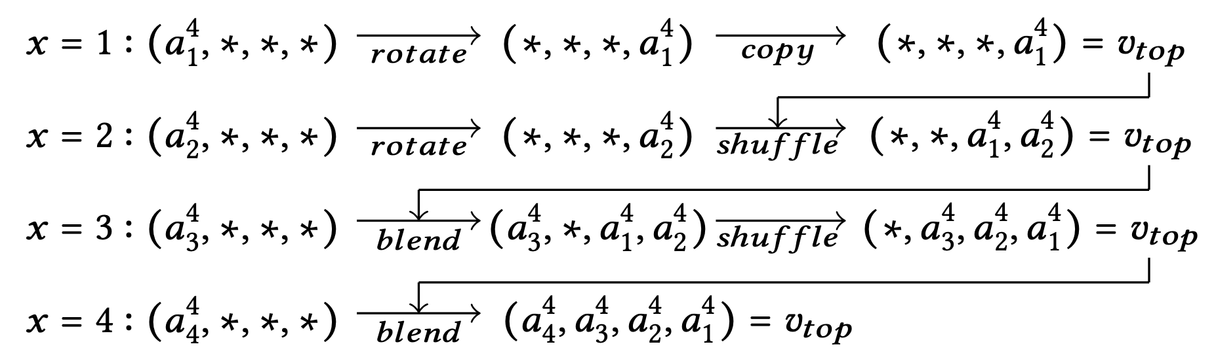
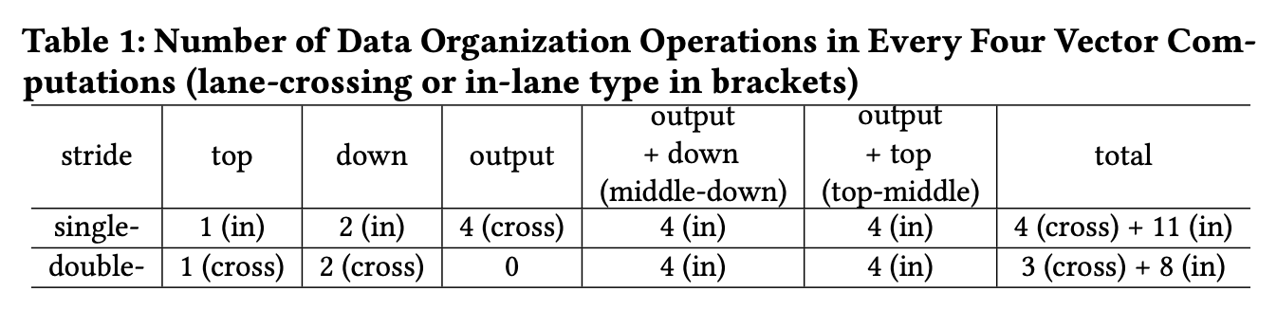
Data reorganization

Slide 11
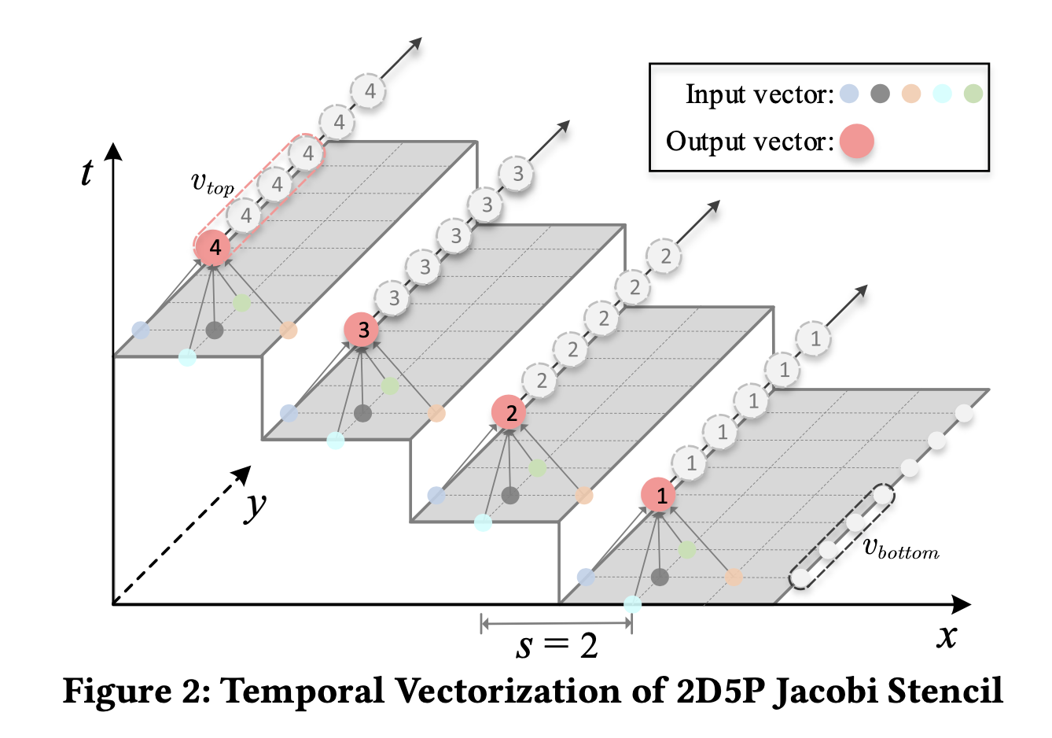
High dimension stencil

Slide 12
Discussion
V.S. multi-load
  no redundant data transfer
  easy to align top and down vector accesses
V.S. data reorganization
  number of data reorganization operations in temporal vectorization is fixed and irrelevant to the vector length, the stencil order, and dimensionality
V.S. DLT
  better data reuse
  low overhead data transpose operations

Slide 13
Discussion
Temporal vectorization
= strip-mining of the time loop +
time skewing of the inner time loop and outermost space loop +
loop-peel +
outer-loop vectorization
Temporal vectorization is applicable to Gauss-Seidel stencils

Slide 14
Results
Two Intel Xeon E5-2670 processors with 2.70 GHz clock speed
  32KB private L1 cache
  256KB private L2 cache
  a unified 30MB L3 cache shared by 12 cores
  ICC compiler version 19.1.1 using the optimization flag ‘-O3 -xavx2’
6 Jacobi and 4 Gauss-Seidel stencils
  Heat-1D, 2D and 3D, Laplacian-2D and 3D, Game of Life
  GS-1D, 2D and 3D, Longest common subsequence (LCS)

Slide 15
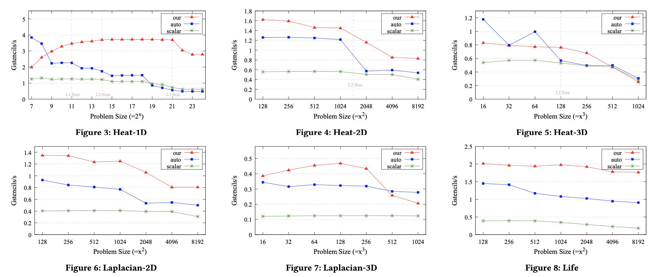
Results: sequential, Jacobi

Slide 16
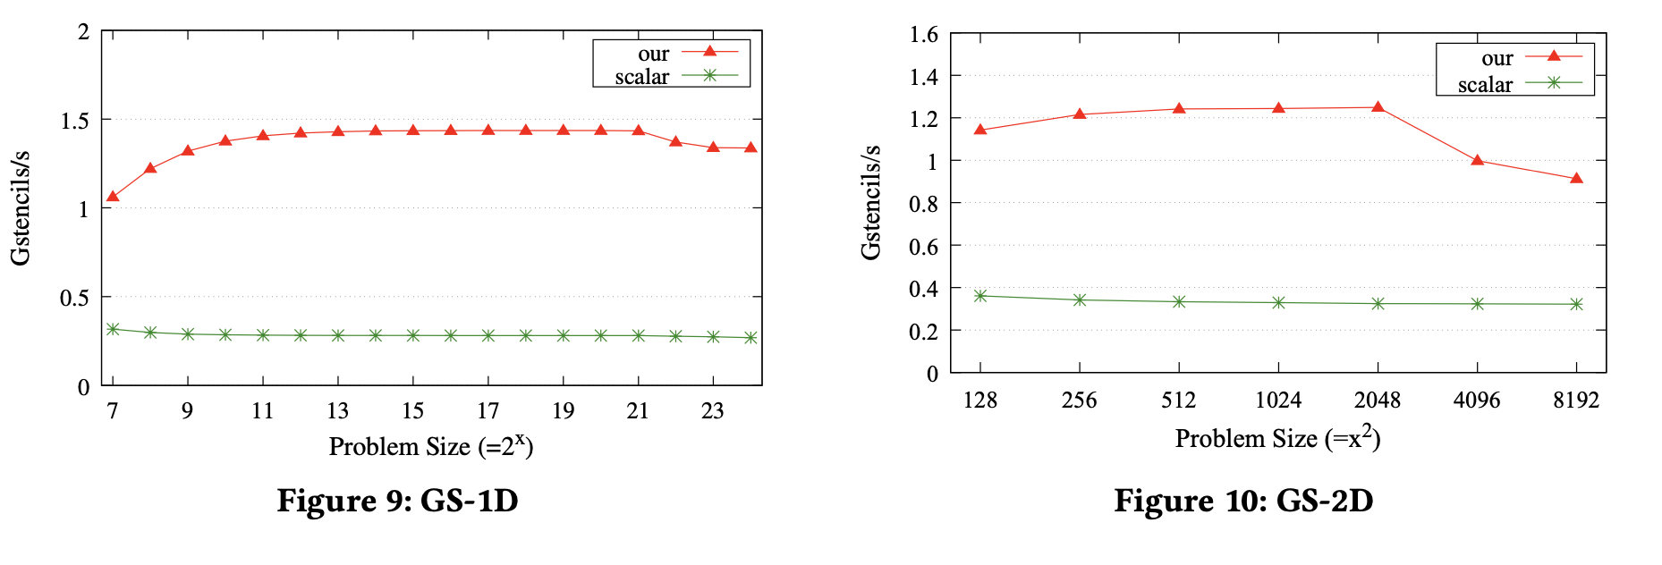
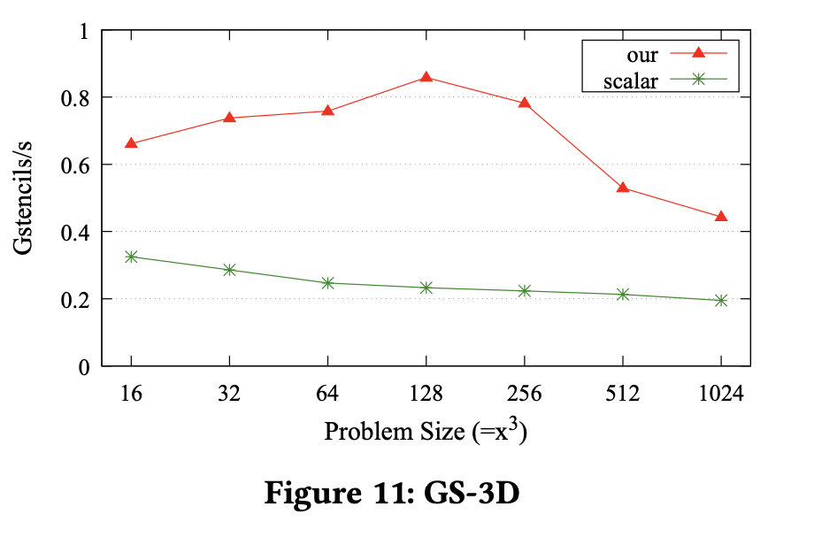
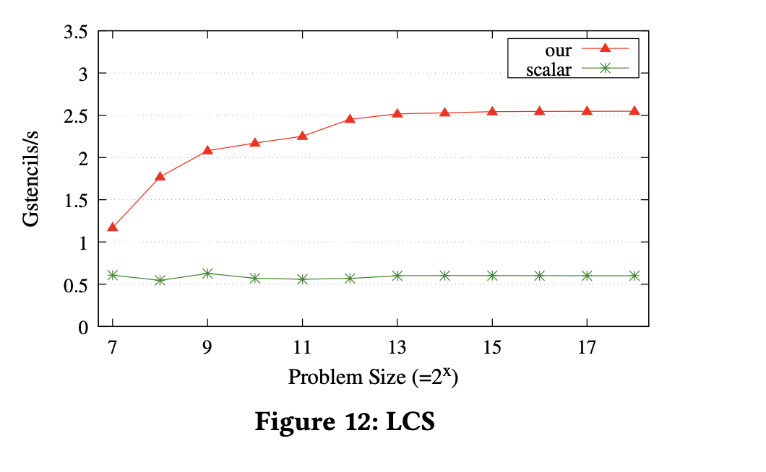
Results: sequential, Gauss-Seidel

Slide 17
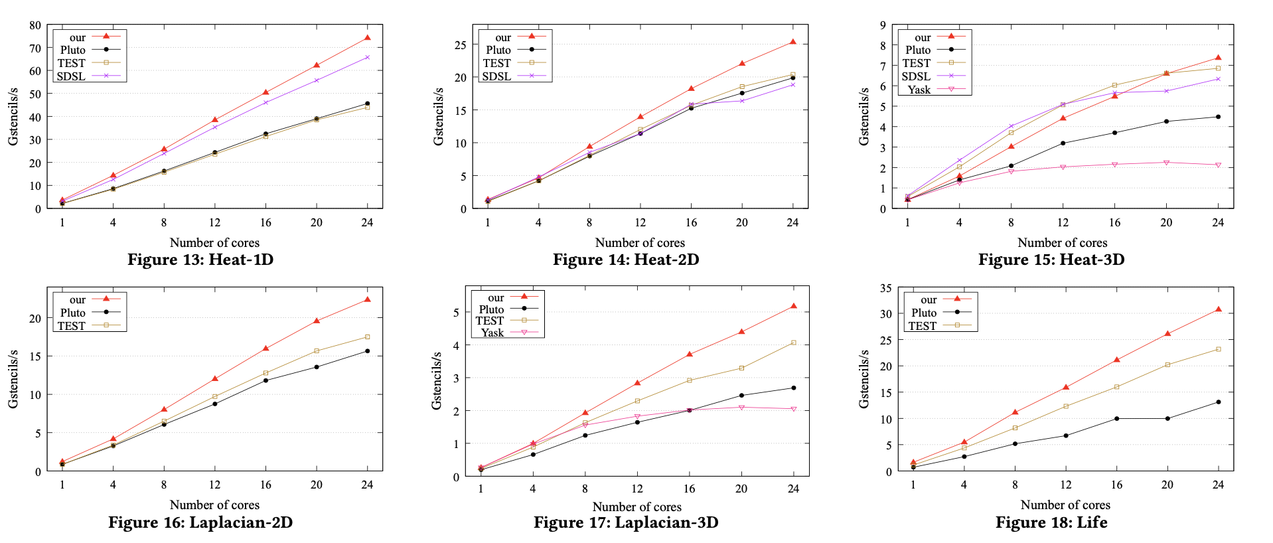
Results: parallel, Jacobi

Slide 18
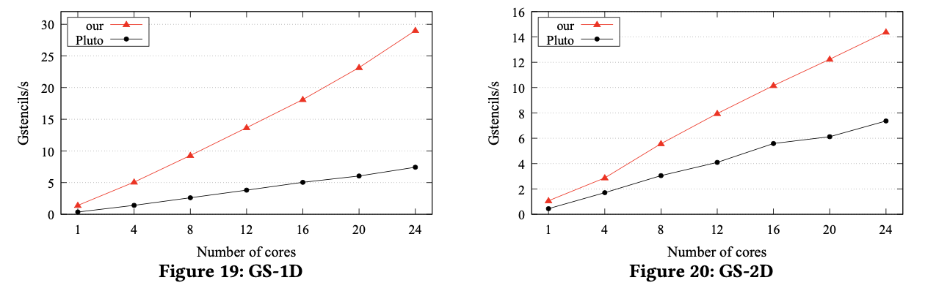
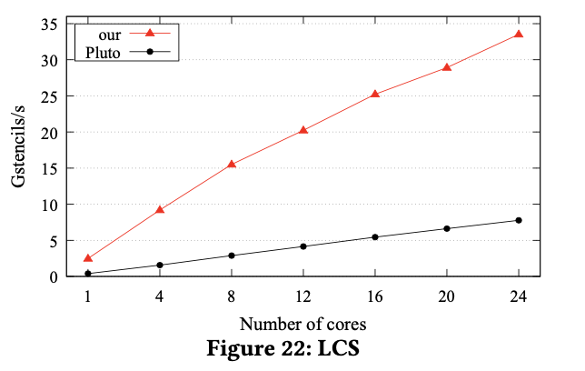
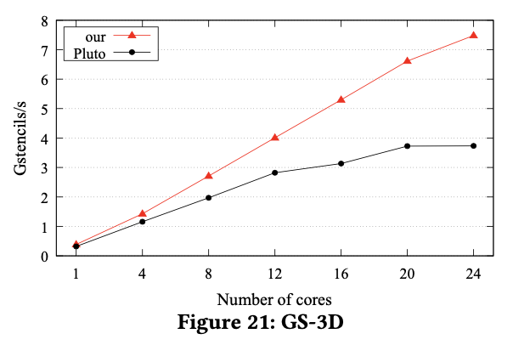
Results: sequential, Gauss-Seidel

Slide 19
Summary
A new temporal vectorization scheme
  Tiling : spatial, temporal
  Vectorization: spatial, temporal
Incur a small fixed number of vector reorganizations
  irrelevant to the vector length, stencil order, and dimension
Applicable to Gauss-Seidel stencils.

