Slide 1
Krill: A Compiler and Runtime System
for Concurrent Graph Processing
Hongzheng Chen, Minghua Shen, Nong Xiao, Yutong Lu
Sun Yat-sen University
SC'21
Nov 17, 2021, St. Louis, MO
Notes:
I just received my bachelor degree this year from Sun Yat-sen University in China, and I’m now pursing a PhD degree at Cornell University.
Today my topic is Krill: A compiler and runtime system for concurrent graph processing.
This work was done during my undergraduate study. The other co-authors are also affiliated with Sun Yat-sen University.

Slide 2




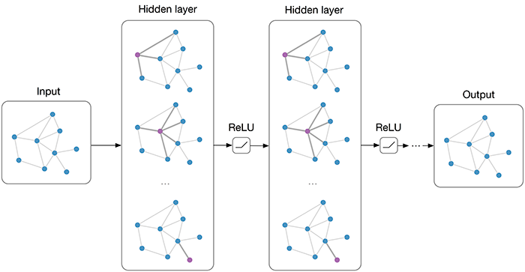
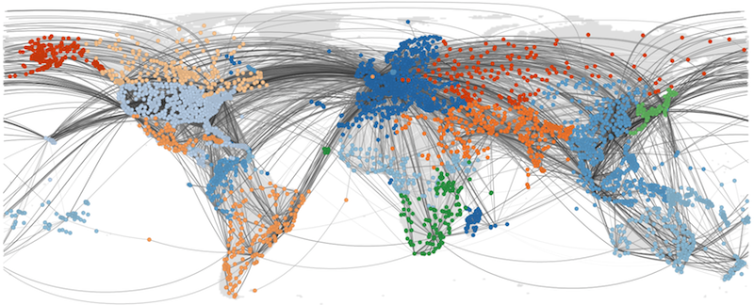
Graphs are everywhere …
Internet
Social Media
Sci. Comp.
ML
2
Notes:
Graph, as an important data structure, is commonly-used in different applications, including inter network, social media, scientific computing, and machine learning.

Slide 3
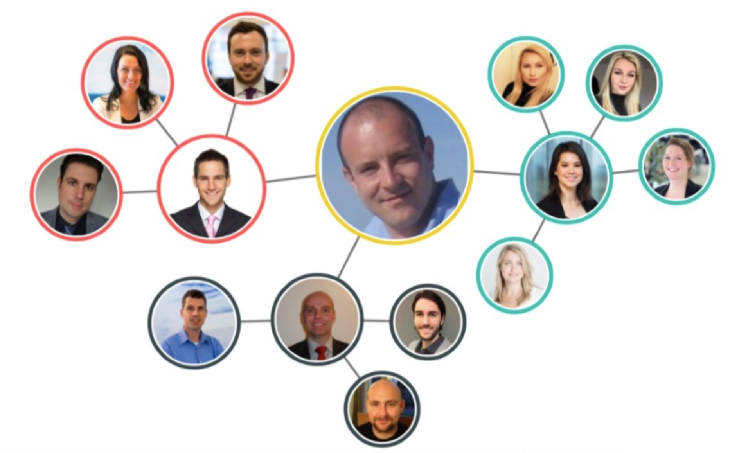
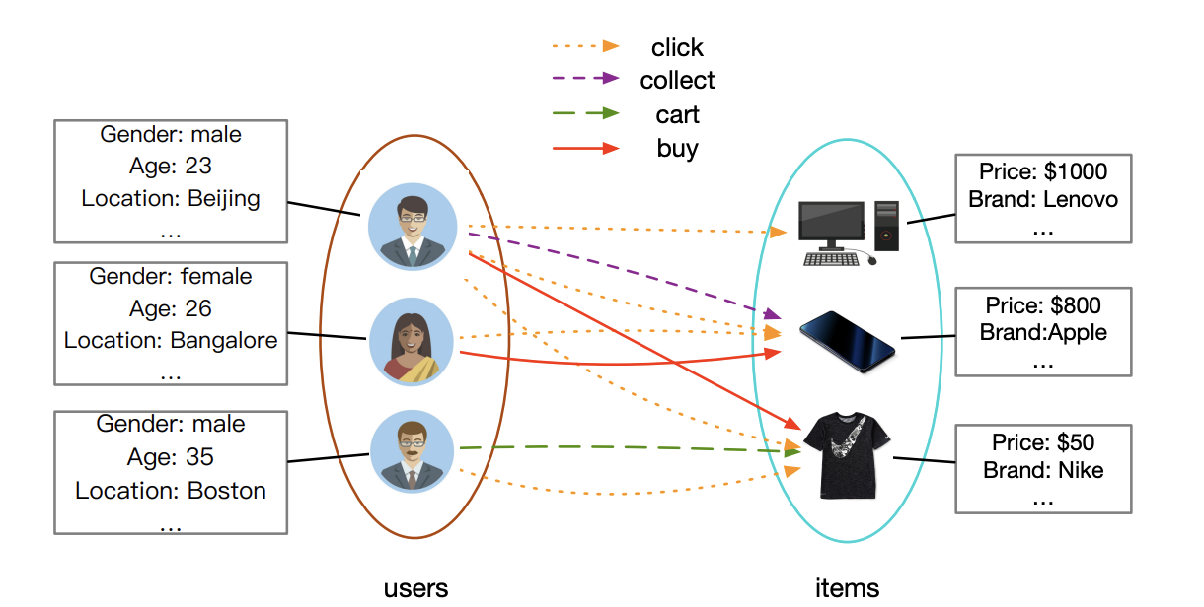
Increasing Demand of Concurrent Graph Processing
Scenario 1: Mountains of concurrent graph query requests on the cloud
Multiple queries are issued by different users simultaneously on the same graph
LinkedIn social network
Query: Degree of connection
Alibaba user-product graph
Query: Customized recommendation
Require low response latency!
Fig source: 1. Microsoft, https://appsource.microsoft.com/es-es/product/power-bi-visuals/WA104381236?tab=Overview
2. Rong Zhu, Kun Zhao, Hongxia Yang et al. AliGraph: a comprehensive graph neural network platform. VLDB. 2019.
3
Notes:
As more and more graph applications running on the underlying systems, the demand of concurrent graph processing is increasing.
There‘re two scenarios here.
The first scenario is that there‘re mountains of concurrent graph query requests on the cloud.
Multiple queries can be issued by different users simultaneously on the same graph.
For example, when several users open the linkedin webpage, linkedin automatically calculates the degree of connection of different people, which is done concurrently.
Also, Alibaba needs to do customized recommendation for different users on their large user-product graph. (Click)
Both of them process the requests concurrently and require low response latency.

Slide 4
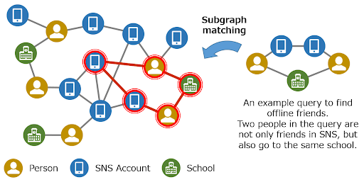

Increasing Demand of Concurrent Graph Processing
Scenario 2: Complex graph analytic applications
A wide range of graph applications are composed of several basic graph algorithms
Random Walk (w/ multiple walkers)
Subgraph Matching (different patterns)
Require high job parallelism!
* Fig source: Onizuka Lab. http://www-bigdata.ist.osaka-u.ac.jp/en/research/
4
Notes:
The second scenario is for complex graph analytic applications.
We can see that for a wide range of graph applications, they are composed of several basic graph algorithms.
For example, random walk usually needs to start multiple walkers on the same graph.
Subgraph matching, which is commonly-used in fraud detection, DNA matching, and drug compound matching, usually needs to evaluate different subgraph patterns.
Both of them require high job parallelism.

Slide 5
Challenges of Concurrent Graph Processing
Most of the existing graph systems are designed for processing a single job
struct BFS_F {
BFS_F(uintE* _Parents) : Parents(_Parents) {}
inline bool update (uintE s, uintE d) {
if(Parents[d] == UINT_E_MAX) { Parents[d] = s; return 1; }
else return 0;}
inline bool updateAtomic (uintE s, uintE d){
return (CAS(&Parents[d],UINT_E_MAX,s));
}
inline bool cond (uintE d) { return (Parents[d] == UINT_E_MAX); }
uintE* Parents;
};
void Compute(graph& G) {
long n = G.n;
uintE* Parents = newA(uintE,n);
parallel_for(long i=0; i<n; i++) Parents[i] = UINT_E_MAX;
Parents[start] = start;
vertexSubset Frontier(n,start);
while(!Frontier.isEmpty()){
vertexSubset output = edgeMap(G, Frontier, BFS_F(Parents));
Frontier.del();
Frontier = output;}
Frontier.del();
free(Parents);
}
Key Problem: Tightly coupled graph model
Algorithm：Specific compute patterns, e.g., BFS, SSSP
Structure：Connectivity between vertices,
usually stored in CSR format
Property：Affiliated feature values
e.g., Parents in BFS, PR value in PageRank
When processing concurrent graph jobs:
Cannot share underlying structure across jobs
Cannot make cross-job property optimization
Example: BFS written in Ligra
Large compute & memory access overhead
* SHUN J, BLELLOCH G E. Ligra: A Lightweight Graph Processing Framework for Shared Memory. PPoPP. 2013.
5
Notes:
However, most of the existing graph systems are designed for processing a single job.
The key problem here is the tightly coupled graph model.
The left shows the example of BFS written in Ligra, which is one of the state-of-the-art single graph processing system.
We can see that the algorithm, structure, and property are all coupled together in the code.
So when using these systems to process concurrent graph jobs, they cannot share the underlying structure across different jobs
and cannot make cross-job property optimization, which leads to large compute and memory access overhead

Slide 6
Decoupled SAP Graph Model
Decouple them!
Graph algorithm: The computation patterns
Graph structure: Edge connectivity
Graph property: Property data attached in each vertex
Separation of Concerns
Easy to write concurrent programs
Algorithm
Structure
Property
Multiple jobs sharing
Reduce memory access
Memory layout optimization
Improve memory locality
6
Notes:
So an intuitive way is to decouple them.
We propose the decoupled SAP graph model, consisting of graph algorithm, graph structure, and graph property.
In this way, programmers can focus on one thing at a time, organize their property data, and reuse the algorithm they declared.
The system can also make specific optimizations for these three parts.

Slide 7
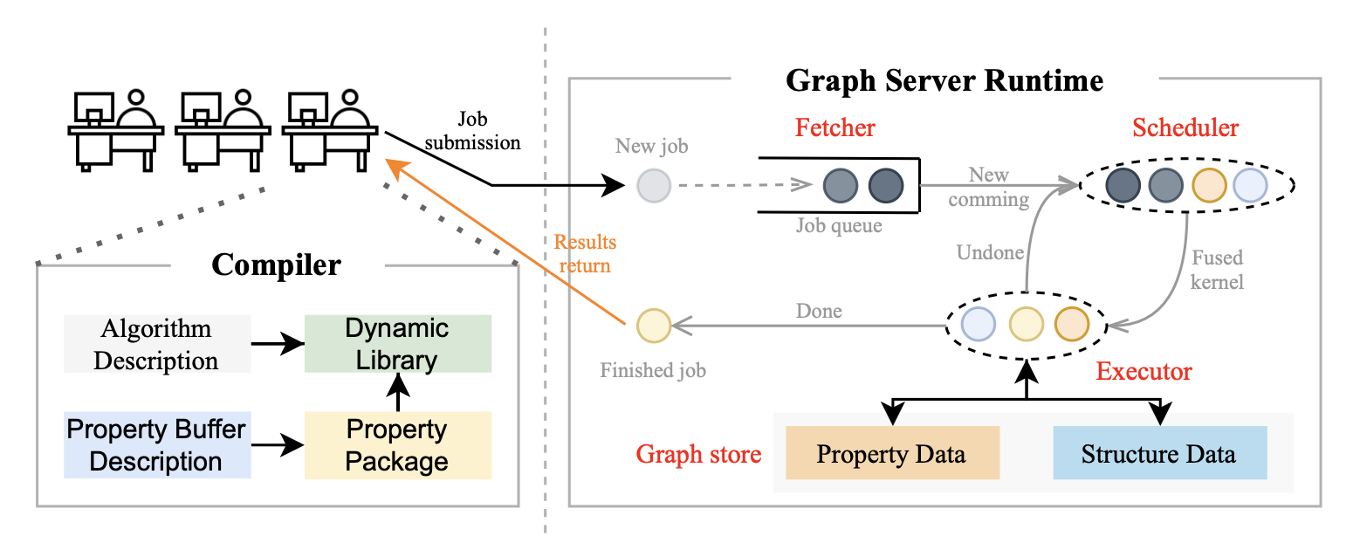
Krill: Concurrent Graph Processing System
Compiler + Runtime
Property buffers for easy property data declaration & management
Graph kernel fusion for efficient graph structure traversal & computation
7
Notes:
Based on this model, we propose krill, an efficient concurrent graph processing system, which consists of a compiler and a runtime.
For compiler, we propose property buffers for easy property data declaration & management.
For runtime, we propose a graph kernel fusion technique which is used for efficient graph structure traversal and computation.

Slide 8
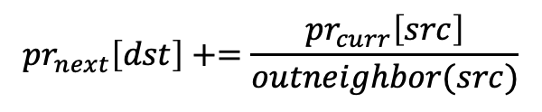
Challenge 1: Missing Property Management
Manually create property data when writing the graph algorithm
Different types of data are hard to write and organize
  Mixing types in a class involves memory alignment
  Cause extra memory usage (more serious when CG jobs are considered)
The system has no control on these property data
  Scattered around the memory -> Bad temporal memory locality
  e.g. PageRank
  Prevent optimization across different jobs
$${pr}_{next}\left[dst\right]+=\frac{{pr}_{curr}\left[src\right]}{outneighbor(src)}$$
8
Notes:
Let’s firstly look at the challenges of using current graph processing systems to process concurrent jobs, and I will talk about how we solve the problem.
The first challenge comes from the missing property management.
Existing graph systems require users to manually create property data when writing the graph algorithm.
However, for programmers, different types of data are hard to write and organize. Mixing types in a class involves memory alignment and may cause extra memory usage.
For system, it has no control on these property data. The data just scattered around the memory, which leads to bad temporal memory locality.
The PageRank example here shows, for just one update function, the system needs to access different locations for property data in two arrays.
This also prevents optimization across different jobs since the system doesn’t know when and where the property data creates.

Slide 9
Property Buffers
Declare property data in a separated file (named .propbuf)
Protocol-buffer-like grammar <type><name> = <init_val>;
Better organize property data mixing different types
Compile to a header file for further linkage
Demo.pb.h
Demo.propbuf
class Parents { // BFS_Prop
int get (int i) const;
void set (int i, int val);
// more accessors
};
class MinLen { // SSSP_Prop
int get (int i) const;
void set (int i, int val);
// …
};
class PropertyManager {
PropertyManager (size_t n);
BFS_Prop::Parents* add_Parents();
SSSP_Prop::MinLen* add_MinLen();
void initialize();
};
Source-to-source
Compilation
property BFS {
int Parents = -1;
}
property SSSP {
int MinLen = MAX_INT;
}
* Google Protocol Buffer, https://developers.google.com/protocol-buffers
9
Notes:
Thus, to solve the problem, we abstract the property data interface, and propose property buffers.
So programmers may declare property data in a separated file as shown below.
It uses Google protocol-buffer-like grammar and can better organize property data mixing different types.
Here shows two jobs example including BFS and Single Source Shorest Path.
For BFS, users declare a property buffer named Parents, and initialize the elements of this array to all 1.
For SSSP, users declare a MinLen property buffer, and initialize the elements to MAX_INT.
Then our property buffer compiler may take the file and compile to a header file to further linkage.

Slide 10
Property Buffers
Easy property access using .get() /.set() methods
Add compute kernels (jobs) by setKernels(G, K)
Property Declaration
Algorithm Description
Demo.propbuf
BFS.h (pseudocode)
Demo.cpp
property BFS {
int Parents = -1;
}
property SSSP {
int MinLen = MAX_INT;
}
BFS(size_t n, PropertyManager& prop, int start):
parents = prop.add_Parents();
cond(dst): return (parents->get(dst) == -1);
update(src, dst):
if (parents->get(dst) == -1)
parents->set(dst, src);
SSSP(size_t n, PropertyManager& prop, int start):
minLen = prop.add_MinLen();
cond(dst): return true;
update(src, dst, edgeLen):
newLen = minLen->get(src) + edgeLen;
if (minLen->get(dst) > newLen)
minLen->set(dst, newLen);
void setKernels(Graph& G, Kernels& K)
{
Demo::PropertyManager prop(G.n);
BFS* bfs = new BFS(G.n, prop, 0);
SSSP* sssp = new SSSP(G.n, prop, 0);
K.appendJob({bfs, sssp});
prop.initialize();
}
SSSP.h (pseudocode)
10
Notes:
After declaring the property data, programmers can later easily access the property in their algorithm using .get() and .set() methods.
And then the users can combine these two jobs together by calling the setKernels function.

Slide 11
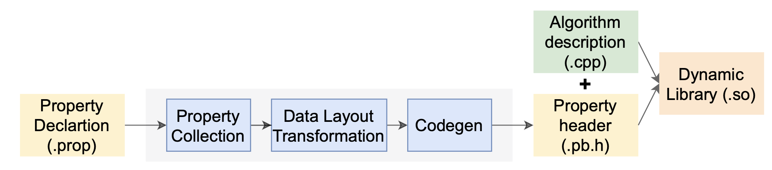
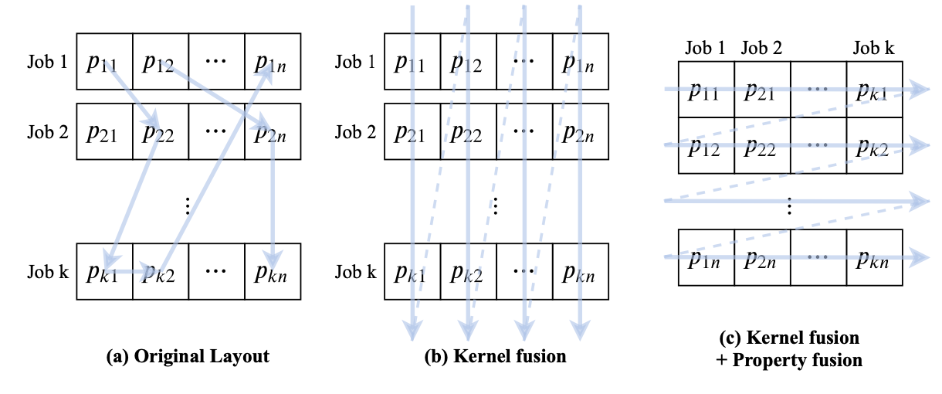
Property Buffer Compiler
Compilation flow
Can make data layout transformation that organizes data of different jobs together to improve spatial locality
11
Notes:
The detailed compilation flow of our property buffer compiler is shown below.
Basically, it collects the property declared by the users, make optimizations, and codegen the header file.
The optimization here is data layout transformation that organizes property data of different jobs together to improve spatial locality.
Finally, the algorithm description file will be combined with the generated header file and generate a dynamic library for the runtime to use.

Slide 12
Runtime System
Graph store: Long-running service storing structure & property data in memory
Fetcher: Fetch the new-coming jobs and put into job queue
Scheduler: Manipulate graph kernel fusion
Executor: Execute specific graph algorithm
12
Notes:
For runtime, we have four modules.
A graph store which stores the structure and property data in memory.
A fetcher that fetches the new-coming jobs and put. them into job queue.
A scheduler that performs some optimizations that I will talk later.
And an executor that execute specific graph algorithms.

Slide 13
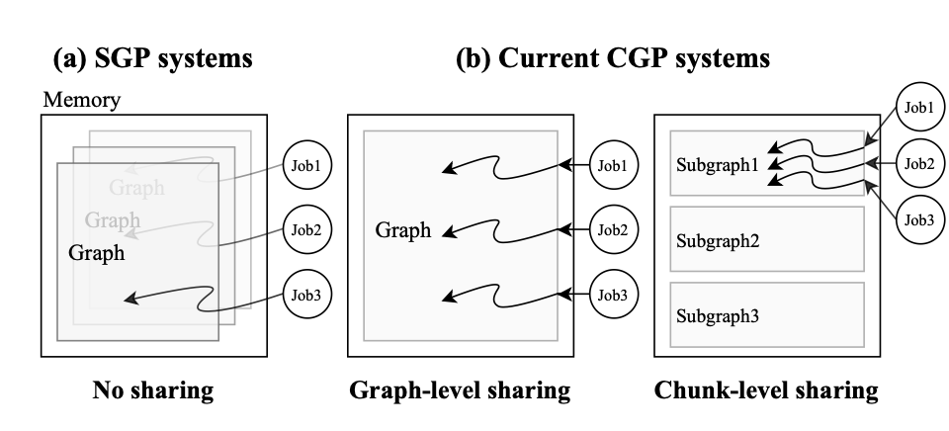
Challenge 2: Redundant Structure Accesses
Existing Single Graph Job Processing (SGP) systems
  Ligra[PPoPP'13], Gemini[OSDI'16]
  Multiple copies of graph structure
Existing Concurrent Graph Jobs Processing (CGP) systems
  Seraph[HPDC'14], CGraph[ATC'18], GraphM[SC'19]
  Shared graph structure, but jobs still access the graph individually
Can further reduce accesses by exploring
  Similar graph traversal patterns
  Shared active vertices
13
Notes:
When we look at the graph traversal part, we can see there’re lots of redundant structure accesses, which is the second challenge of concurrent graph processing.
Existing single graph job processing systems like Ligra and Gemini may need to store multiple copies of graph structure when processing concurrent jobs, which is a large memory consumption.
Many concurrent graph jobs processing systems are proposed these years, including Seraph, CGraph, and GraphM.
They all share the underlying graph structure, but the jobs still access the graph individually, which incurs redundant memory access.
Actually, we can further reduce the access by exploring similar graph traversal patterns and shared activate vertices.

Slide 14

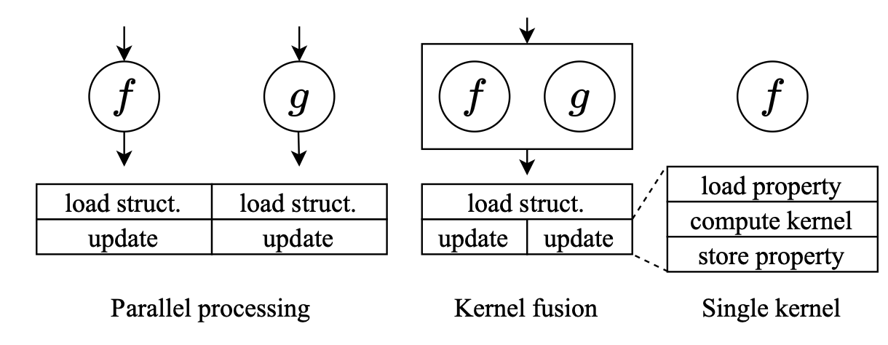
Graph Kernel Fusion
Existing CGP systems require $O(c|E|)$times of structure access
(a) Basic Push engine in CGP
(b) Basic Pull engine in CGP
1 for job in jobs do
2 for each vSrc in vertices do
3 if (!vSrc in frontier) continue
4 for vDst in vSrc.outngh do
5 if cond(vDst) then
6 updateAtomic(vSrc, vDst)
1 for job in jobs do
2 for each vDst in vertices do
3 if (!cond(vDst)) continue
4 for vSrc in vDst.inngh do
5 if vSrc in frontier then
6 update (vSrc, vDst)
Key idea: Force all the jobs to access the same edge, only $O(|E|)$access!
14
Notes:
We can see that existing CGP systems require O(c|E|) times of structure access no matter they use Push or Pull engine, where c is the number of jobs.
This is shown in the second and fourth line of the code snippet.
The key idea of our proposed graph kernel fusion is to force all the jobs to access the same edge, which only takes O(|E|) times of access.
Basically, this is moving the outer-most loop into the inner-most.

Slide 15
Graph Kernel Fusion
Moving in the job loop leads to $O(|E|)$times of structure access
(a) Modified Push engine in CGP
(b) Modified Pull engine in CGP
1 for each vSrc in vertices do
2 if (!vSrc in frontier) continue
3 for vDst in vSrc.outngh do
4 if cond(vDst) then
5 for job in jobs do
6 updateAtomic(vSrc, vDst)
1 for each vDst in vertices do
2 if (!cond(vDst)) continue
3 for vSrc in vDst.inngh do
4 if vSrc in frontier then
5 for job in jobs do
6 update (vSrc, vDst)
15
Notes:
And it becomes this.
Ideally, we can have O(|E||) times of structure access.

Slide 16
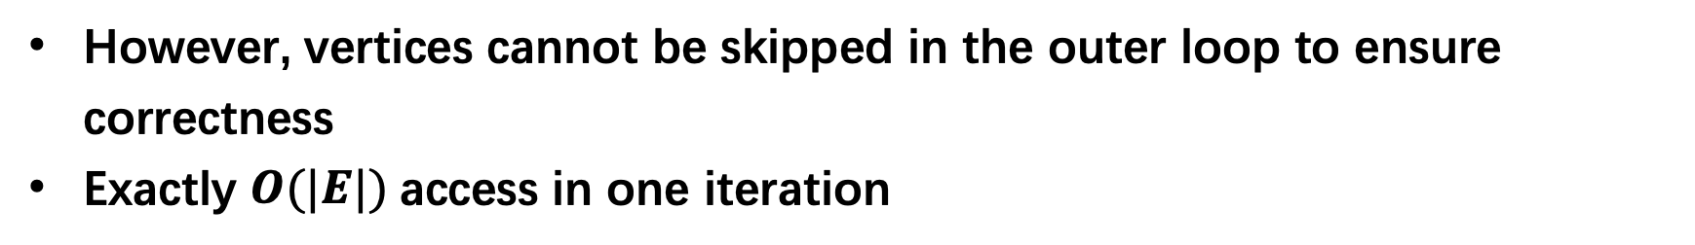
Graph Kernel Fusion
However, vertices cannot be skipped in the outer loop to ensure correctness
Exactly $O(|E|)$access in one iteration
(a) Modified Push engine in CGP
(b) Modified Pull engine in CGP
1 for each vSrc in vertices do
2 if (!vSrc in frontier) continue
3 for vDst in vSrc.outngh do
4 if cond(vDst) then
5 for job in jobs do
6 if vSrc & vDst meet requirement
7 updateAtomic(vSrc, vDst)
1 for each vDst in vertices do
2 if (!cond(vDst)) continue
3 for vSrc in vDst.inngh do
4 if vSrc in frontier then
5 for job in jobs do
6 if vSrc & vDst meet requirement
7 update (vSrc, vDst)
16
Notes:
However, traditional single graph processing system may use frontier set to record the active vertices and use frontier to quickly traverse the vertices in the Push engine.
After we move the job loop to the inner-most, the vertices cannot be skipped in order to ensure the correctness.
It exactly takes O(|E|) access in one iteration.

Slide 17
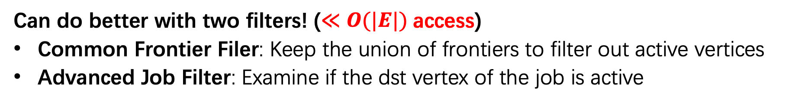
Graph Kernel Fusion w/ Fast Filters
Can do better with two filters! (≪ $O(|E|)$access)
Common Frontier Filer: Keep the union of frontiers to filter out active vertices
Advanced Job Filter: Examine if the dst vertex of the job is active
(a) Common Frontier Filter
(b) Advanced Job Filter
1 for each vSrc in comonFrontier do
2 for vDst in vSrc.outngh do
3 for job in jobs do
4 if vSrc & vDst meet requirement
5 … // update job
1 for each vDst in vertices do
2 … // calculate availJob
3 for vSrc in vDst.inngh do
4 for job in availJob do
5 if vSrc & vDst meet requirement
6 … // update job
17
Notes:
But we can do even better with two filters.
We propose two filters here.
Common frontier filer helps keep the union of the frontiers of different jobs and filter out the active vertices.
Advanced job filter can examine if the destination vertex of the job is active.

Slide 18
Graph Kernel Fusion w/ Fast Filters
Traverse graph structure once but do multiple computation for each vertex
Greatly reduce # of memory accesses
Two BFS example:
Initial state
1st iteration
2nd iteration
3rd iteration
BFS1
2
5
2
5
2
5
2
5
1
4
7
1
4
7
1
4
7
1
4
7
BFS2
3
6
3
6
3
6
3
6
GraphM [SC'19]
visited: {1}, {4}
visited: {2, 3}, {2, 3, 7}
visited: {1, 5, 6}, {4, 5, 6}
visited: {7}, {}
Krill
visited: {1, 4}
visited: {2, 3, 7}
visited: {1, 4, 5, 6}
visited: {7}
Common Frontier Filter
Advanced Job Filter
18
Notes:
So using graph kernel fusion with fast filters, we can traverse the graph structure exactly once but do multiple computation for each vertex, which greatly reduce the number of memory access.
The following example shows how two BFS in our system work.
The orange and yellow circles are basically the active vertices of BFS in different iterations.
In the initial state, vertex one and four are the active vertices for BFS1 and BFS2, and they are appended to the frontier.
In the first iteration, the BFS traverses the neighbors of the active vertices, and have the new frontiers.
Using common frontier filter, Krill can only record the union of the frontiers, which reduces memory usage and also memory access.
It is similar for the second iteration.
In the last iteration, only BFS1 needs to visit the vertex 7.
With advanced job filter, we can only need to visit the jobs that are active in that iteration.
Thus, common frontier filter and advanced job filter both reduce memory access.

Slide 19
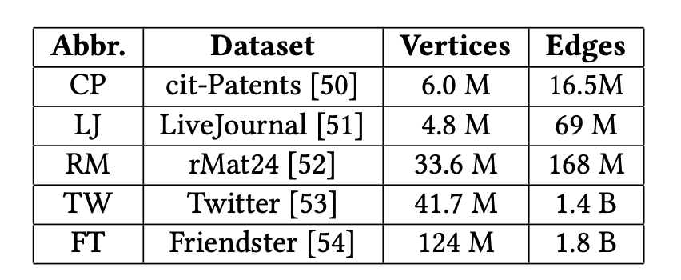
Experimental Setup
Build Krill on top of Ligra (shared-mem) & Gemini (dist)
Baseline systems
  Ligra-S: Sequentially execute jobs, still parallel in one job
  Ligra-P: Execute jobs in parallel
  GraphM: The state-of-the-art shared-memory CGP system
  Seraph: The state-of-the-art distributed CGP system
Datasets
19
Notes:
For our experiments, we build Krill on top of Ligra and Gemini for shared memory and distributed systems.
We compare with four baseline systems, including Ligra-S, which sequentially executes the jobs, but still parallelize the computation in one job.
Ligra-P, which executes the jobs in parallel.
and GraphM and Seraph, both of which are the state-of-the-art concurrent graph processing system.
We also conduct our experiments on five commonly-used datasets, and the largest one has 1.8 billion edges.

Slide 20
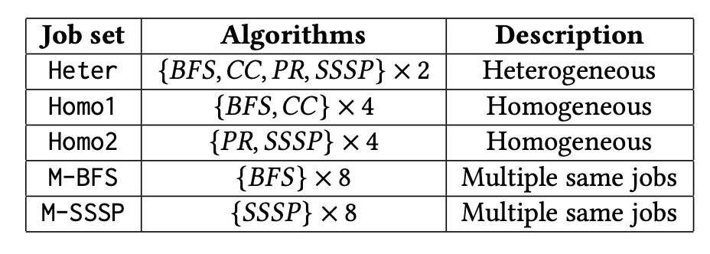
Experimental Setup
Machines & Environment
  2*Intel Xeon Gold 5118 CPU (48 cores)
  768 GB memory
  2 nodes for distributed experiment
  Cilk Plus (shared-mem) / OpenMPI (dist)
Applications
  Breadth-First Search (BFS)
  Connected Components (CC)
  PageRank Delta (PR)
  BellmanFord (SSSP)
Job sets (8 jobs in a batch submitted simultaneously)
20
Notes:
We mainly consider four applications including BFS, connected components, PageRank, and BellmanFord.
Based on these applications, we construct 5 job sets, which mixes 8 jobs in each set.
They show different characteristics based on the memory bandwidth consumption, so we makes a heterogenous job set that consists all the four applications,
The homogeneous job sets consists applications that show similar memory bandwidth consumption.
And also two job sets of multiple BFS and multiple SSSP.
We use a machine of 48 cores and a machine with 2 nodes to make an evaluation.

Slide 21
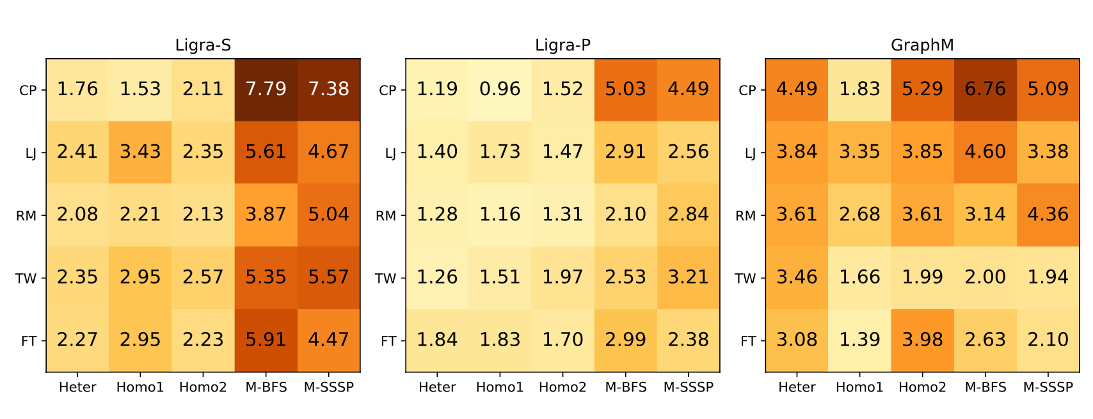
Experimental Results
Datasets
Job sets
Up to 7.79x speedup compared with Ligra, and 6.67x compared with GraphM
Preference to heterogeneous job sets
21

Slide 22
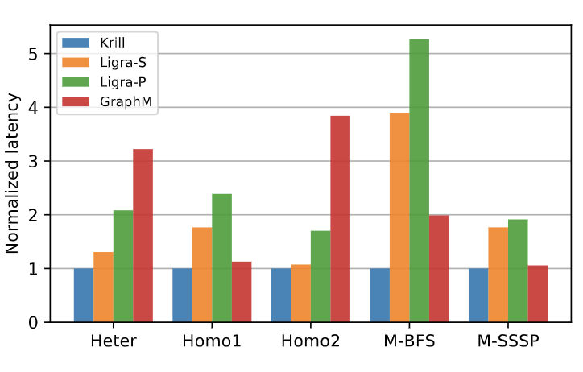
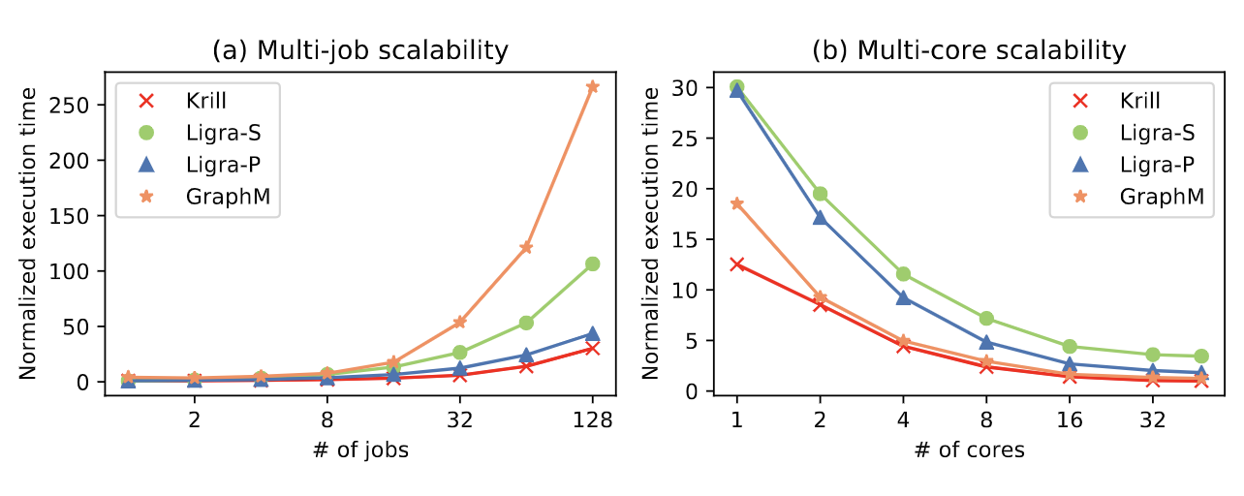
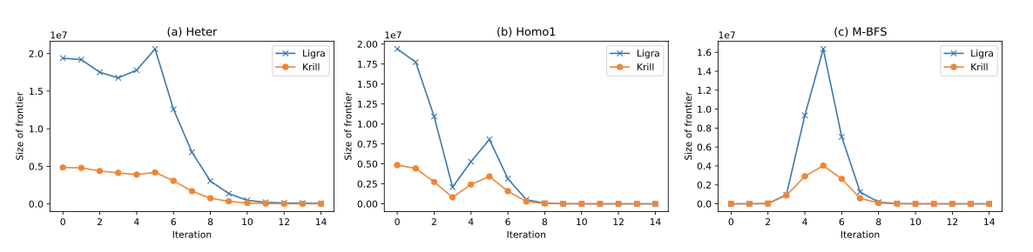
Experimental Results
>5x
Low response latency
High scalability
Minimum frontier set, reducing graph structure access
22

Slide 23
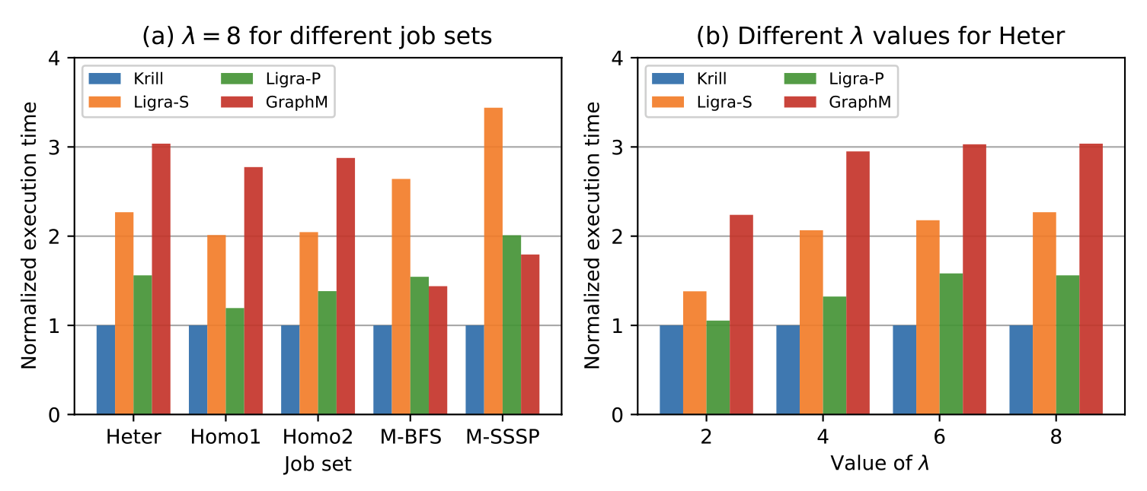
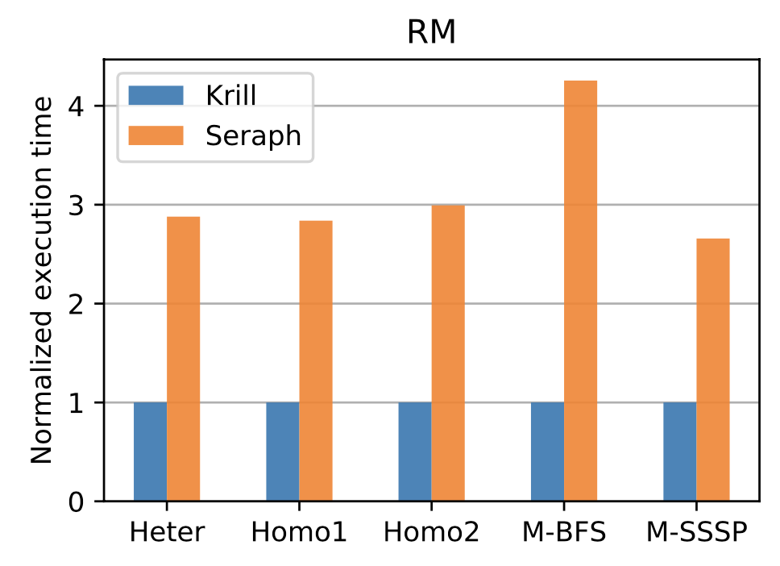
Experimental Results
Dynamic graph job submission
> 3x speedup
Distributed Environment
Max 4.25x speedup
23

Slide 24
Conclusion
Krill: Concurrent graph processing system
  High performance, end-to-end, full-stack solution
Compiler: Property buffers
  Automatic property management
Runtime: Graph kernel fusion
  Optimal structure access
Reduce execution time, memory access, respond latency, etc.
24

Slide 25



Thanks & QA
Krill: A Compiler and Runtime System
for Concurrent Graph Processing
Hongzheng Chen, Minghua Shen, Nong Xiao, Yutong Lu
https://github.com/chhzh123/Krill
Artifact
Available
Artifact
Functional
Results
Reproduced

