Slide 1
SW_Qsim: A Minimize-Memory Quantum Simulator with
High-Performance on a New Sunway Supercomputer
Fang Li¹, Xin Liu¹, Yong Liu¹, Pengpeng Zhao¹, Yuling Yang¹, Honghui Shang², Weizhe Sun¹, Zhen Wang¹, Enming Dong¹, Dexun Chen³
1. National Supercompuer Center in Wuxi
2. SKL of Computer Architecture, Institute of Computing Technology, Chinese Academy of Sciences
3. Tsinghua University
Notes:
Hello everyone.
It is a great pleasure for me to present to you the work we did.
I will demonstrate SW_Qsim, A Minimize-Memory Quantum Simulator with High-Performance on the many-core Sunway Supercomputer.
First, let me introduce our team members.
Our team include Xin Liu,Yong Liu,Pengpeng Zhao, Yuling Yang, Weizhe Sun, Zhen Wang, Enming Dong from National Supercomputer Center in Wuxi.
Dexun Chen from Tsinghua University.
Honghui Shang from Institute of Computing Technology.
And I Fang Li from National Supercomputer Center in Wuxi.

Slide 2
Outline of presentation
Introduction
Performance measurement
Significance of the paper
Compared with other simulators
Performance results
Background
Memory requirement
GEMM acceleration on SW26010pro
Tensor permutation acceleration on SW26010pro
Strong scaling and weak scaling results
Quantum Simulation Method
Computing equipment
Innovations
Parallelism
Fault tolerance and parallel
stability
Conclusions
Notes:
ok, first, Introduction

Slide 3
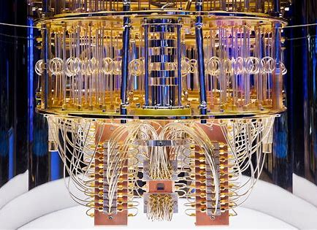

INTRODUCTION
Extend the boundary of RQCs that can be simulated in the classic computers.
Significance of the paper
Quantum computation —— A new paradigm of computing that takes advantage of the quantum mechanics.
has a huge advantage
Questions like Boson sampling, random quantum circuit (RQCs) sampling, quantum annealing, and quantum system simulation , et al can be efficiently solved with a quantum computer, but not with classical computers, even leading HPC systems.
Notes:
Quantum computation is a new paradigm of computing that takes advantage of the quantum mechanics.
Some problems can be efficiently solved with a quantum computer but not with classical computers, even HPC systems.
These problems include Boson sampling, random quantum circuit sampling(RQCs) , quantum annealing, and quantum system simulation , et al.
Among them, RQCs is proposed to measure the performance of quantum computing devices.
So the purpose of our paper is to extend the boundary of RQCs simulated in the classic HPC computers.

Slide 4
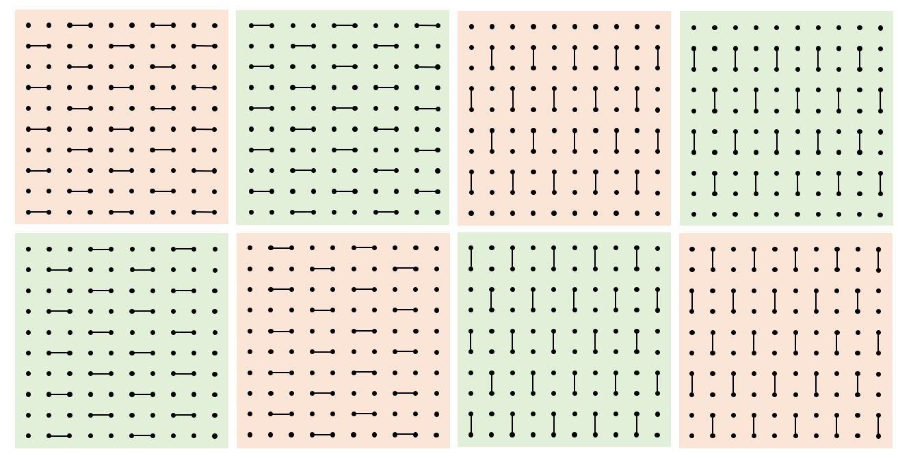
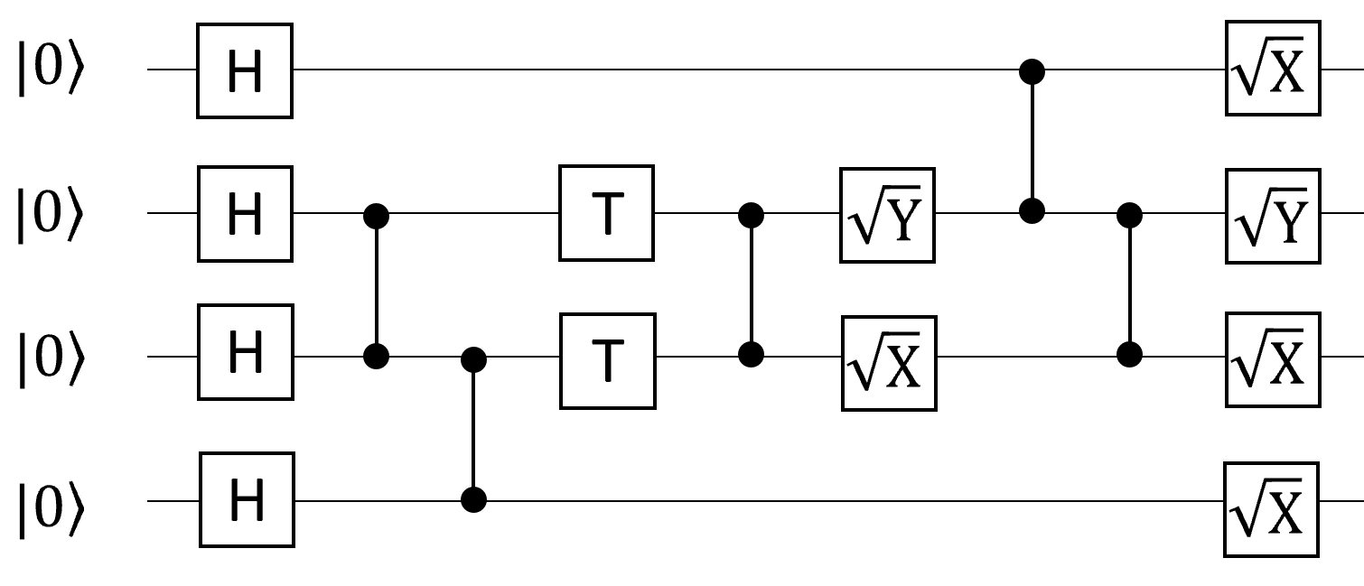
INTRODUCTION
Our studying case——RQCs (random quantum circuit sampling)
depth
N
M
8 different RQC’s CZ gates’ pattern: a — or | represents a CZ gate
A 4-qubit RQC
3-D structure of RQC
RQCs comprises specific single-qubit gates and two-qubit gates between the nearest neighbor qubits that can be easily implemented in the current quantum chips.
Notes:
RQCs comprises specific single-qubit gates and two-qubit gates between the nearest neighbor qubits.
And they can be easily implemented in the current quantum chips.
But with hundreds of two-qubit gates, though the quantum gates are accessible, RQCs may have highly entangled quantum states.
That makes large-scale RQCs are difficult to simulate even with the fastest supercomputers.
So RQCs is considered an ideal benchmark for both current quantum computers and classical supercomputers.

Slide 5
INTRODUCTION
Compared with the existing simulators in the field of RQC:
With increasing numbers of qubits, the computational and storage costs of RQCs increase exponentially.
Table: A broad overview of existing simulators in the field of RQC
Work | Year | Machine | scale | depth
ETH | 2017 | Cori II | 5*9 | 25
IBM+Illinois | 2017 | Blue Gene/Q | 7*7 | 27
Google | 2017 | a single workstation | 5*9 | 40
Chicago + agong | 2017 | Theta | 5*9 | 11
Tsinghua + ict | 2018 | Sunway TaihuLight | 7*7 | 55
Alibaba | 2018 | ACQDP | 9*9 | 40
NUDT+PCL | 2019 | Tianhe-2 | 7*7 | 40
Illinois+NASA+Google | 2020 | Summit | 7*7 | 40
Our work | 2021 | The new Sunway Supercomputer | 8*8 | 40
Our work | 2021 | The new Sunway Supercomputer | 10*10 | 32
 |  |  | 20*20 | 16
Notes:
With increasing numbers of qubits, the computational and storage costs of RQCs increase exponentially.
In recent years, many algorithms have been developed to simulate large-scale RQCs.
Compared with the existing simulators in the field of RQC, our work on the new Sunway Supercomputer is outstand.
In 2020, Illinois+NASA+Google simulated RQC of 7*7 qubits and 40 depth.
In this paper, we simulated RQCs of 8*8qubits-40depth, 10*10qubits-32depth and 20*20qubits-16depth, become the new state-of-art.

Slide 6
Outline of presentation
Introduction
Performance measurement
Significance of the paper
Compared with other simulators
Performance results
Background
Memory requirement
GEMM acceleration on SW26010pro
Tensor permutation acceleration on SW26010pro
Strong scaling and weak scaling results
Quantum Simulation Method
Computing equipment
Innovations
Parallelism
Fault tolerance and parallel
stability
Conclusions
Notes:
Before describing our methods, let me introduce our Quantum Simulation Method and Computing equipment.

Slide 7
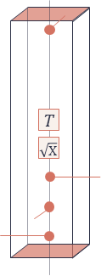
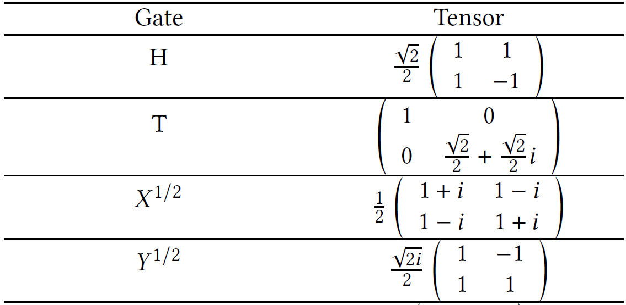
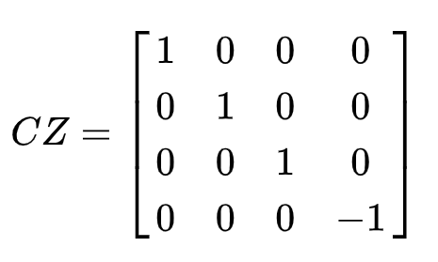
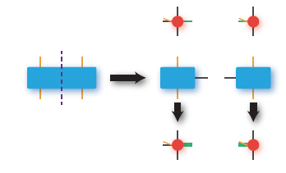
BACKGROUND
Quantum Simulation Method —— PEPS(Projected Entangled-Pair States)
The PEPS method of simulating quantum many-body systems is built on the framework of tensor network evolution and contraction.
Tensor network
N
Single-qubit gate
N
M
M
Network Evolution
Two-qubit gate
Notes:
SW_Qsim introduced in this paper is based on PEPS, which is especially suitable for massive parallelization.
The PEPS method of simulating quantum many-body systems is built on the framework of tensor network evolution and contraction.
As the numbers of qubits and circuit depth increase, the size of the tensor evolutes exponentially.
For a single-amplitude RQCs simulation of 𝑚×𝑛 rectangular grid with circuit depth L, the largest tensor network will reach a size of 2 to the power of n*L.
For example, for 𝐿 = 32, 𝑚 = 10, 𝑛 = 10, the largest tensor slice reaches 0.25 petabytes in size
It cannot be saved by any node on any computer.

Slide 8
BACKGROUND
Quantum Simulation Method —— PEPS(Projected Entangled-Pair States)
The PEPS method of simulating quantum many-body systems is built on the framework of tensor network evolution and contraction.
B
C
B
C
C
j
k
g
j
k
g
k
g
I
I
k
g
k
(x)
I
n
p
p
p
a single-amplitude
Network Contraction
Notes:
The main operation in the PEPS method is the tensor contraction.
To break the bottleneck of memory overhead of single node, we slice the tensor network to many sub-tasks.
So the dimension of the intermediate tensor networks is descended.
And we implement the simulation on the distributed New Sunway Supercomputer with its extreme-scale nodes.

Slide 9
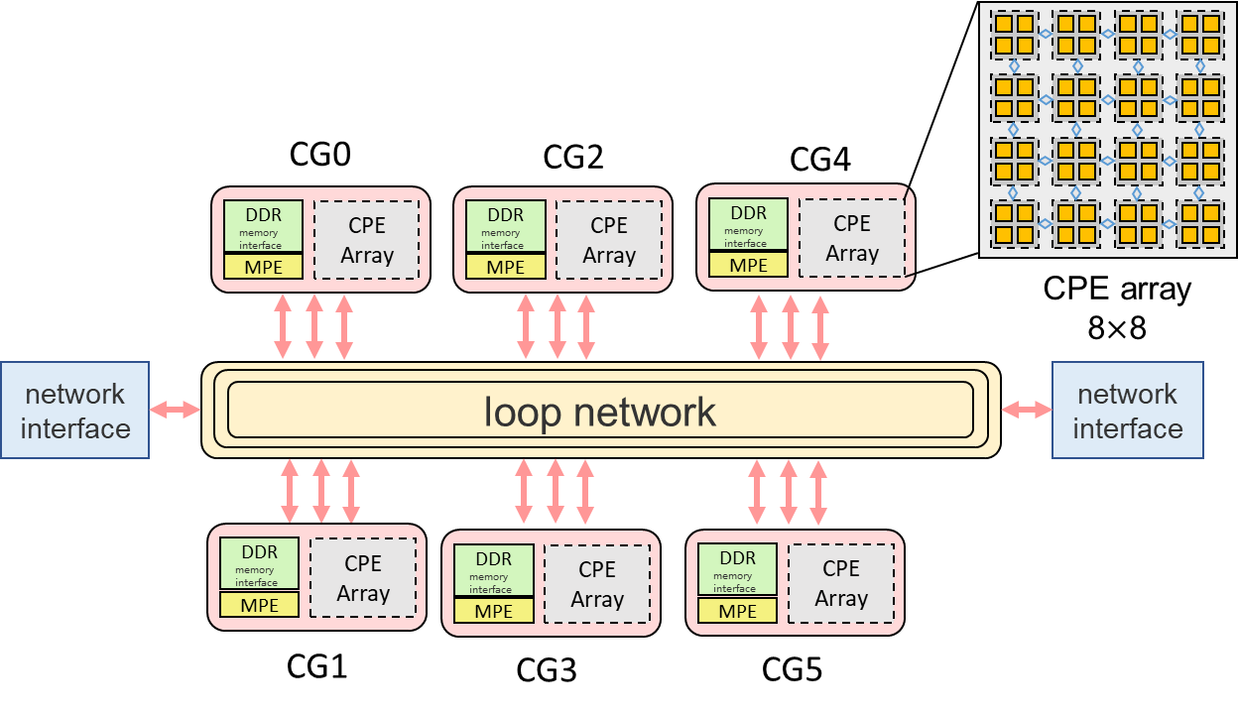
BACKGROUND
Computing equipment ——The New Sunway Supercomputer
The processor chip is composed of 6 core-groups (CGs), Each core group includes a MPE and 64 CPEs, totally of 390 cores.
SW26016pro is 96 GB memory and 16 GB memory in each CG. Each CPE has a 256KB scratch pad memory.
The CPE adopts the SW64 instructions and provide 512-bit SIMD support.
Notes:
The New Sunway Supercomputer is the successor of the Sunway TaihuLight.
It adopts a new generation of high-performance many-core processor SW26010pro and interconnection network chips.
SW26010pro is designed for massive thread and data parallelism and to deliver high performance on parallel workloads.
The processor chip is composed of 6 core-groups (CGs), connected via a network on chip.
Each core group includes a management processing element (MPE) and 64 computing processing elements (CPEs) arranged in an 8 by 8 grid, a total of 390 cores.

Slide 10
Outline of presentation
Introduction
Performance measurement
Significance of the paper
Compared with other simulators
Performance results
Background
Memory requirement
GEMM acceleration on SW26010pro
Tensor permutation acceleration on SW26010pro
Strong scaling and weak scaling results
Quantum Simulation Method
Computing equipment
Innovations
Parallelism
Fault tolerance and parallel
stability
Conclusions
Notes:
so now, let’s see our innovations on the new generation Sunway supercomputer.

Slide 11
INNOVATION
SW_Qsim execution steps
Step 2
Step 1: Choose initial state and target state
time
Step 2: Evolute tensor from the initial state of every qubit
Step 3: Product the final state to each tensor and get the tensor network of the amplitude
Step 3
Step 4: Fractal Recursive Slice Parallel computing the amplitude
Step 5: Path contraction method
Step 6: MPI_Reduce
Notes:
SW_Qsim uses PEPS to calculate the probability amplitude of a single final state of a quantum grid.
First, we start from the initial state of each qubit and perform tensor network evolution according to a given RQC.
Second, we multiply the final state of each qubit to their evolated tensor, and obtain the target tensor network.
Then, we decompose the tensor network into numbers of independent sub-tensor network using our new “fractal recursive slice parallel” method.
Finally, we collect the contraction results obtained on these parallel tasks.
Now, the probability of transition the quantum grid from the initial state to a certain final state through a random circuit is obtained.

Slide 12






INNOVATION
Parallelism——Process-level parallelism + Thread-level parallelism
Step 1: Choose initial state and target state
CPE array 8$×$8
Step 2: Evolute tensor from the initial state of every qubit
Step 4
First slice
Second slice
Tensor network contraction
the $s_{th}$slice
Level-1 tasks 1
Level-2 tasks 1
Step 3: Product the final state to each tensor and get the tensor network of the amplitude
Level-1 tasks 2
Level-s tasks 1
Task $({i−1)n}^{s−1}+1$
CG1
……
Level-2 tasks 2
Level-s tasks 2
Task $({i−1)n}^{s−1}+2$
CG2
……
……
Level-1 tasks i
Level-2 tasks i
…
……
$$⋮$$
……
……
Level-s tasks i
Task $({i−1)n}^{s−1}+i$
CGi
Step 4: Fractal Recursive Slice Parallel computing the amplitude
Level-1 tasks n
……
……
$$⋮$$
Level-2 tasks n
Level-s tasks n
Task $({i−1)n}^{s−1}+n$
CGn
Step 5: Path contraction method
Process-level parallelism
Thread-level parallelism
Step 6: MPI_Reduce
Notes:
Tensor contraction produces massive intermediate tensor networks, which cannot be stored on a single computing node.
So we use two-level hardware-friendly parallelism on the many-core New Sunway Supercomputer
Thus we can decompose the squared tensor network into independent contraction of several easy-to-calculate sub-tensor networks.
This enables us to perform simulations with high numbers of qubits and deep depth of quantum circuits.

Slide 13

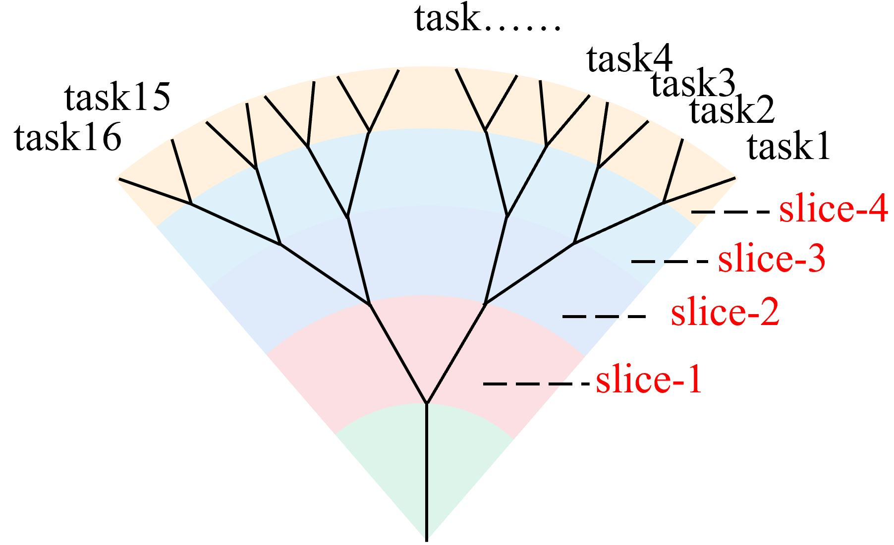
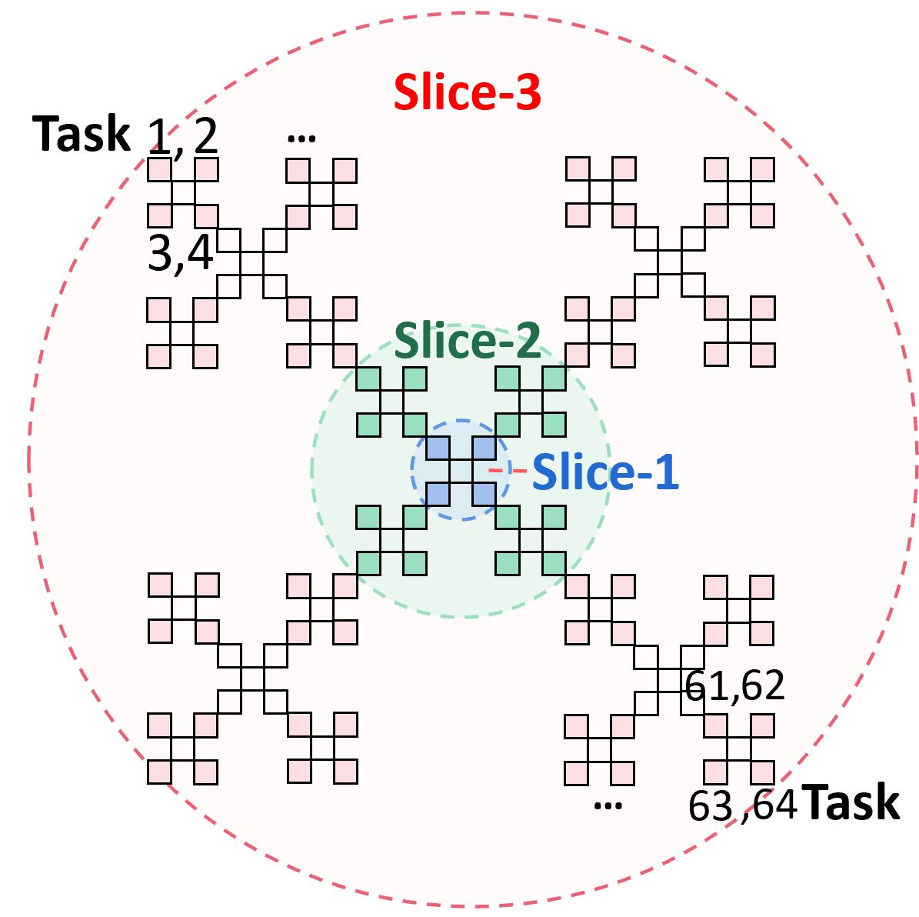
INNOVATION
Process-level parallelism
Parallel strategy: Fractal recursive slice parallel algorithm
All tasks
All tasks
parallel of 8-layer RQCs
parallel of 16-layer RQCs
Notes:
Fractal recursive slice comes from fractal theory, and its typical feature is recursion.
As examples, the fractal recursive slice parallel of 8-layer and 16-layer RQCs are shown in the figures.
The branches obtained by one division continue to be divided according to the same rules, and each branch in different levels is self-similar.
Each task obtains its tensor branch by a vector projection algorithm.
We slice the tensor network recursively level by level.
All of the sub-tasks have the same sub-tensor network structure, achieving a good load balance.
Moreover, tensor network cutting is a communication-avoiding algorithm so our simulator has high scalability.

Slide 14











INNOVATION
Process-level parallelism
Optimize every process task: searching for minimize-memory contraction path of tensor network
s slice
(1,1)
Take the 𝑚 × 𝑛(𝑚 ≥ 𝑛) bits rectangular tensor network shown in left figure as an example. After 𝑠 continuous slices in the same direction, we find the minimize-memory contraction path method shown in the right figure.
$$A$$
$$B$$
$$A$$
$$B$$
m
(s+1, $\left\lceil n/2\right\rceil$)
$T^{\left\lceil n/2\right\rceil +1}$tensor is created
(s+2,p)
$$C$$
$$E$$
$$F$$
$$D$$
(m,1)
(m,p)
(m,$\left\lceil n/2\right\rceil$)
(m,n)
n
Notes:
Since the rank of new intermediate tensors is decided by the contraction path.
The contraction path is extremely important for each sub-tensor network.
Searching for the optimized contracting path is an NP-hard problem.
However, we find a minimize-memory contraction path for specific situation .
Take rectangular tensor network shown in left figure as an example.
After s continuous slices in the same direction, two partitions A and D have been generated.
In the sequential contraction, we proved that the contraction algorithm shown in the right figure must be the minimize-memory one in the case of continuous slices in the same direction.

Slide 15
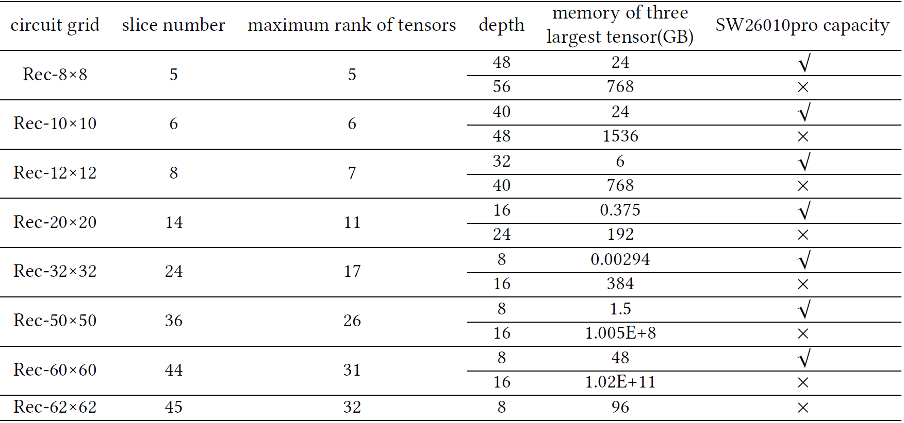
INNOVATION
Process-level parallelism
To achieve the balance between memory and time: Memory-limited Simulation Capacity on SW26010pro
the relationship between 𝑚 × 𝑛 and L satisfies:
⌈𝐿/8⌉ ( ⌈𝑛/2⌉ + 1) =
27 + 𝑙𝑜𝑔2 (𝑀/3)
Notes:
As we have found the minimize memory contraction path, we can calculate the memory-limited simulation capacity of any processor.
in other words, we can obtain the relationship between the maximum number of qubits 𝑚 , 𝑛 and quantum depth L for a specified processor.
The memory of one processor of SW26010pro is 96GB, its simulation capabilities of various circuit grids are shown in the TABLE.

Slide 16
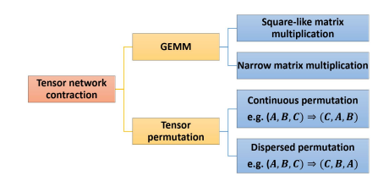
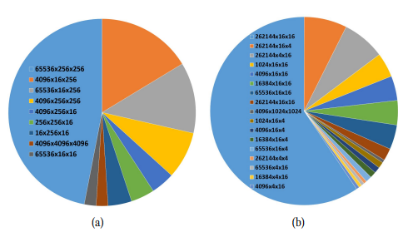
INNOVATION
Thread-level parallelism
The major time-consuming step high-rank tensor contration
10 × 10 × (1 + 32 + 1)
20 × 20 × (1 + 16 + 1)
Thread-level parallelization of SW_Qsim
Distribution of matrix sizes of GEMM
Notes:
The thread-level parallelization of SW_Qsim is implemented on one CG of SW26010pro.
The major time-consuming step is tensor contraction
It consists two main kernels GEMM and tensor permutation.
The typical statistical dimension ratio of GEMM in RQCs of 10 × 10 × (1 + 32 + 1) and 20 × 20 × (1 + 16 + 1) indicates that the matrices are highly irregular.

Slide 17
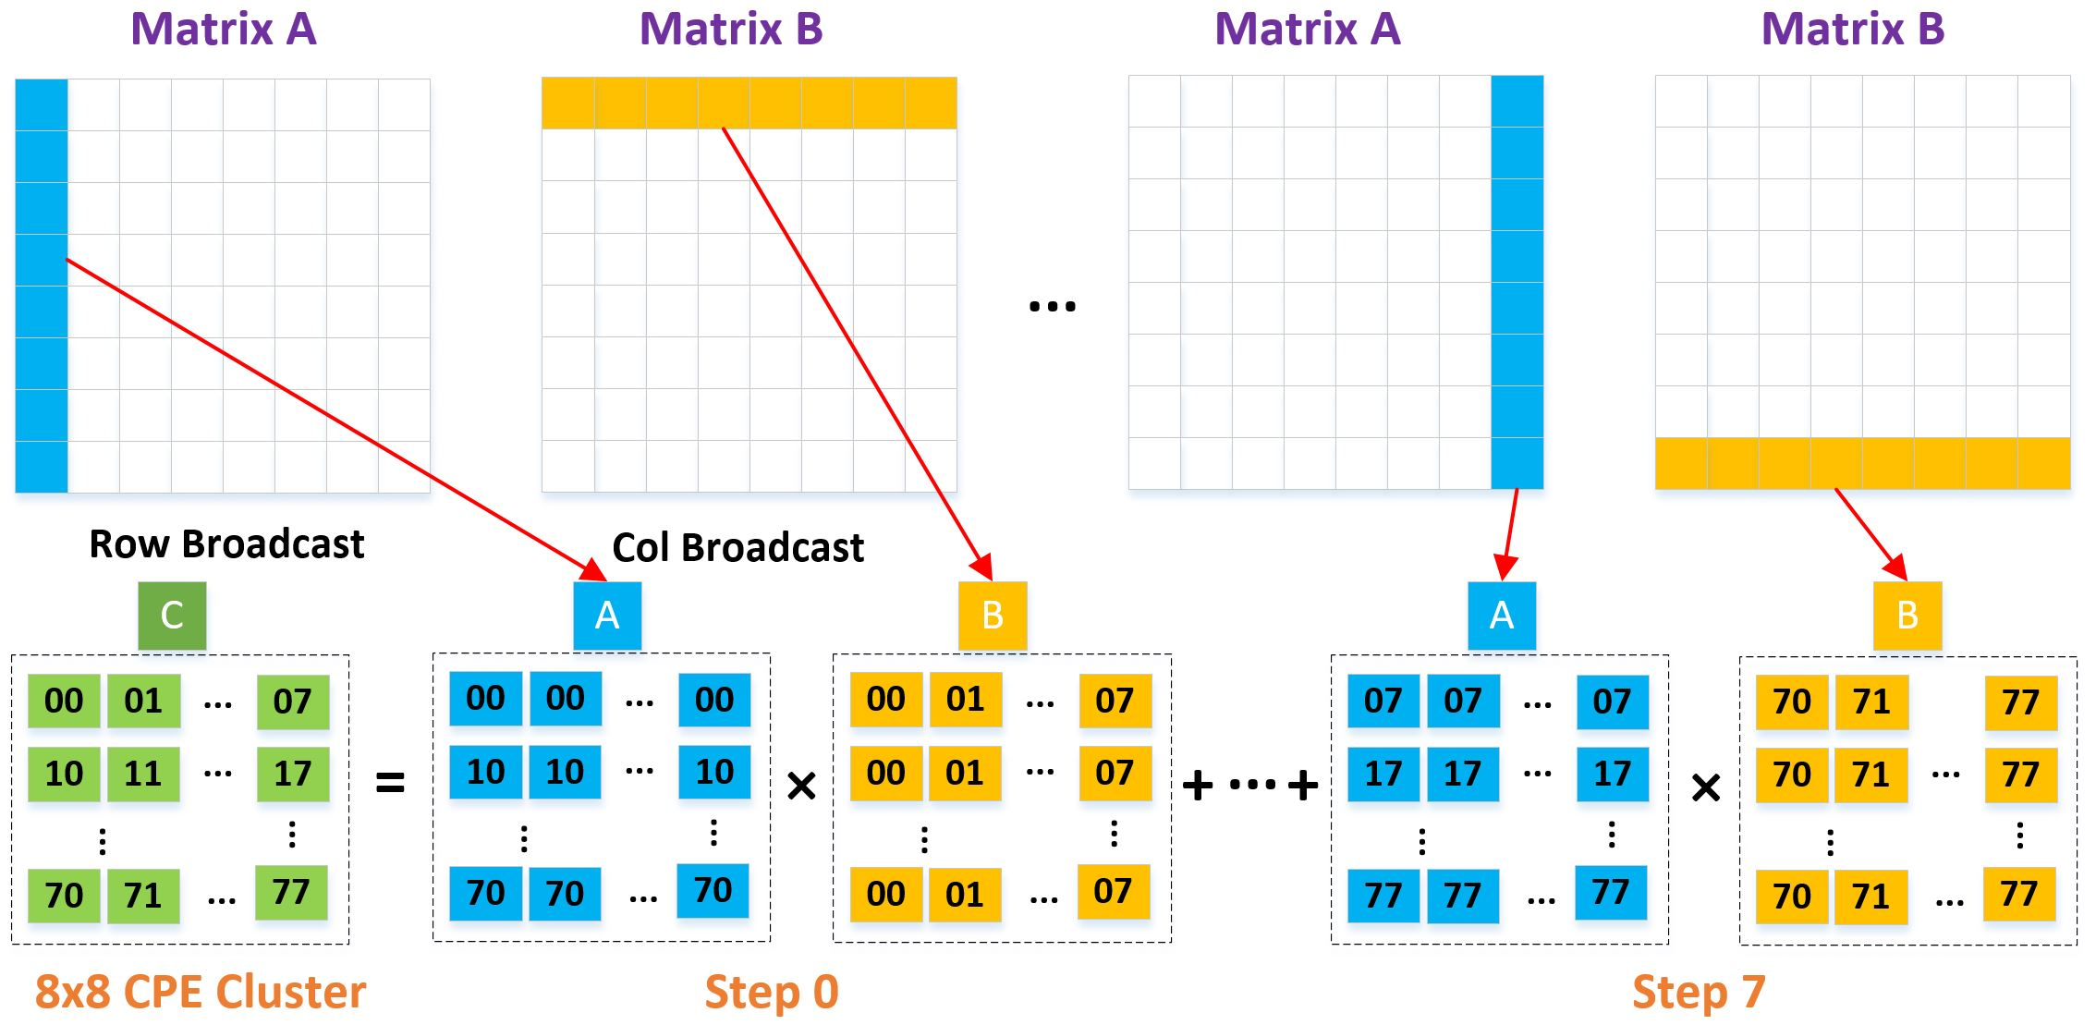
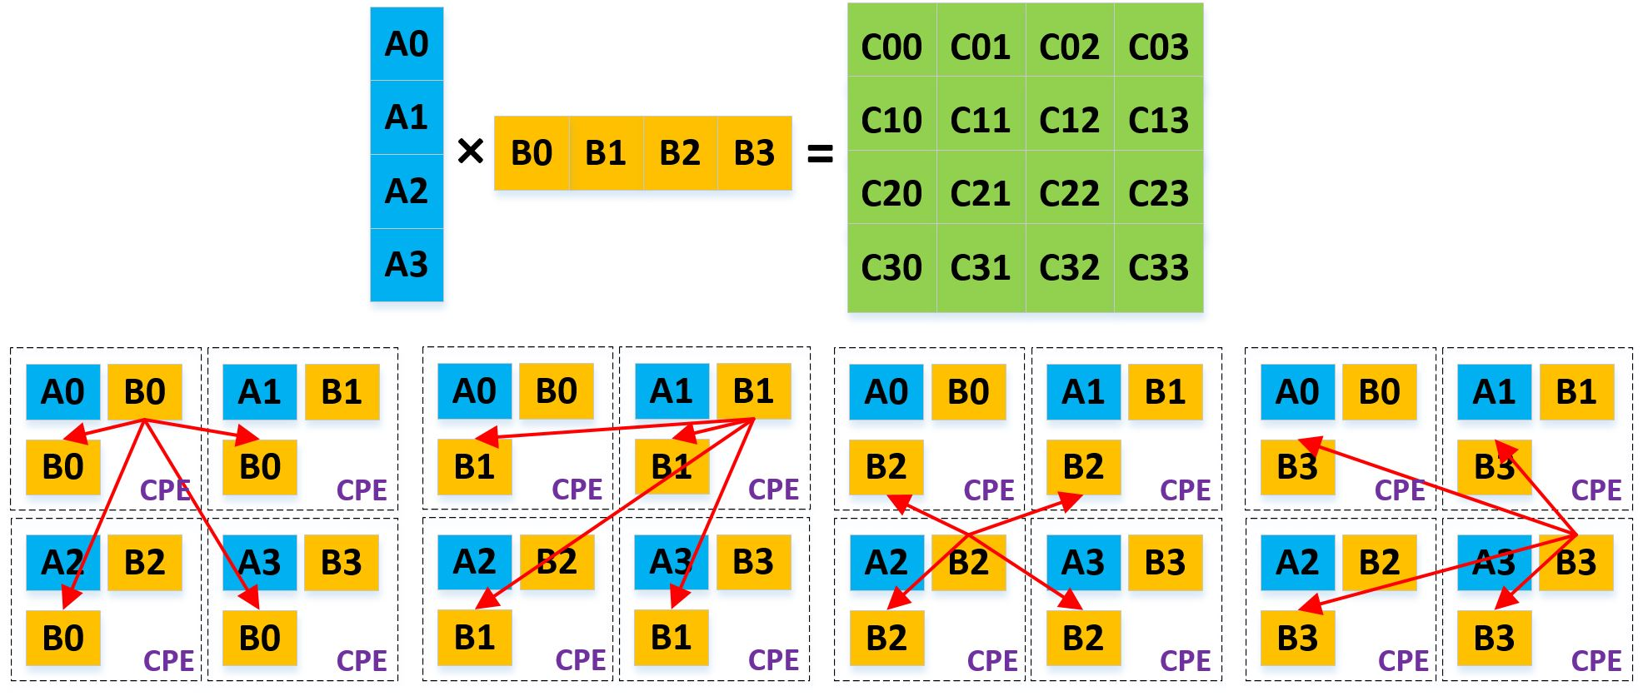
INNOVATION
Thread-level parallelism
The optimizations in matrix–matrix multiplication: GEMM optimizations
Square-like matrix multiplication
Narrow matrix multiplication
Notes:
For square-like matrix and narrow matrix we use different optimization methods.
The square-like matrix multiplication is a computation-intensive problem and the narrow matrix multiplication is a bandwidth-constrained problem. Their optimization methods are demonstrates in the slide.

Slide 18
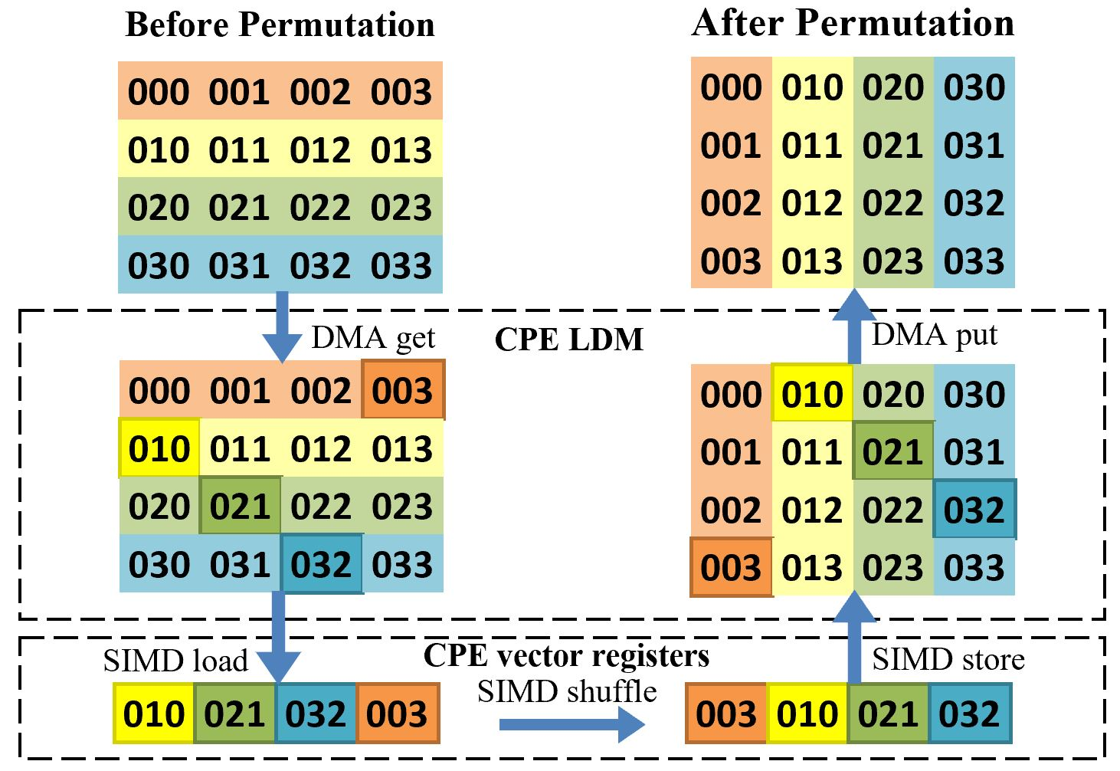
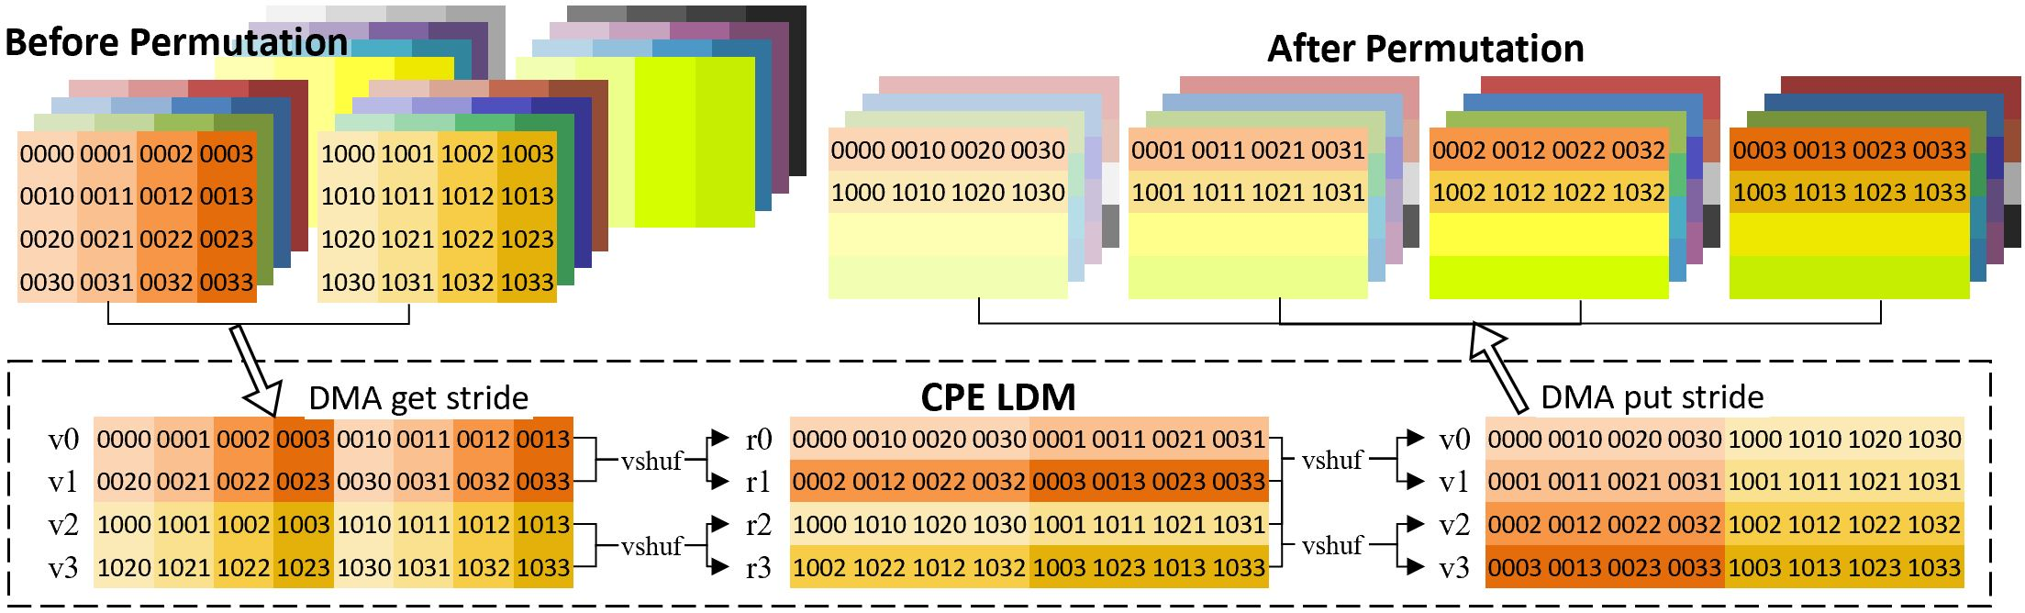
INNOVATION
Thread-level parallelism
The optimizations in high-rank tensor contractions: Tensor permutation optimizations
Continuous permutation
Dispersed permutation
Notes:
In order to improve the efficiency of high-rank tensor contractions, we first reformat the tensor contractions into 2D matrix multiplications using tensor permutation.
According to different dimensions of tensor permutation, we propose two methods Continuous permutation and Dispersed permutation.
For the case of continuous permutation, the essence of optimization is the regular movement of data.
For the case of Dispersed permutation, the essence of optimization is the movement of a piece of dispersed data.
High-dimensional data should be permuted by striding DMA, and low-dimensional data should be permuted by SIMD shuffle instruction on each CPE as much as possible.

Slide 19
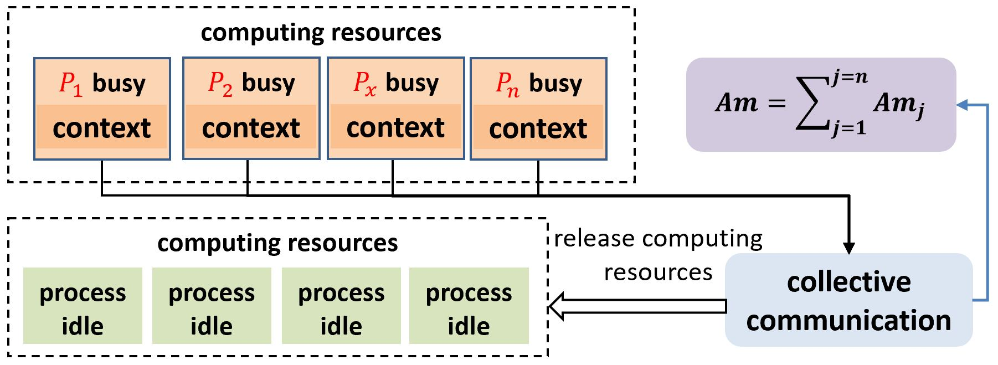
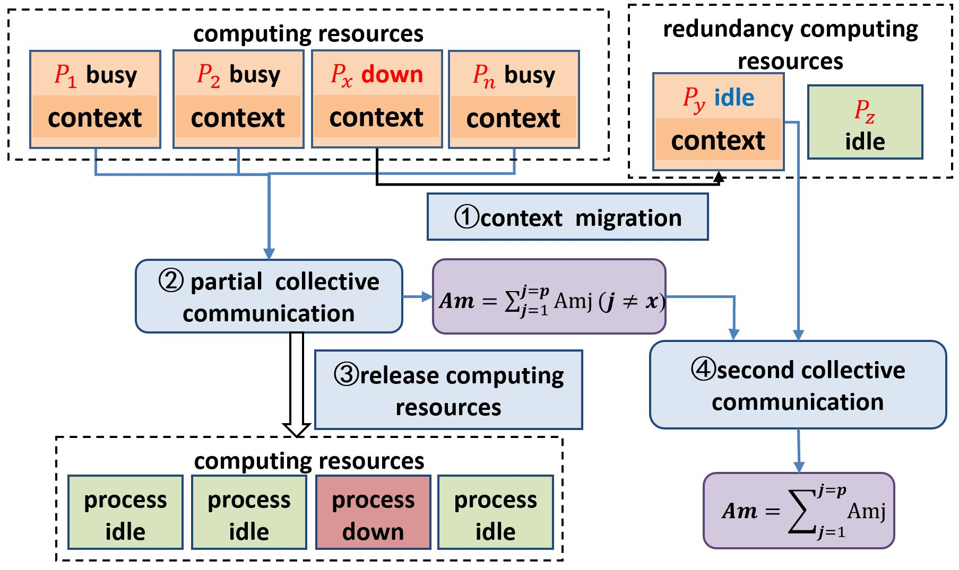
INNOVATION
Fault tolerance and parallel stability
If one node fails, it will be detected by the runtime process and its status will be set to failed in the node status list.
The partial collective communication is based on the healthy nodes, and data of the failed nodes are ignored.
The computing resources of the ending tasks are released.
After the calculation, the simulation result of the migrated task is merged with others by further collective communication.
Notes:
A new job migration and step-by-step collective communication is proposed to improve the long-time calculation stability.
When the SW_Qsim is running, the runtime system of the New Sunway Supercomputer will run a process to detect the node status.
If a node error is detected, the process will migrate the tasks on the node to an idle healthy node through a log-file.
When the tasks of the original healthy nodes end, these parts of calculation results are collected by partial collective communication.
After the migrated tasks end, its simulation result is merged with others by further collective communication.
At this time, the whole simulation result is obtained.
This kind of parallel fault tolerance mechanism enables SW_Qsim to work continuously to get the correct calculation results even if some nodes fail.

Slide 20
Outline of presentation
Introduction
Performance measurement
Significance of the paper
Compared with other simulators
Performance results
Background
Memory requirement
GEMM acceleration on SW26010pro
Tensor permutation acceleration on SW26010pro
Strong scaling and weak scaling results
Quantum Simulation Method
Computing equipment
Innovations
Parallelism
Fault tolerance and parallel
stability
Conclusions
Notes:
ok, so now performance measurement.

Slide 21
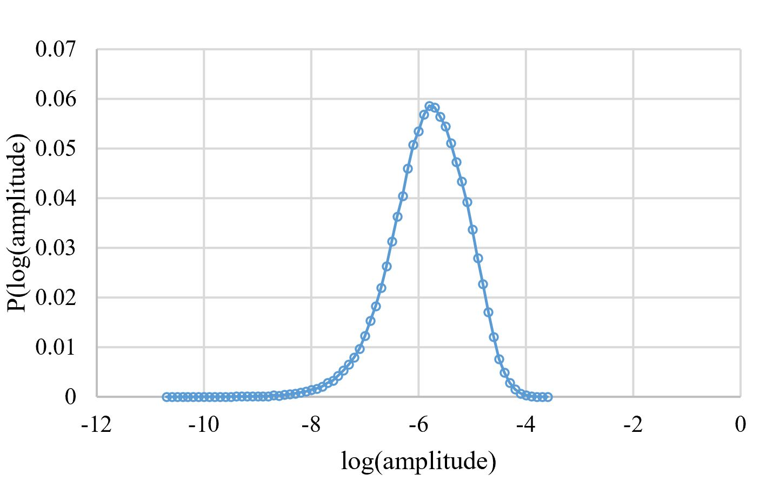
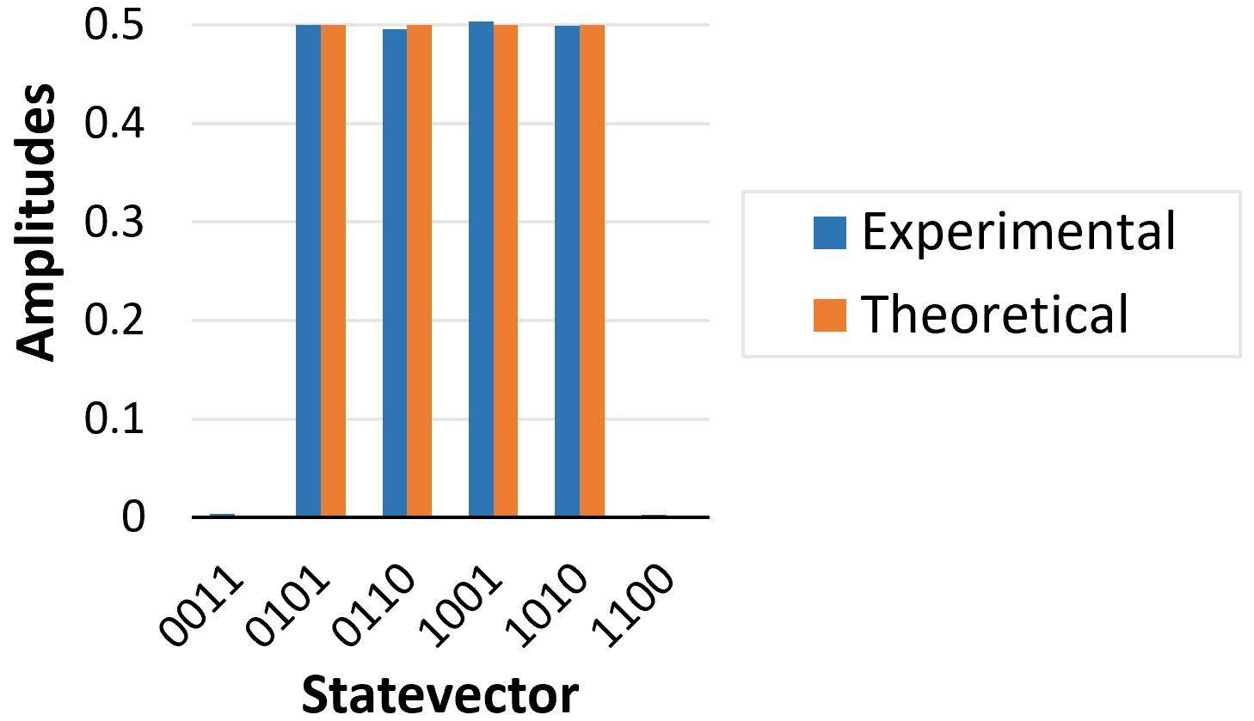
PERFORMANCE MEASUREMENT
20 × 20 × (1 + 8 + 1) scale quantum circuit. The output result conforms to the Porter–Thomas distribution law.
VQE, with a jellium Hamiltonian, and apply it to the four-qubit 𝐻₂ molecule system. The final ansatz state is exactly the same as the reference result.
Notes:
We use Porter–Thomas distribution and a VQE algorithm to validate our quantum simulator.
We have measured 100 thousands amplitudes with a 20 × 20 × (1 + 8 + 1) quantum circuit.
The output result conforms to the Porter–Thomas distribution law.
We apply the Trotter quantum circuit with a Hamiltonian to the four-qubit hydrogen molecule system.
The final state is exactly the same as the reference result.

Slide 22
Outline of presentation
Introduction
Performance measurement
Significance of the paper
Compared with other simulators
Performance results
Background
Memory requirement
GEMM acceleration on SW26010pro
Tensor permutation acceleration on SW26010pro
Strong scaling and weak scaling results
Quantum Simulation Method
Computing equipment
Innovations
Parallelism
Fault tolerance and parallel
stability
Conclusions
Notes:
ok, now performance results.

Slide 23
PERFORMANCE RESULTS
Memory requirement
Contraction Paths | Cut | Max rank of intermediate tensors | Memory of the maximum rank tensor (GB)
Conventional (rows by rows) | 0 | 11 | 131072
plain cuts | 6 | 8 | 32
minimize-memory cuts (Our work) | 6 | 6 | 0.125
Case: 10 × 10 × (1 + 32 + 1) quantum circuit
The memory of the maximum rank tensor with “minimize-memory cut” is reduced by 256 times compared with “plain cuts” algorithm.
Notes:
Take a 10 × 10 × (1 + 32 + 1) quantum circuit as an example,
the memory requirement for our minimized-memory contraction path stands out when comparing to other methods.
The maximum rank of intermediate tensors reduces from 11 to 8, and finally to 6 through the three contraction paths.
Moreover, the memory of the maximum rank tensor is reduced by 256 times compared with “plain cuts” algorithm.

Slide 24
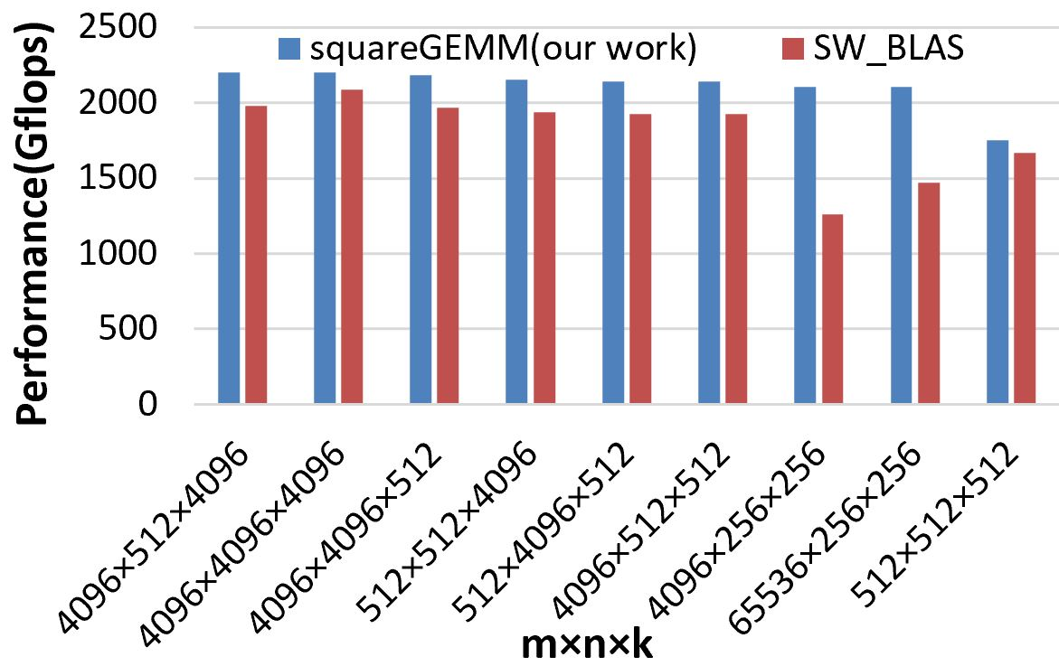
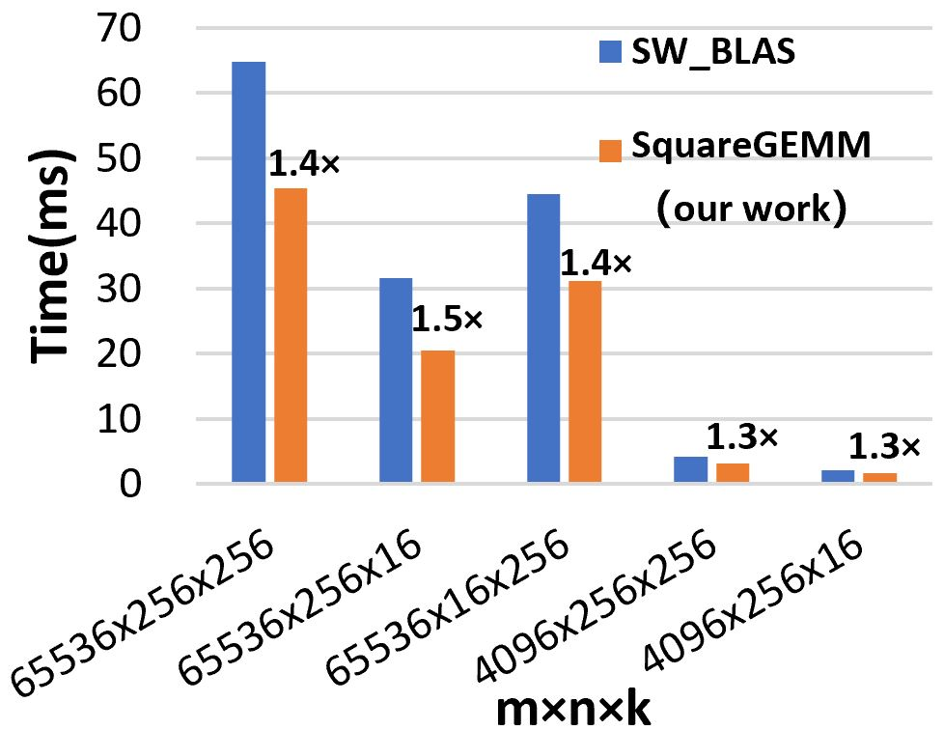
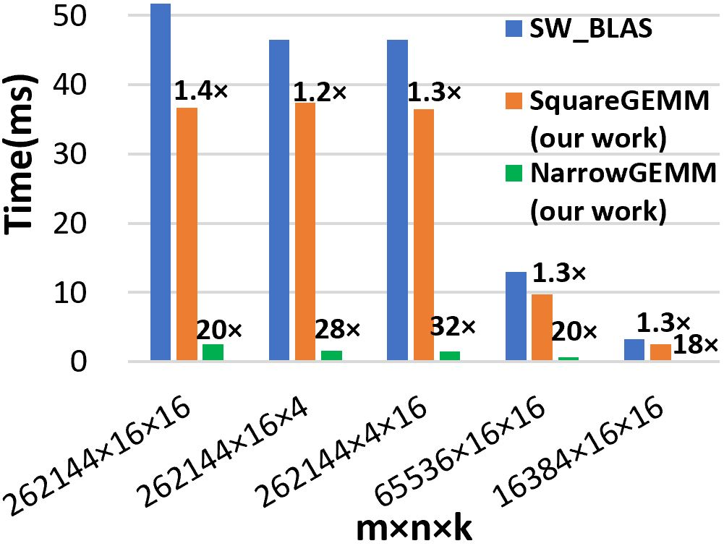
PERFORMANCE RESULTS
GEMM performance on SW26010pro
Circuit:10×10×(1+32+1)
Circuit:20×20×(1+16+1)
the average performance of square-like gemm can deliver 2000 Gflops, and the maximum performance can reach 2200 Gflops, about 94% of peak performance.
the performance of square-like gemm is 30%-50% higher than SW_BLAS. And narrow gemm is 20 times better than SW_BLAS on average.
Notes:
the average performance of our square-like gemm can deliver 2000 Gflops
and the maximum performance can reach 2200 Gflops, about 94% of peak performance.
In RQC 10 × 10 × (1 + 32 + 1) and 20 × 20 × (1 + 16 + 1), the performance of square-like gemm is 30%-50% higher than that of SW_BLAS.
The performance of narrow gemm is 20 times better than SW_BLAS on average.

Slide 25
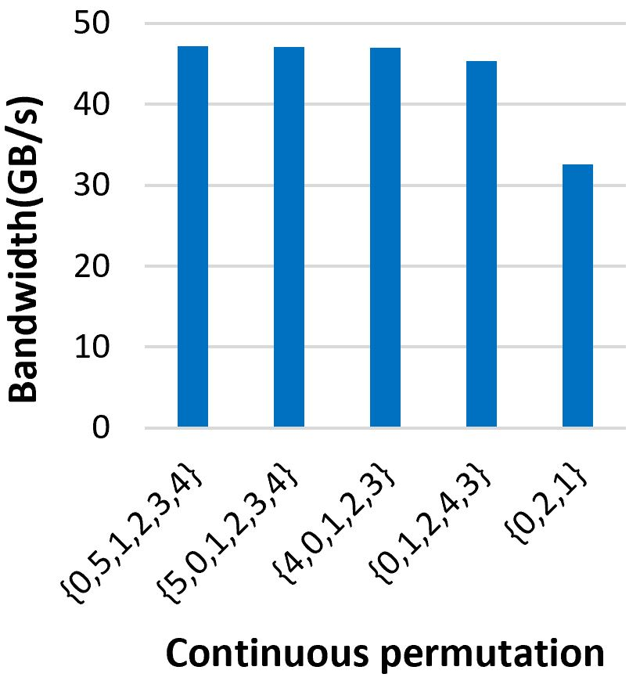
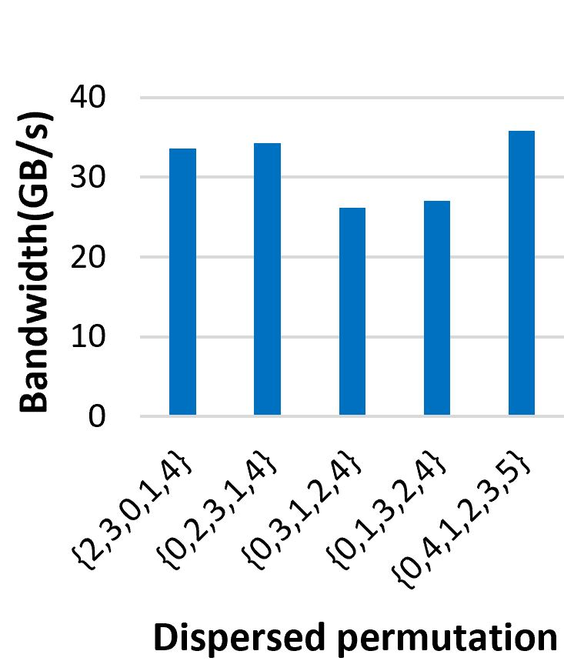
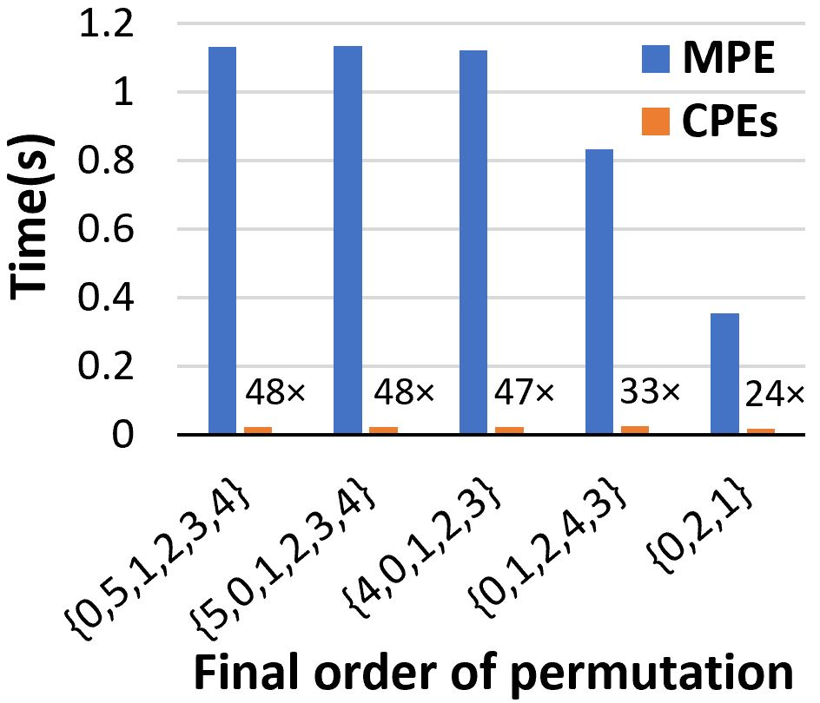
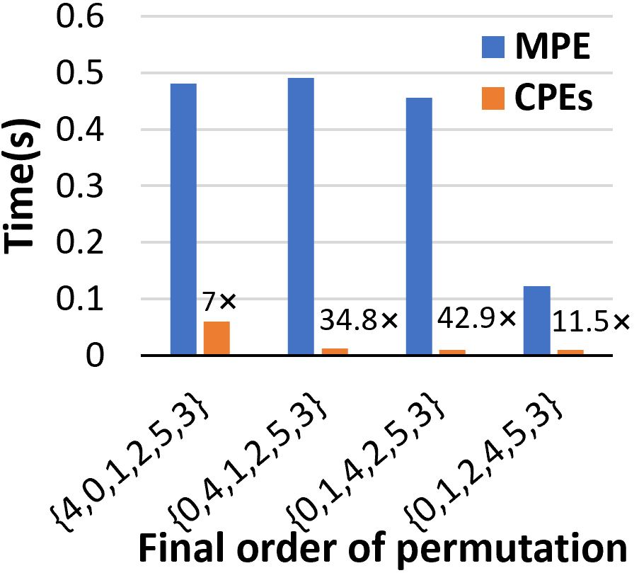
PERFORMANCE RESULTS
Tensor permutation acceleration on SW26010pro
Continuous
Dispersed
The performance of continuous tensor permutation is over 40GB/s (about 80% of the theoretical value). The performance of dispersed tensor permutation is over 30GB/s.
For the continuous permutation, the acceleration of one CG to one MPE is about 20-48 times. For the dispersed permutation, the acceleration is 7-43 times.
Notes:
The performance of continuous and dispersed tensor permutation is over 40GB/s and 30GB/s respectively .
As for the acceleration of one CG to one MPE, continuous permutation is about 20 to 48 times
dispersed permutation is 7 to 43 times.

Slide 26
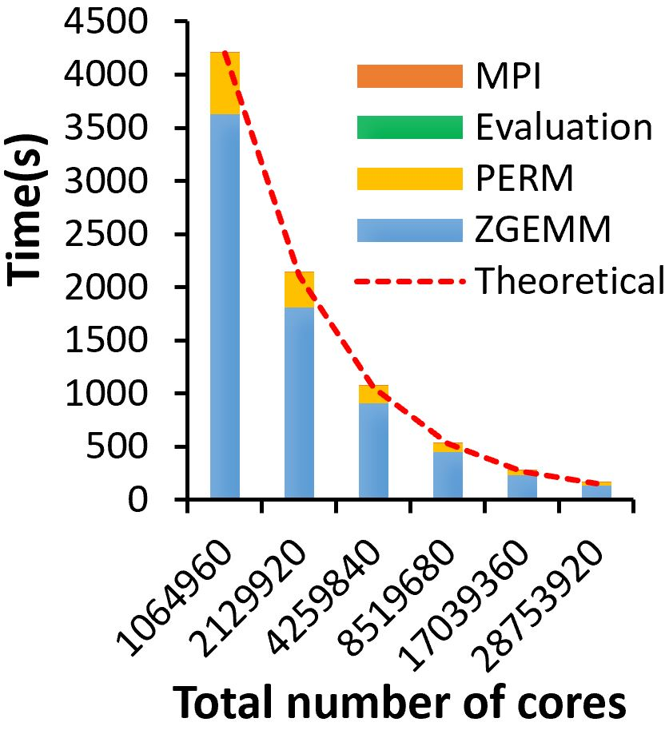
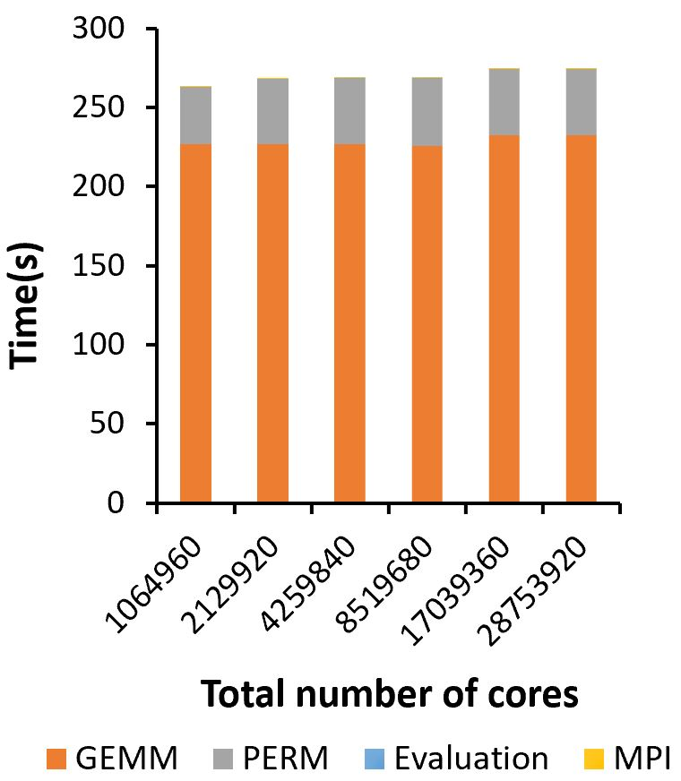
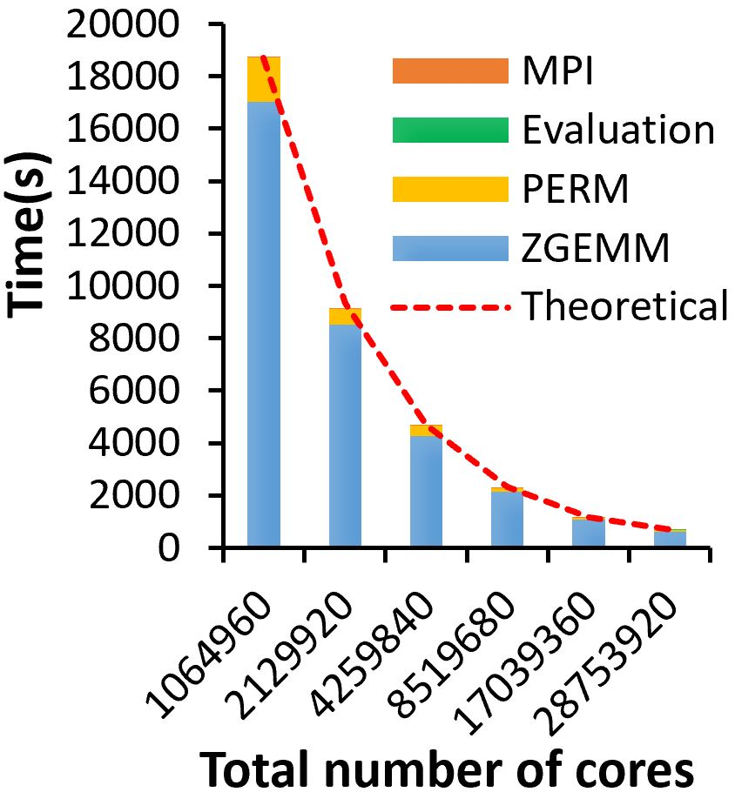
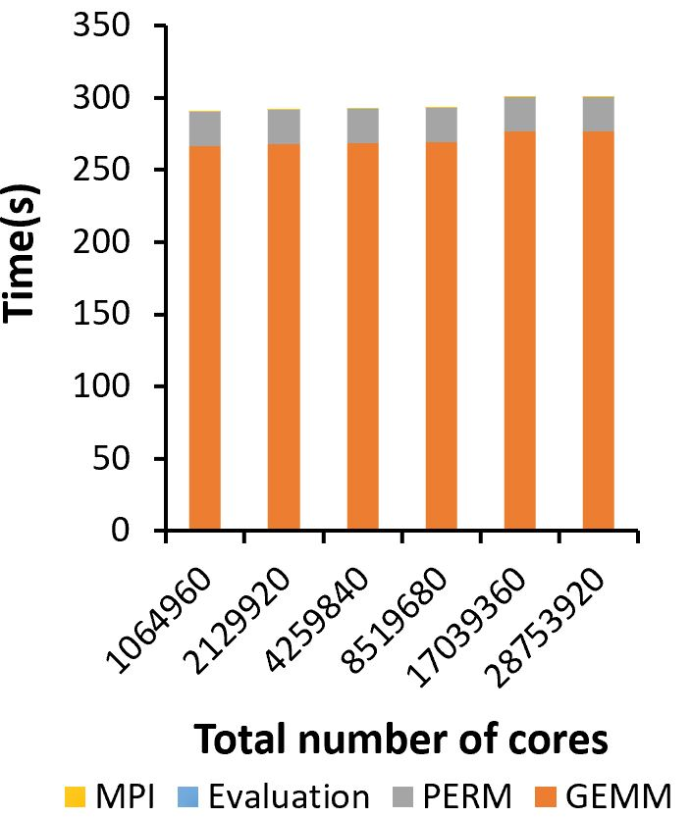
PERFORMANCE RESULTS
Strong scaling and weak scaling results
Circuit:10×10×(1+32+1)
Circuit:20×20×(1+16+1)
Strong scaling
Weak scaling
Strong scaling
Weak scaling
Scaling from 1,064,960 cores to 28,753,920 cores, the parallel efficiency maintains over 95%.
Notes:
We record the total simulation time of two RQCs 100-bits 32-depth and 400-bits 16-depth. For both strong scaling and weak scaling test, over 95% parallel efficiency is achieved with up to 28.75 million cores.

Slide 27
Outline of presentation
Introduction
Performance measurement
Significance of the paper
Compared with other simulators
Performance results
Background
Memory requirement
GEMM acceleration on SW26010pro
Tensor permutation acceleration on SW26010pro
Strong scaling and weak scaling results
Quantum Simulation Method
Computing equipment
Innovations
Parallelism
Fault tolerance and parallel
stability
Conclusions
Notes:
Now Some summary

Slide 28
CONCLUSIONS
We propose SW_Qsim, a minimize-memory quantum simulator with high-performance on a New Sunway Supercomputer.
SW_Qsim can perform simulations of random circuits of up to 100 and 400 qubits, and can achieve linear strong and weak scaling up to 28.75 million cores.
In future work, we will add support to emulate the effects of noise, and expand the applications of the present simulator to other fields such as quantum machine learning.
Notes:
In this work, we propose SW_Qsim, a minimize-memory quantum simulator with high-performance on a New Sunway Supercomputer.
SW_Qsim can perform simulations of random circuits up to 100 and 400 qubits.
And it can achieve linear strong scaling and weak scaling up to 28.75 million cores.
In future work, we will add support to emulate the effects of noise,
and expand the present simulator to other fields such as quantum machine learning.

Slide 29
Thanks for listening!

Slide 30


INTRODUCTION
Our team member:
National Supercompuer Center of China:
Fang Li
Xin Liu
Yong Liu
Pengpeng Zhao
Tsinghua University:
Dexun Chen
Yuling Yang
Weizhe Sun
Zhen Wang
Enming Dong
SKL of Computer Architecture, Institute of Computing Technology, Chinese Academy of Sciences:
Honghui Shang

