Slide 1




Whale: Efficient Distributed Stream Processing using RDMA-assisted One-to-Many Data Partition
Jie Tan, Hanhua Chen, Yonghui Wang, Hai Jin
National Engineering Research Center for Big Data Technology and System
Services Computing Technology and System Lab
Cluster and Grid Computing Lab
School of Computer Science and Technology
Huazhong University of Science and Technology
Notes:
Good afternoon everyone. I am Tan Jie, a master student from Huazhong University of Science and Technology. I am very glad to report our paper - Whale a novel RDMA-assisted distributed stream processing system with efficient one-to-many data partitioning.

Slide 2



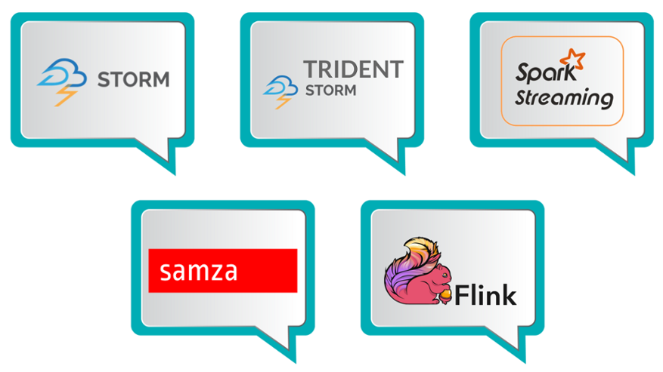

Stream processing system scenario
Data Streams
  Continuous arrive at high speed
  Large amount of streaming data
Transmission
  Lightweight stream data
  Large amount of data
Stream Applications
  Twitter detects hot events
  On-demand ride-hailing platforms
  Real-time system logs analyzing
Application Characteristics
  Low-latency
  High-throughput
Stream Processing System
  Spark Streaming、Storm、Flink、Samza、Heron、DStream
Notes:
Existing real-time stream processing systems are widely used in big data scenarios. The data stream continues to arrive at a high speed, and large amounts of streaming data needs to be processed in a short time. The data transmission is lightweight, and a lot of streaming data need to transfer. Existing stream processing applications are Twitter detects hot events, on-demand ride-hailing platforms, and Real-time system logs analyzing. These streaming processing applications have high-throughput and low-latency.

Slide 3
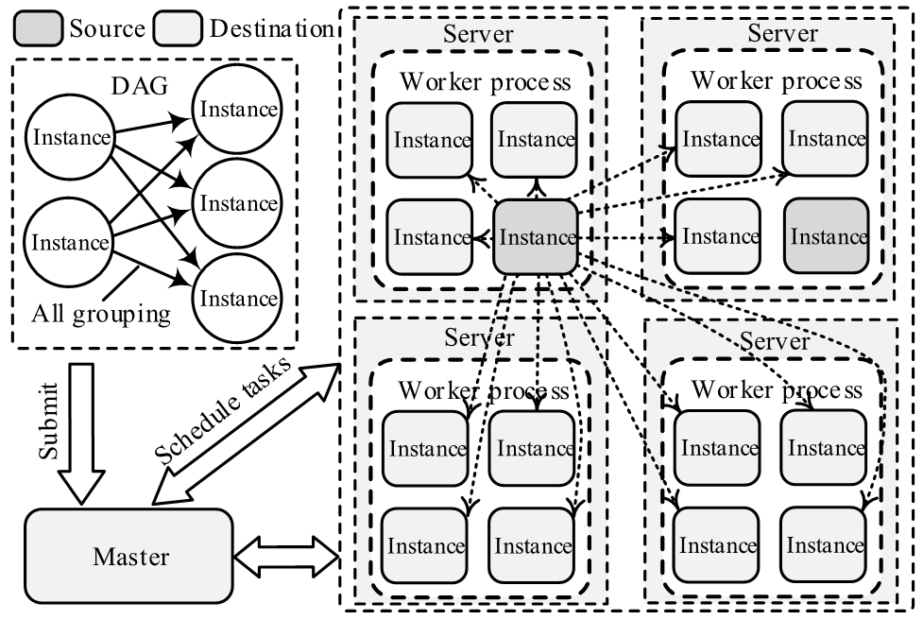
Existing stream processing system^{[1][2][3]}
Instance-oriented communication
Pipeline parallelism
  DAG Topology
Data parallelism
[1] A. Toshniwal, S. Taneja, A. Shukla, K. Ramasamy, J. M. Patel, S. Kulkarni, J. Jackson, K. Gade, M. Fu, J. Donham, N. Bhagat, S. Mittal, and D. V. Ryaboy, “Storm@twitter,” in Proceedings of SIGMOD, 2014.
[2] S. Kulkarni, N. Bhagat, M. Fu, V. Kedigehalli, C. Kellogg, S. Mittal, J. M. Patel, K. Ramasamy, and S. Taneja, “Twitter heron: Stream processing at scale,” in Proceedings of SIGMOD, 2015.
[3] P. Carbone, A. Katsifodimos, S. Ewen, V. Markl, S. Haridi, and K. Tzoumas, “Apache flinkTM: Stream and batch processing in a single engine,” IEEE Data Eng. Bull., vol. 38, no. 4, pp. 28–38, 2015.
Notes:
A distributed stream processing system models a stream application as a DAG and deploys an application topology on a cluster to achieve pipeline parallelism. It further generates multiple instances for a processing element to exploit data parallelism, and thus an upstream instance can partition workloads among different downstream instances.

Slide 4
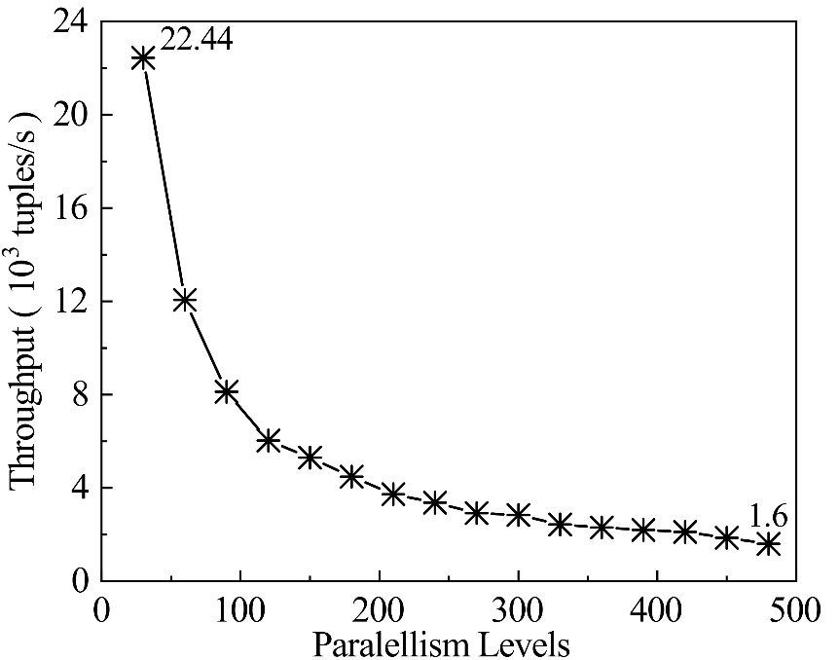
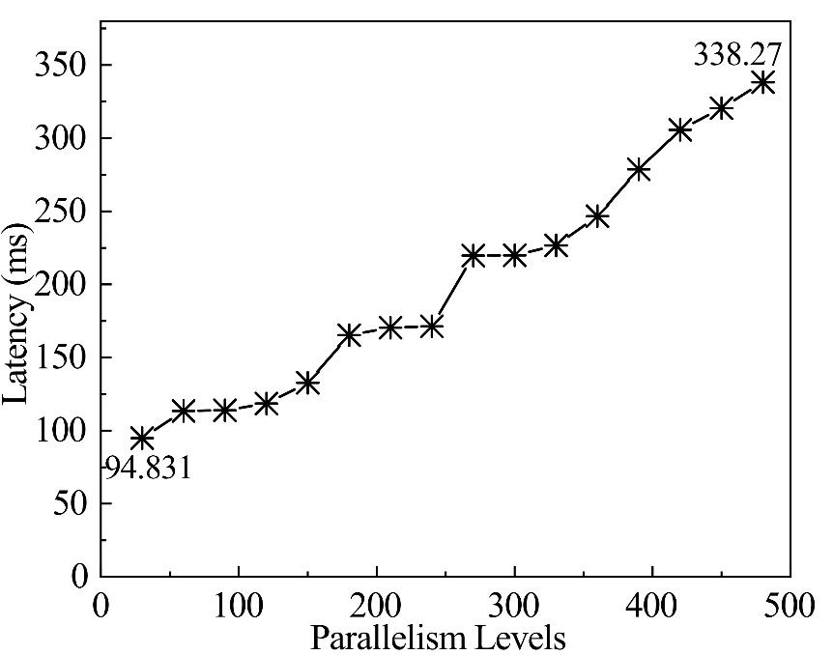
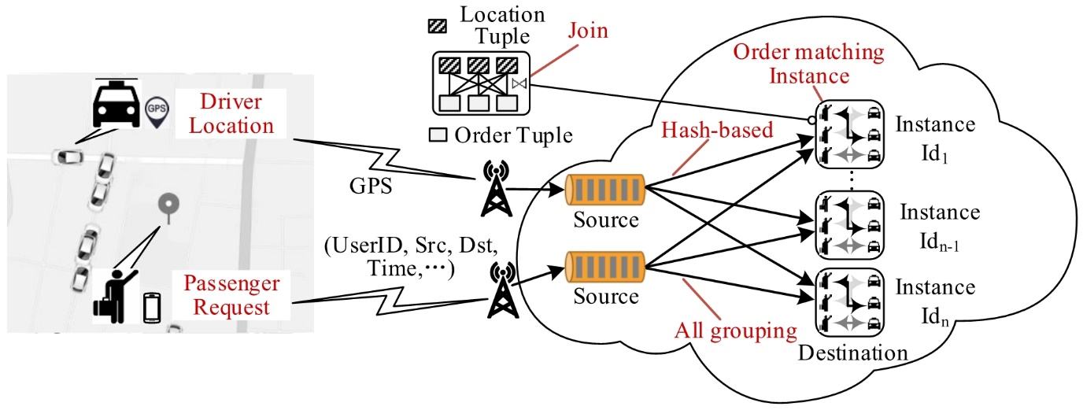
Experimental Analysis
▲Throughput with different parallelism levels
▲Processing latency with different parallelism levels
▲An on-demand ride-hailing system
Notes:
We examine the performance of the all grouping strategy which leverages one-to-many data partitioning. We emulate an on-demand ride-hailing application system atop Apache Storm, a popular distributed stream processing system. We use the dataset collected from Didi, the most popular on-demand ride-hailing platform in China. In the experiment, we adjust the parallelism level (i.e., the number of matching instances) and examine the system performance. The left figure shows the system throughput decreases as the parallelism level increases, while the right figure shows the rapid rise of the processing latency. The results show a striking performance degradation of one-to-many data partitioning.

Slide 5
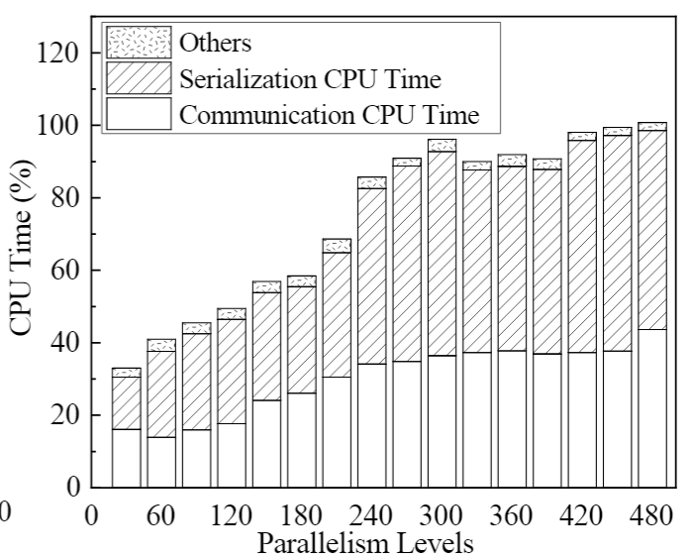
Experimental Analysis
▲Breakdown CPU time of upstream instance
Notes:
We further examine the CPU utilization of both the upstream and downstream instances. We break down the CPU time of the upstream instance. The figure shows that two kinds of workloads dominate the CPU time, tuple serialization and packet processing with multi-layer network protocol during tuple transmission. Such CPU overload inspires the opportunity of exploiting the zero-copy (RDMA) network, whose kernel-bypass feature has the potentials to save the cost for kernel data copying and context switching in OS.

Slide 6
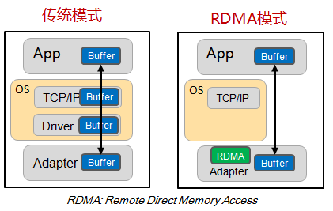
One-to-many stream partitioning
Multiple serialization and redundant data transmissions
  Serialize a tuple multiple times
  Intensively movement of the packets between user space and kernel space
Source multicast processing latency high
  Transfer the packets to each downstream instance in [O(N)]
  Communicate frequently to destination instances and causes high waiting processing time.
task
item
tuple
worker
send
worker
task
task
transfer
transfer
task
thread
thread
Serialization
  TCP/IP
task
Deserialization
Distributed Stream Processing System
Notes:
Through analysis, we find that the existing one-to-many data partitioning strategy has the following two main problems. First，multiple serialization and redundant data transmissions. Existing one-to-many data partitioning strategy needs to serialize a tuple multiple times. Streaming data packet will perform intensive data movement in user space and kernel space
Second，the source multicast processing latency is too high. The source instance need to transfer the packets to each downstream instance in [O(N)]. The source instance communicates frequently to destination instances, and it will cause high waiting processing time. These two problems end up causing heavy CPU workloads of source instance.

Slide 7
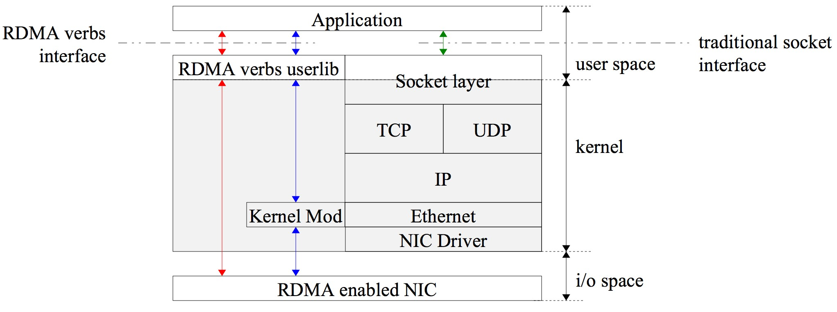
Remote direct memory access
Feature
  Kernel-by-Pass
  Zero-copy
  CPU offload
Performance
  High-throughput
  Low-latency
Notes:
RDMA is an efficient remote memory access technology, whose zero-copy and kernel bypass characteristics can effectively save CPU resource during remote memory access

Slide 8
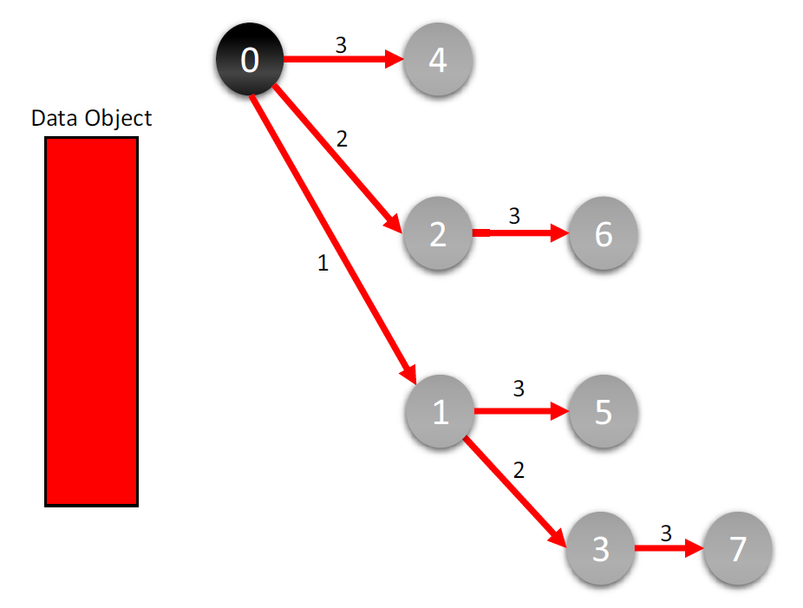
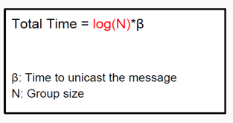
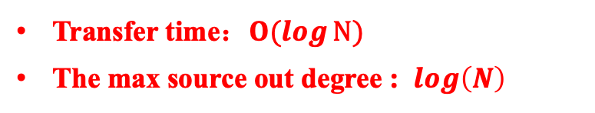
RDMC: A Reliable RDMA Multicast for Large Objects^{[1]}
Source node : S
Worker set : {w₁, w₂,…,w_{n}}
Each worker has bandwidth :{b₁, b₂, …, b_{n}}
Transfer File Size : F
Transfer Time Unit: 1tick （transfer a single large object）
Transfer time：$O(log{N})$
The max source out degree : $\log\left(N\right)$
[1] J. Behrens, S. Jha, K. Birman, and E. Tremel, “Rdmc: A reliable rdma multicast for large objects,” in Proceedings of DSN, 2018.
Notes:
Recently, Behrens et al. propose a RDMC for one-to-many large object transmission with RDMA network, where the sender splits a large object into multiple data blocks. The system organizes all the receivers as a static binomial tree structure and uses a relaying pattern to reduce the transmission latency. However, such a design is not suitable for one-to-many data partitioning in stream processing. It can suffer from blocking the transfer queue in the presence of dynamic streams.

Slide 9
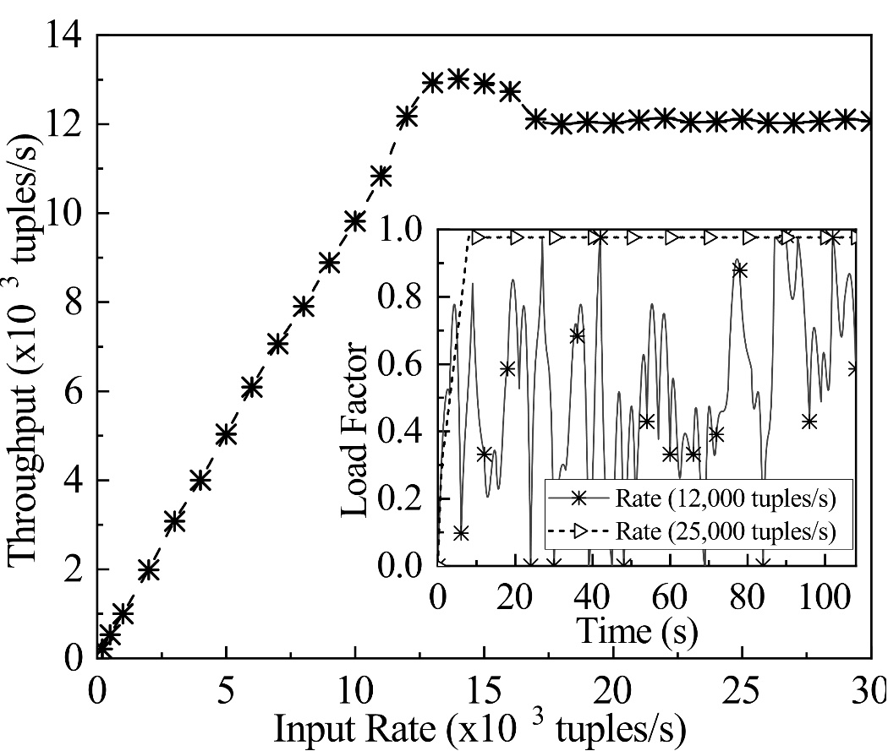
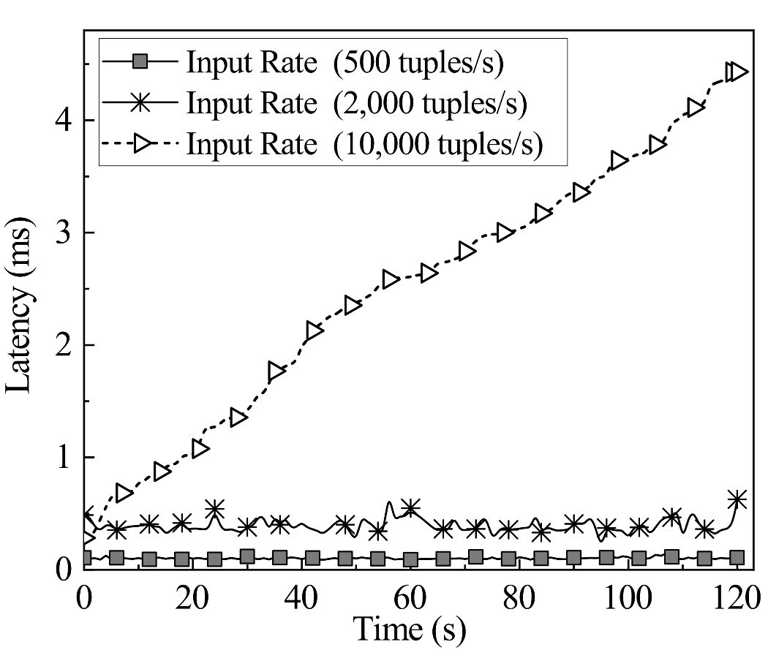
Performance bottleneck in RDMC
▲Throughput and load factor with different input rates
▲Processing latency with different input rates
Notes:
We examine the performance of RDMC on our 30-node emulation system by setting up the Mellanox InfiniBand FDR 56 Gbps RDMA network. In the examination, we create 480 matching instances and dynamically adjust the stream input rate according to the results by Mai et al. Figure1 shows that the system throughput first increases with the input rate, then stops increasing when stream input rate > 12,000 tuples/s, and starts to decrease when stream input rate > 14,000 tuples/s. Figure2 shows that the processing latency increases when stream input rate > 10,000 tuples/s. We can clearly see the blocking of the transfer queue when stream input rate = 25,000 tuples/s in the mini figure. However, we find sufficient computing resources for downstream instances. This demonstrates RDMC cannot support efficient one-to-many data partitioning for processing dynamic streams.

Slide 10
RDMA-assisted one-to-many stream partitioning
Kernel-by-pass with RDMA hardware
RDMA-assisted Non-blocking multicast tree
Reduce the data transfer time by controlling the number of cascaded instances
Build a non-blocking multicast tree to minimize multicast processing latency
▲ The number of cascaded Source instances is 7, and the complexity of broadcast time is O(N).
▲ The number of cascaded Source instances is 2, and the broadcast time complexity is O(log₂N)
Notes:
In this work, we propose Whale, a novel efficient RDMA-assisted one-to-many stream data partitioning design. Whale designs a novel self-adjusting non-blocking tree structure, which prevents the transfer queue of an instance from blocking due to stream dynamics. In addition, Whale designs and implements a new worker-oriented communication mechanism which replaces the instance-oriented design in previous DSPSs and significantly reduces the CPU overhead for serialization and communications.

Slide 11
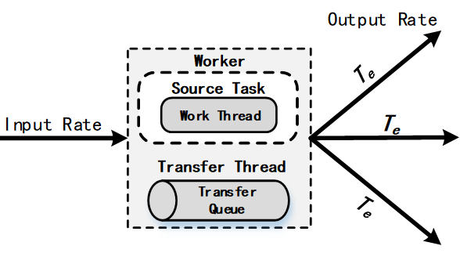
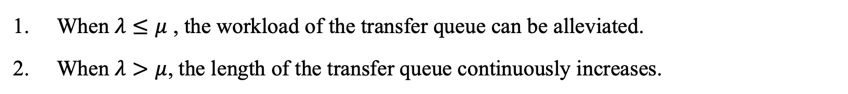
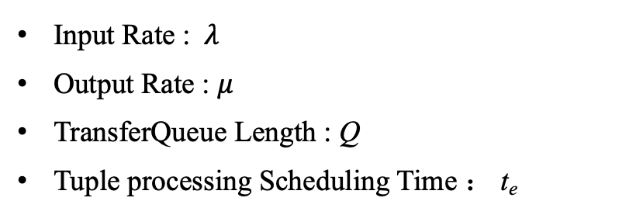
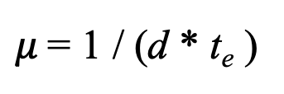
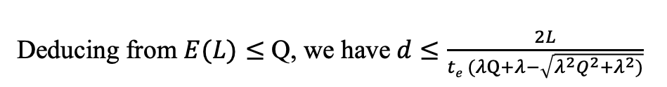
Determine the max d in stream multicast model
Input Rate : $λ$
Output Rate : $μ$
TransferQueue Length : Q
Tuple processing Scheduling Time ： t_{e}
Input Rate
M/D/1 Queue Model
The stream input rate following the poisson process
Time
the average queue length：
processing rate：
$μ$= 1 / (d * t_{e} )
When $λ≤μ$ , the workload of the transfer queue can be alleviated.
When $λ>μ$, the length of the transfer queue continuously increases.
Deducing from $E(L)≤$ Q, we have$d≤\frac{2L}{te (λQ+λ−\sqrt{λ^{2}Q^{2}+λ^{2})}}$
Notes:
As the stream tuples arrive randomly with an unpredictable rate, we analyze the dynamic system with the queuing theory and formally model the process as an M/D/1 system. Let lambda denote the stream input rate at the source instance. With an out-degree of d_0, the source S needs to generate d_0 replicas and send them to the corresponding RDMA channels. Each replica has a processing time of t_e. Thus, the processing rate $\mu$ of the source instance can be computed by Eq.1),
The average queue length of $S$ can be computed by Eq.2,
When \lambda$ <= $\mu, the workload of the transfer queue can be alleviated and the out-degree of $S$ can be increased. When $\lambda > $\mu, the length of the transfer queue continuously increases. To prevent the transfer queue from blocking, Whale decreases the out-degree of $S$ to increase the processing rate. Formally, we need to ensure that the average queue length of the source instance is not greater than its maximum capacity $Q$. Deducing from $ E(L) <= Q$, we have

Slide 12
Non-blocking multicast tree
The maximum out-degree of source instance ：d*=2
Destination instance sets: {t₁, t₂,…,t_{n}}
Container Set
S
Notes:
Whale also designs a non-blocking multicast tree which restricts a binomial multicast tree with the maximum out-degree of source instance $d^*$. Whale dynamically adjusts $d^*$ to prevent the system from blocking. The non-blocking multicast tree has multiple logic layers.
Figure1 shows an example for constructing a non-blocking multicast tree with the total instance $|T|=7$ and $d^*=2$. For simplicity, we use $T_{i-j}$ to denote the $j$th instance on the $i$th logical layer. Initially, the structure only contains $S$. The first logical layer contains only $T_{1-1}$, which is the directly cascading instance of $S$. On the second logical layer, $S$ connects to one instance, $T_{2-1}$, while $T_{1-1}$ connects to $T_{2-2}$. If the out-degree of an instance on the multicast tree reaches $d^*=2$, it cannot connect to any new instances remaining in $T$. For example, when constructing the third logical layer, if $S$ connects to one more instance, the out-degree of $S$ will exceed $d^*=2$. Thus, Whale lets $T_{1-1}$ connect to a new instance, denoted as $T_{3-1}$. In the same way, $T_{2-1}$ connects to $T_{3-2}$; $T_{2-2}$ connects to $T_{3-3}$. On the fourth logical layer, $T_{2-1}$ connects to $T_{4-1}$.
Figure2 also illustrates the stream multicast procedure based on the constructed multicast tree. In the first time unit, $S$ sends the tuple $tuple_1$ to the instance $T_{1-1}$. In the second time unit, $S$ and $T_{1-1}$ send $tuple_1$ to $T_{2-1}$ and $T_{2-2}$, respectively. In the third time unit, $tuple_2$ arrives and $S$ starts to send $tuple_2$ to $T_{1-1}$. Meanwhile, $T_{1-1}$ sends $t_1$ to $T_{3-1}$; $T_{2-1}$ sends $tuple_1$ to $T_{3-2}$; and $T_{2-2}$ sends $tuple_1$ to $T_{3-3}$. In the fourth time unit, $S$ sends $tuple_2$ to $T_{2-1}$; $T_{1-1}$ sends $tuple_2$ to $T_{2-2}$; and $T_{2-1}$ sends $tuple_1$ to $T_{4-1}$. Thus, Whale completes the multicast of $tuple_1$.

Slide 13
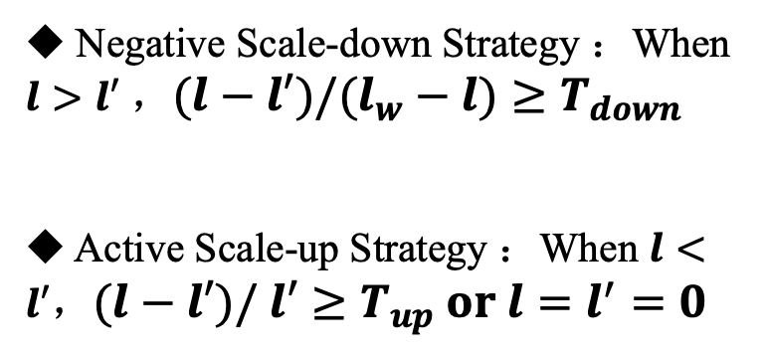
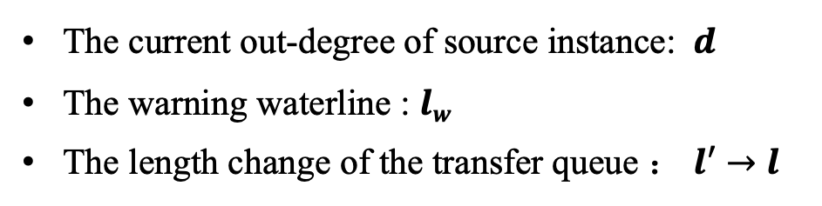


Queue-based self-adjusting mechanism
The current out-degree of source instance: $d$
The warning waterline : $lw$
The length change of the transfer queue ： $l′→l$
Negative Scale-down Strategy ：When $l>l′$ ，$(l−l′)/(l_{w}−l)≥T_{down}$
Active Scale-up Strategy ：When $l<l′$，$(l−l′)/ l′≥T_{up} or l=l^{′}=0$
80%
80%
$$l$$
$$l′$$
d_{n-1}
d_{n} ?
Notes:
To cope with stream dynamics, we model the transfer queue of $S$ as a pool with a floor drain at the bottom. The stream continuously pours data into the pool, while the floor drain (dream) releases data at the bottom. If the input rate is higher than the output rate, the waterline rises. On the contrary, it declines. For dynamic input rate, we can prevent the pool from becoming full by adjusting the output rate.
Similarly, Whale prevents the amount of waiting tuples from exceeding the maximum capacity of the transfer queue $Q$. Whale sets a warning waterline $l_w$ and periodically monitors the current workloads of the transfer queue at each time interval in $\Delta t$. When the monitor detects that the waterline rises and exceeds the warning line $l_w$, Whale adjusts the current multicast structure by decreasing the out-degree of $S$ instance to increase the processing rate. We call such a strategy as \emph{negative scale-down}. On the contrary, if the monitor detects that the waterline drops rapidly under $l_w$, Whale adopts an \emph{active scale-up} strategy to increase the out-degree of $S$. Besides, Whale can determine $d^*$ according to the stream input rate $\lambda$. We use the notation $l^{'} \to l$ to denote the length change of the transfer queue from $l^{'}$ to $l$. Whale determines whether to adjust the multicast structure or not based on the following rules.

Slide 14
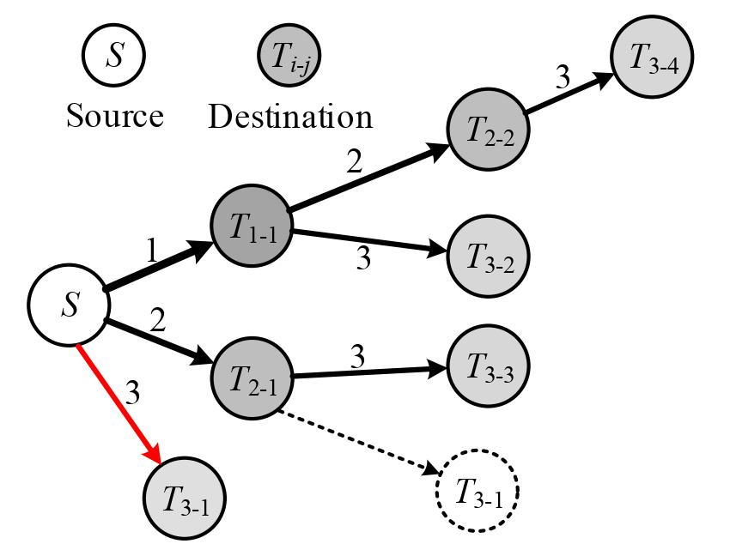
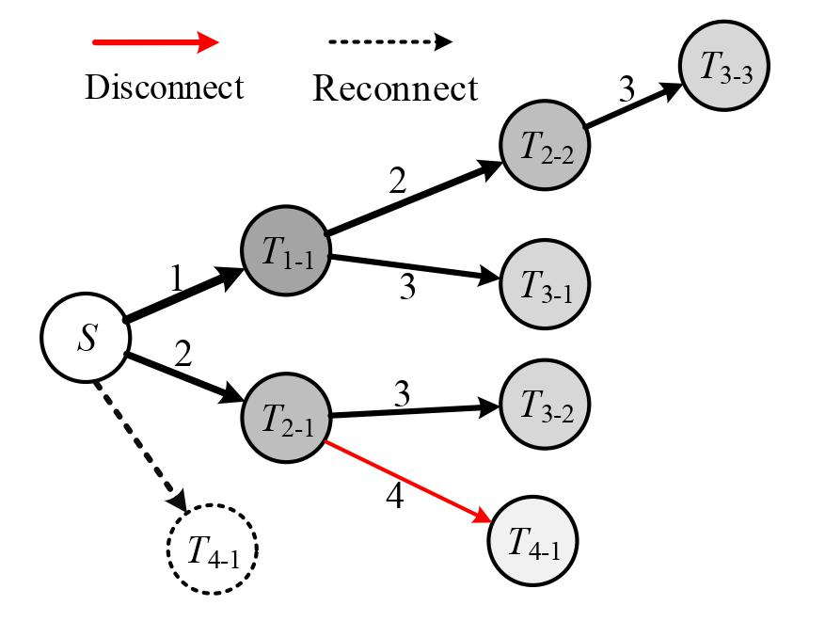
Stream multicast dynamic switching mechanism
Negative scale-down dynamic switch
Active scale-up dynamic switch
The maximum output of a non-blocking multicast tree changed from 3 to 2.
The maximum output degree of non-blocking multicast tree changed from 2 to 3
Notes:
Whale dynamically adjusts the multicast structure according to the current maximum out-degree of instance $d^*$. It can rapidly reorganize the positions of the destination instances to adapt to a new maximum out-degree $d^*$ based on the current multicast structure. Specifically, Whale dynamically reorganizes the partial destination instances by disconnecting certain connections and establishing new connections based on the current multicast structure without significant change.
Figure show two examples of the dynamic switching strategies. In the example of the dynamic switching mechanism for negative scale-down (Fig. 8a), 𝑑∗ changes from three to two. The algorithm traverses the multicast tree from 𝑆 to the third layer and marks the instances which need to be adjusted. In this example, 𝑑∗ is larger than two. Thus, Whale collects 𝑇3−1 and re-assigns it. Finally, 𝑇3−1
connects to 𝑇2−1 whose out-degree is less than 𝑑∗. Specifically, 𝑇3−1 disconnects from 𝑆 and re-connects to 𝑇2−1.
Right figure shows an example of dynamic switching for active scaleup, where 𝑑∗ changes from two to three. The algorithm（哦个瑞整） traverses the multicast tree from the fourth layer to 𝑆. Thus, Whale collects 𝑇4−1
and re-assigns it. Finally, 𝑇4−1 disconnects from 𝑇2−1 and connects to 𝑆 because the out-degree of 𝑆 is less than 𝑑∗ (𝑑∗ = 3)

Slide 15
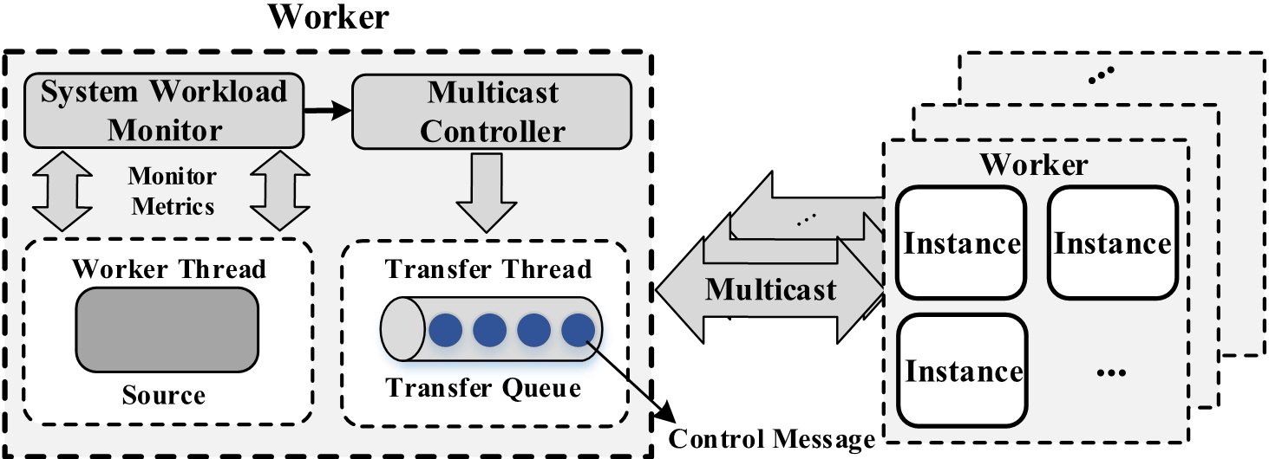
Stream multicast dynamic switching mechanism
Control Message
  Stream Multicast Dynamic Switching Strategy (Negative Scale-down & Active Scale-up)
  Control Configuration (inform destination instances to disconnect or establish a new connection for reorganizing the structure)
Multicast Controller
  It monitors the workloads of the transfer queue and determines the stream multicast structure adjustment.
Notes:
This figure shows the dynamic switching mechanism of Whale's non-blocking multicast structure. The system workload monitor monitors the workloads of the transfer queue while the multicast controller determines the structure adjustment. When determining to adjust, the ControlMessage is generated and multicast to all the destination instances. The ControlMessage contains the current status ({negative scale-down} or {active scale-up}) and the control configuration, which is used to inform destination instances to disconnect or establish a new connection for reorganizing the structure.
A relay instance stores the structure of the multicast tree with ControlMessage and obtains its direct cascading instances from the structure.

Slide 16
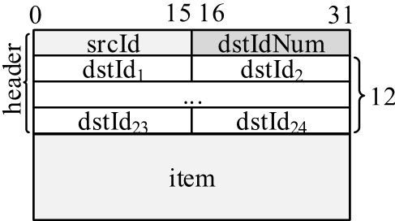
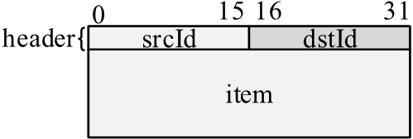
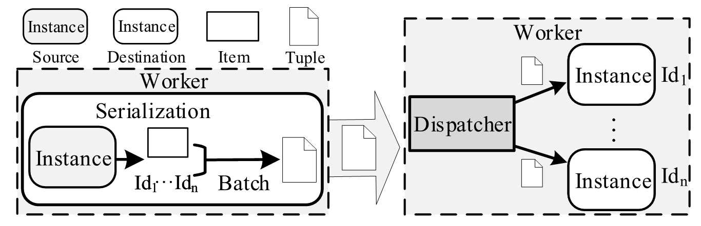
Worker-oriented communication mechanism
▲Tuple format in Storm
▲Tuple format in Whale
▲Worker-oriented communication mechanism
Batch & Dispatcher Component：
  Encapsulate and distribute WorkerMessage messages
  Reduce the cost of CPU serialization and solve the problem of multiple CPU serialization
Notes:
Whale proposes a new worker-oriented communication mechanism. For one-to-many data partitioning, the source instance sends a tuple to the worker process hosting multiple instances instead of separately sending to the instances. Figure illustrates the worker-oriented communication mechanism. The \emph{batch} component generates \emph{BatchTuple}. Then, the \emph{batch} component serializes the data item and packages the serialized data item with the IDs into a \emph{WorkerMessage}. In the destination worker, the \emph{dispatcher} component receives the \emph{WorkerMessage} from the source instance, deserializes the data item and obtains the ID of the destination instances, and dispatches the data item locally to the destination instances according to the obtained IDs.

Slide 17
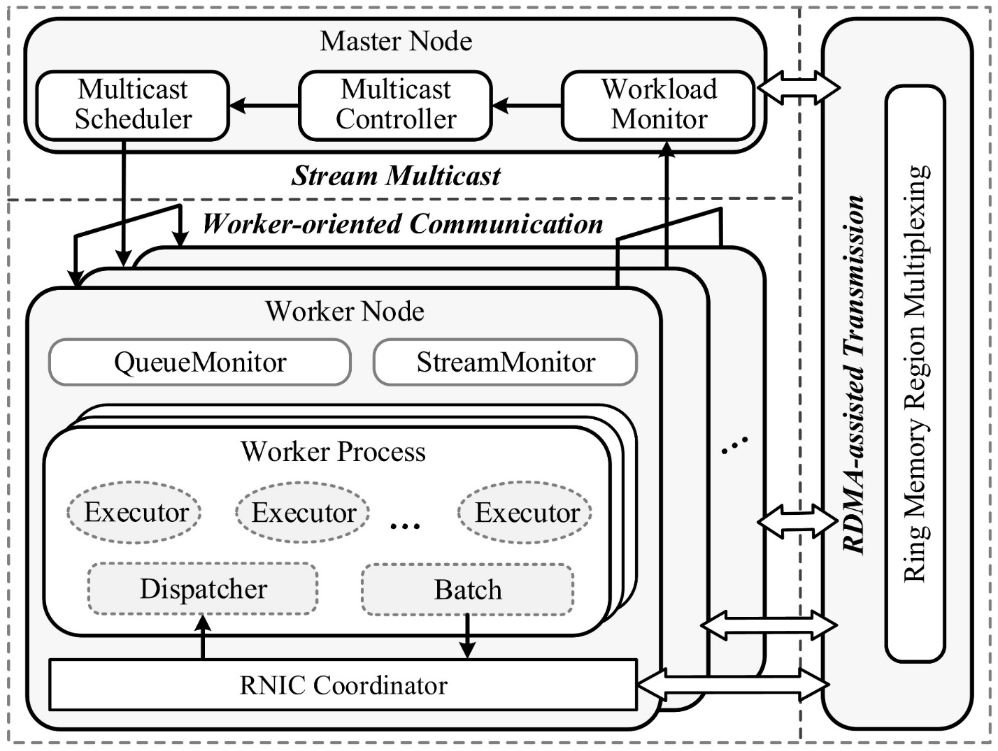
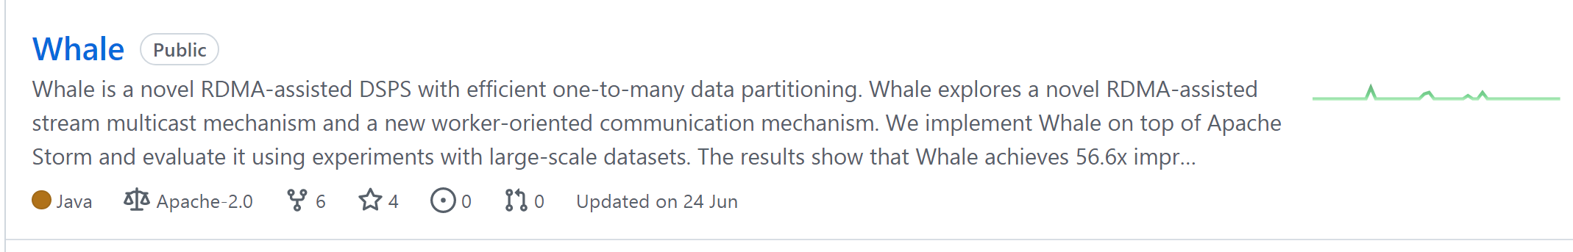
System architecture
https://github.com/CGCL-codes/Whale
Notes:
Based on the above design, we designed and implemented a distributed stream multicast system Whale based on RDMA. The structure of the system is shown in the figure. We make the source code of Whale publicly available.
Figure shows the architecture（啊可太true） of Whale, which includes two main components, stream multicast and worker-oriented communication. The stream multicast component fully exploits the zero-copy
RDMA network to efficiently process highly dynamic streams.
In the stream multicast component, Whale constructs the proposed efficient non-blocking multicast tree structure to support efficient one-to-many data partitioning. The system can dynamically adjust the structure to copy with stream dynamics. Specially, the stream multicast scheduler chooses the maximum out-degree of the non-blocking multicast tree structure for the incoming stream and minimizes the average multicast latency. The system workload monitor periodically monitors the current workloads of the source instance while the multicast controller adjusts the multicast structure accordingly. The worker-oriented communication component addresses at reducing the redundant serialization and communication. The batch component packages the IDs with the data item into a BatchTuple and serializes the BatchTuple for multicasting. The dispatcher deserializes the BatchTuple and dispatches the receiving tuple to the locally hosted destination instances according to the obtained instance IDs.

Slide 18
Experimental setup
Dataset | # of tuples | # of keys
Didi Chuxing orders | 13 Billion | 6 Million
NASDAQ Stock exchange records | 274 Million | 6.7 K
Application | Description
The on-demand ride-hailing platforms | Join the driver trajectory record and the user order stream
The stock exchange application | Match between the stock buyer and seller using sophisticated matching rules.
Notes:
We deploy Whale on a 30-node cluster, each machine is equipped with a 16-core 2.6 GHz Intel Xeon CPU, 64GB RAM, a Mellanox InfiniBand FDR 56 Gbps NIC, and a 1 Gbps Ethernet NIC. One server acts as \emph{Nimbus}, and the others as \emph{Supervisors}. We examine the system performance of two real-world applications, on-demand ride-hailing and stock exchange. The on-demand ride-hailing application matches the passengers‘ requests to the drivers’ locations. The stock exchange application matches the stock buyer and seller using the specified matching rules.

Slide 19
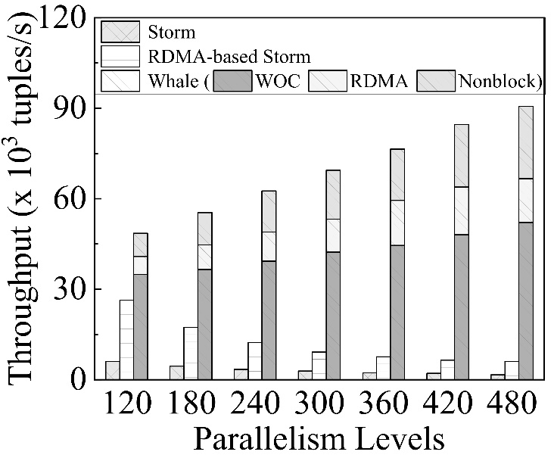
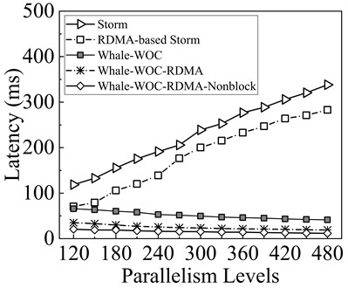
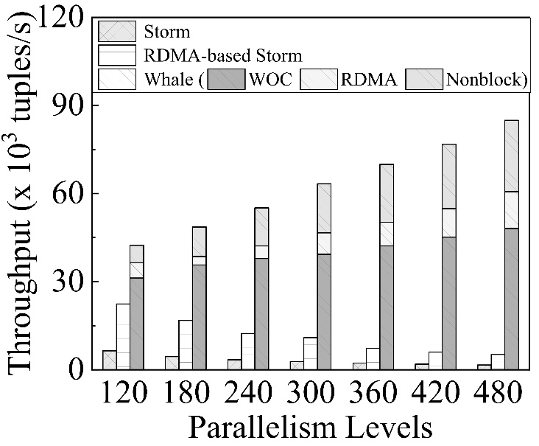
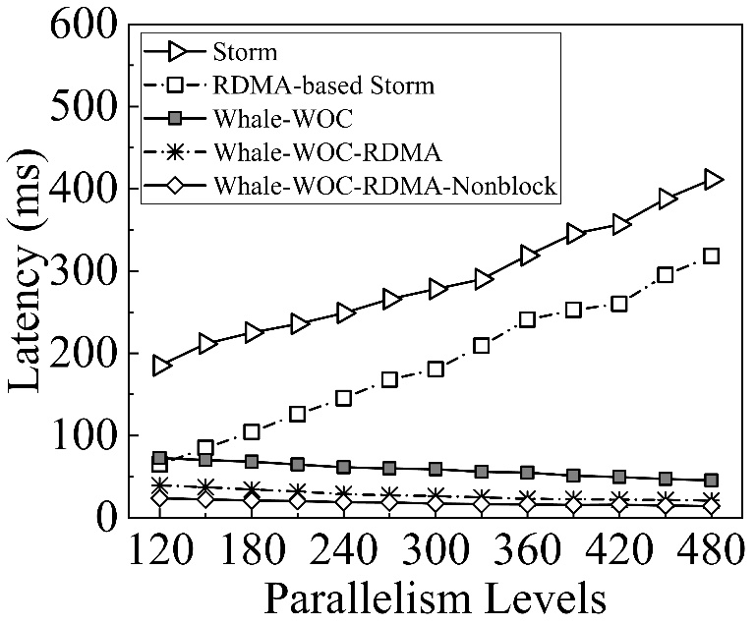
Overall system performance evaluation
▲Overall system throughput on Didi dataset
▲Overall system latency on Didi dataset
▲Overall system throughput on Nasdaq dataset
▲Overall system latency on Nasdaq dataset
Notes:
In terms of overall system performance evaluation, the throughput and average latency of the Whale system are optimal. In the best case, Whale's system throughput improved 56.6× times compared to other systems and processing latency was reduced by 97 percent.

Slide 20
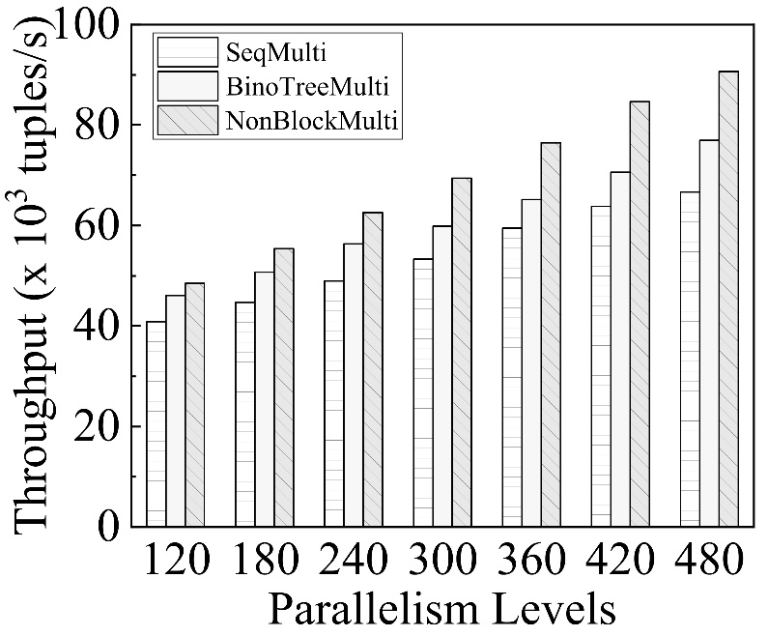
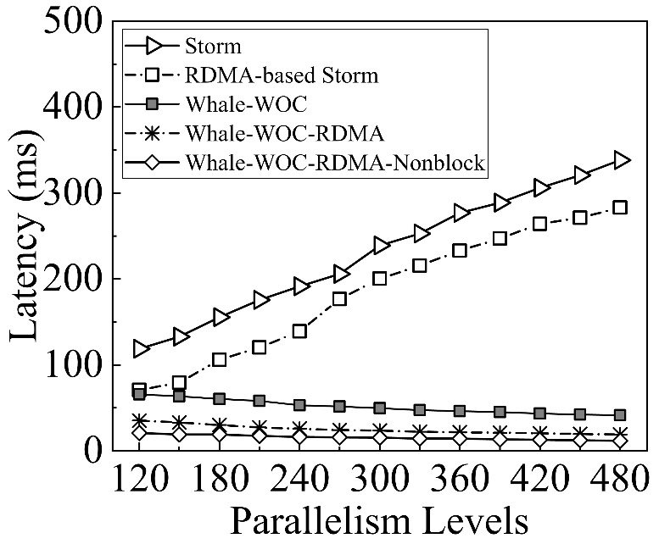
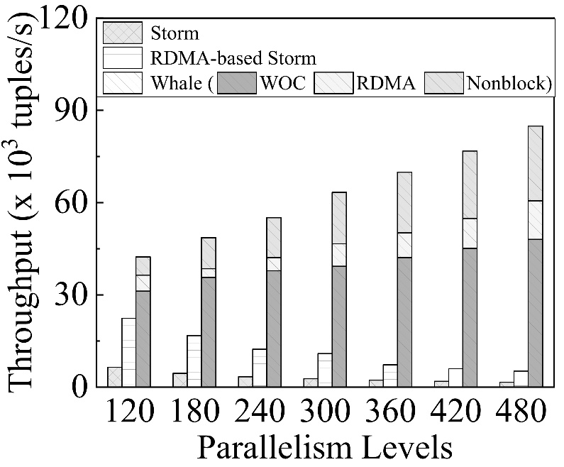

Stream multicast performance evaluation
▲Throughput comparison using Didi dataset
▲Latency comparison using Didi dataset
▲Throughput comparison using Nasdaq dataset
▲Latency comparison using Nasdaq dataset
Notes:
In stream multicast structure performance evaluation. The non-blocking multicast tree proposed by us is superior to binomial and sequential multicast in both overall system throughput and processing delay.

Slide 21
Conclusion
We propose Whale, a novel RDMA-assisted distributed stream processing system with efficient one-to-many data partitioning
We design a novel non-blocking multicast tree structure for RDMA-assisted one-to-many data partitioning
We design a new worker-oriented communication mechanism in distributed stream processing systems.
Whale achieves 56.6× improvement of system throughput and 97% reduction of processing latency compared to existing designs.
Notes:
We propose Whale, a novel RDMA-assisted distributed stream processing system with efficient one-to-many data partitioning
We design a novel non-blocking multicast tree structure for RDMA-assisted one-to-many data partitioning
We design a new worker-oriented communication mechanism in distributed stream processing systems.
Whale achieves 56.6× improvement of system throughput and 97% reduction of processing latency compared to existing designs.

Slide 22
Thank you very much!
Notes:
Thank you very much for your attention. Any questions will be appreciated.

