Slide 1

Hardware-Supported Remote Persistence for Distributed Persistent Memory
Zhuohui Duan, Haodi Lu, Haikun Liu, Xiaofei Liao,
Hai Jin, Yu Zhang, Song Wu
https://github.com/CGCL-codes/PRDMA
National Engineering Research Center for Big Data Technology and System
Services Computing Technology and System Lab, Cluster and Grid Computing Lab
School of Computer Science and Technology, Huazhong University of Science and Technology, China

Slide 2
Outline
Background
Challenge
Motivation
Challenge
Challenge
Design
Evaluation
Conclusion
Notes:
Here is the outline. (stop 3 seconds)
Let’s begin with the background.

Slide 3
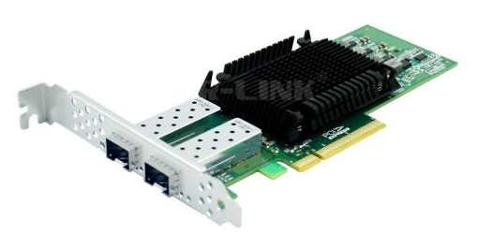
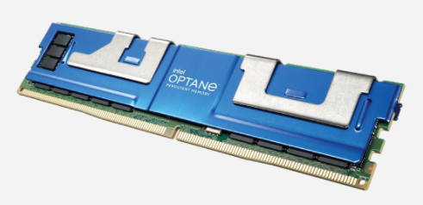
Background
RDMA + NVM
Zero-copy
Bypass Kernel and CPU
Low-latency remote memory accesses
High memory density
Low cost per bit
Near-zero standby power consumption
We want:
Low cost ,overhead
and persistence
RDMA + NVM =
Reality is:
RDMA + NVM (as DRAM) =
No guarantee
Notes:
NVM promise high memory density, low cost per bit, DRAM-like performance , and disk-like durability.
RDMA technologies can offer extremely low network latency and high bandwidth, and enable low-latency remote memory accesses over networks by bypassing the operating system kernel and eliminating memory copying across buffers.
We would like to replace the traditional RDMA and DRAM combination with NVM for a low overhead, low cost, high performance and persistent system. However, the fact is that traditional RDMA programming and hardware do not guarantee persistence and recoverability of data at the remote.
The advent of Persistent Memory necessitates an evolution of Remote Direct Memory Access (RDMA) technologies for supporting remote data persistence.

Slide 4
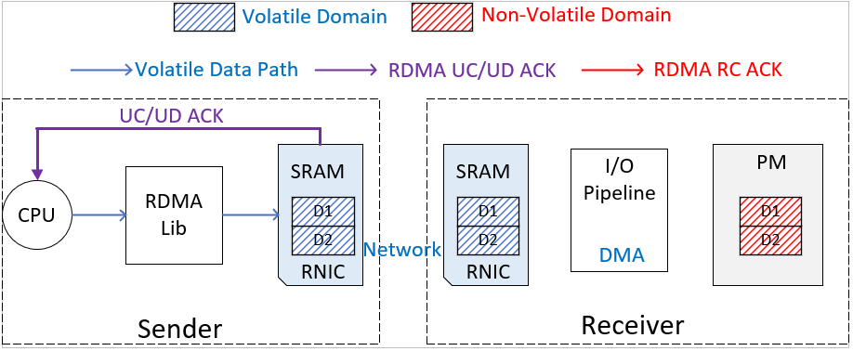
Background
A typical data path of RDMA write
The completion signal of a transmission in RDMA UC/UD mode just means that the command reached the local sender’s NIC.
Notes:
This figure shows a typical data path of RDMA write in an RDMA-based PM system.
In an RDMA communication, the CPU initiates a command, which passes through the local NIC and the remote NIC and is finally stored in the remote memory area.
In the RDMA UC/UD modes, once the sender’s RNIC has sent out the data, it notifies the completion of RDMA operations to applications.

Slide 5
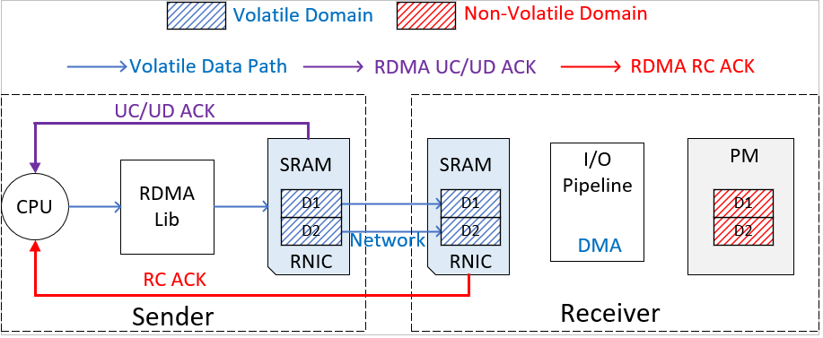
Background
A typical data path of RDMA write
The completion signal of a transmission in RDMA RC mode means that the command has reached the receiver’s NIC.
Notes:
Next, the data reaches the receiver's NIC through the network,
and at this point, for RDMA RC mode, once the data is received by the receiver’s RNIC, it returns a work completion (WC) event to the sender.
Then, the data is transmitted from the receiver's NIC DMA to the PM destination area.

Slide 6
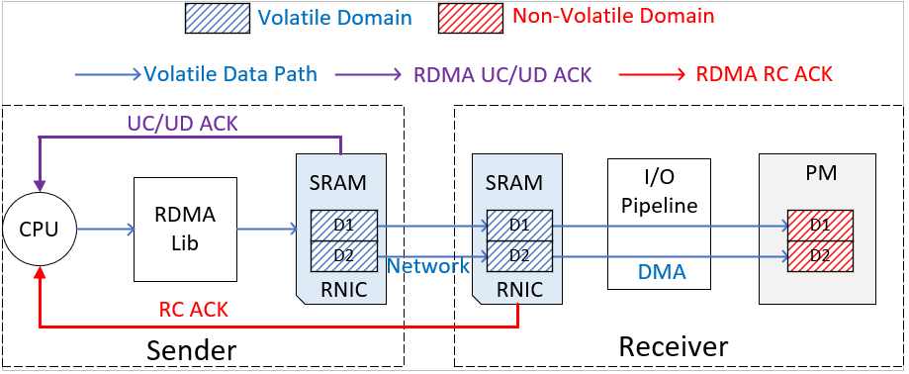
Background
A typical data path of RDMA write
There is a gap between the moment when the data transfer is considered to be over by the sender and the moment when the data actually reaches the persistence region. And this creates the potential for data loss.
Notes:
So, for standard RDMA protocols, the acknowledgement does not necessarily imply that the data buffered in the volatile cache of the server’s RNIC has been persisted in the PM.
Without a validation of remote data persistence, distributed applications may incur data consistency and concurrency problems.
RDMA and NVM researchers need to be able to sense data persistence transfer acknowledgements to avoid the above problems.
Fortunately, data in receiver’s NIC can be piped directly into persistent memory via DMA, making it possible for the NIC to provide persistent acknowledgement.

Slide 7
Background
What about SNIA？
The SNIA PM programming model advocates an RDMA read-after-write mechanism to flush date from volatile NIC to persistence memory and guarantee persistence.
Under non-allocating configuration, data is imported directly into the ADR persistence area by the IO controller.
Cores
L1 & L2
L3
IO
Controller
Mem
Controller
A passive, high-overhead, compromise persistence guarantee strategy
PCIe
PM
ADR
Non-allocating
Notes:
The volatile cache of RNICs is the root cause of data persistence problems in distributed PM systems.
As a result, the SNIA PM programming model advocates an RDMA read-after-write mechanism to guarantee data persistence.
Specifically, the sender reads the last byte of the data from the PM to check its correctness once the RDMA write operation completes
The figure shows the data path from the NIC to the PM with DDIO technology turned off.
With DDIO technology turned off, data is imported directly into the ADR persistence area by the IO controller.
Although the RDMA read-after-write mechanism is easy to implement, it has been questioned since some hardware features of the remote server may affect its effectiveness.
Which is a passive, high-overhead, compromise persistence guarantee strategy on RDMA.

Slide 8
Background
Why not DDIO?
With DDIO technology enabled, data enters the L3 buffer and is subsequently asynchronously flushed to the ADR persistence area.
This causes the RDMA read based persistence method to no longer be valid.
While it is possible to wake up the remote CPU for CLFlush or use the new Intel Optane technology to ensure data consistency, this is still not a direct way to ensure data persistence on the remote side within RDMA.
Cores
L1 & L2
L3
IO
Controller
Mem
Controller
PCIe
PM
ADR
DDIO
Notes:
For example, the DDIO technology provided by intel on the 5th generation Xeon processors allows the receiver’s RNIC directly place the incoming data in the volatile L3 cache.
The sender is not able to perceive whether and when the data is written to the PM.
In this case, the RDMA read-after-write mechanism becomes ineffective because the data read by the sender is actually in the L3 cache.
While it is possible to wake up the remote CPU for CLFlush or use the new Intel Optane technology to ensure data consistency
This is still not a direct way to ensure data persistence on the remote side within RDMA.

Slide 9
Background
Whether it is RPC?
Most existing RPC systems are designed to facilitate RDMA programming and optimize transmission, but they actually support durable RDMA writes.
We investigate some typical RPC systems and place them in a persistent memory environment to classify and analyze them.
RPC Implementations | RDMA Write | RDMA Send | RDMA Write-IMM
RDMA RC | FaRM, L5, RFP | NVFS, DaRPC, Hotpot, Mojim | Orion, Octopus, LITE
RDMA UC/UD | Herd | FaSST | -
DDIO | ScaleRPC | FileMR | -
Notes:
The RDMA write-after-read mechanism is used when data is written directly to memory via RDMA.
Nowadays, the mainstream RDMA-enabled systems are more likely to use RPC for communication.
An RPC often uses a set of RDMA primitives to perform a complicated task with fewer RTTs.
Although most existing RPC systems are designed to facilitate RDMA programming for Distributed Shared Memory,
they actually support durable RDMA writes by synchronizing the process of writing data from NIC to the NVM.
To study previous durable RDMA write mechanisms in existing RPC systems, we classify existing RDMA-based DSM systems according to different RDMA primitives and transmission modes, as shown in Table.

Slide 10
Background
Whether it is RPC?
RPC Implementations | RDMA Write | RDMA Send | RDMA Write-IMM
RDMA RC | FaRM, L5, RFP | NVFS, DaRPC, Hotpot, Mojim | Orion, Octopus, LITE
RDMA UC/UD | Herd | FaSST | -
DDIO | ScaleRPC | FileMR | -
RDMA Write primitive enable flexible design of transmission.
FaRM, L5, RFP use RDMA Write with RDMA RC mode and provide persistence assurance.
Notes:
Let's first take a look at the schematic diagram of RPCs based on the RDMA write primitive with RDMA RC mode.
RDMA write primitive can bypass the remote CPU to transfer data to the remote memory, therefore RDMA Write enable flexible design of transmission.
FaRM, L5, RFP use RDMA Write with RDMA RC mode to design different data transfer methods and provide persistence assurance.
Specifically, FaRM uses RDMA write for transmission. The receivers exploit RDMA recv primitives or a polling mechanism to store the received data in the persistent domain.
If a sender receives a completion event of the RPC, it can confirm that the data has been persisted in the remote server.
Figure (b) illustrates the communication mode of RFP. The sender uses an RDMA write to transfer data, and then uses an RDMA read to collect the result processed by the receiver.
L5 uses two RDMA writes to transfer data and a valid message, respectively. The receiver polls the message buffer for incoming RDMA writes, and then returns the processing result using an RDMA write primitive.

Slide 11
Background
Whether it is RPC?
RPC Implementations | RDMA Write | RDMA Send | RDMA Write-IMM
RDMA RC | FaRM, L5, RFP | NVFS, DaRPC, Hotpot, Mojim | Orion, Octopus, LITE
RDMA UC/UD | Herd | FaSST | -
DDIO | ScaleRPC | FileMR | -
Herd uses RDMA write to send data and the receiver uses RDMA send to return the result.
Herd use primitives in different mode to meet the system requirements in asymmetric environments.
Notes:
herd is a typical RPC system that uses rdma write for data transfer in RDMA uc mode.
Herd uses UC-based RDMA write to send data and the receiver uses UD-based RDMA send to return the result.
The core purpose of herd is using a different RDMA primitive to meet the system requirements in an asymmetric environment.
herd's receiver polling and persists the data, and finally tells the sender about the completed persistence message.

Slide 12
Background
Whether it is RPC?
RPC Implementations | RDMA Write | RDMA Send | RDMA Write-IMM
RDMA RC | FaRM, L5, RFP | NVFS, DaRPC, Hotpot, Mojim | Orion, Octopus, LITE
RDMA UC/UD | Herd | FaSST | -
DDIO | ScaleRPC | FileMR | -
ScaleRPC has two transmission phase: warmup and process.
In the warmup phase the receiver actively gets the data and persists it, while in the process phase it is passive.
ScaleRPC also provides persistence with DDIO-enabled by receiver’s CPU polling.
Notes:
Figure shows the work flow of ScaleRPC. The data transfer includes two phases: warmup and process.
In the former phase, the sender uses an RDMA write to only send the local address of the data to the receiver’s message buffer.
The receiver polls the message buffer and uses an RDMA read to fetch the requested data from the sender.
Once the computation is completed, the receiver notifies the sender of a completion event using an RDMA write.
Subsequently, ScaleRPC begins the process phase, and the data transmission model is the same as FaRM.
ScaleRPC discusses the impact of DDIO on persistent transfers, which still provide persistence due to the CPU polling in both phases of its transfer process

Slide 13
Background
Whether it is RPC?
RPC Implementations | RDMA Write | RDMA Send | RDMA Write-IMM
RDMA RC | FaRM, L5, RFP | NVFS, DaRPC, Hotpot, Mojim | Orion, Octopus, LITE
RDMA UC/UD | Herd | FaSST | -
DDIO | ScaleRPC | FileMR | -
RPC systems like DaRPC and FaSST use RDMA send to transmit data, which can eliminate the polling overhead compared to the RDMA write based approach.
FaSST differs from DaRPC in that it works in UC mode.
Notes:
Figure 2(a) shows a typical RPC design in DaRPC.
At first, the sender uses an RDMA send primitive to send a message (including data and metadata) to the receiver.
The receiver’s RNIC receives the message and stores it in a message buffer.
It notifies the receiver’s CPU to parse data and metadata in the message, and then the data is copied to the target memory space according to the metadata.
At last, the receiver uses an RDMA send primitive to notify the completion of this RPC to the sender
The RDMA send-based RPC design is similar to the previous approach, and eliminates the polling overhead compared to the RDMA write based approach.
Figure 2(b) shows the design of FaSST, who differs from DaRPC in that it works in UC mode.

Slide 14
Background
Whether it is RPC?
RPC Implementations | RDMA Write | RDMA Send | RDMA Write-IMM
RDMA RC | FaRM, L5, RFP | NVFS, DaRPC, Hotpot, Mojim | Orion, Octopus, LITE
RDMA UC/UD | Herd | FaSST | -
DDIO | ScaleRPC | FileMR | -
Octopus and LITE both use the RDMA write-IMM primitive to notify the receiver’s CPU for further data processing.
The difference between RDMA send and RDMA write IMM primitives has little impact on the corresponding RPC design.
Notes:
Octopus and LITE both use the RDMA write-IMM primitive to notify the receiver’s CPU for further data processing.
Their data transmission models are similar to FaRM, except different RDMA primitives used.
Unlike Octopus, LITE implements RPCs in the kernel, and thus data access permissions should be spread to the kernel.
The difference between RDMA send and RDMA write IMM primitives has little impact on the corresponding RPC design.

Slide 15
Outline
Background
Challenge
Motivation
Challenge
Challenge
Design
Evaluation
Conclusion
Notes:
So, Here is our motivation. (stop 3 seconds)

Slide 16
Motivation
Traditional RDMA Write
1: procedure transmission(𝑐𝑜𝑛𝑓𝑖𝑔,𝑎𝑑𝑑𝑟,𝑠𝑖𝑧𝑒) 2: 𝑟𝑒𝑠𝑢𝑙𝑡 = 𝑅𝐷𝑀𝐴_𝑊𝑟𝑖𝑡𝑒(𝑐𝑜𝑛𝑓𝑖𝑔,𝑎𝑑𝑑𝑟,𝑠𝑖𝑧𝑒); 3: ……. 4: #RDMA Write Received by Remote 5: #Remote node shut down and data loss 6: GetACK(𝑟𝑒𝑠𝑢𝑙𝑡); 7: #TimeC ≠ TimeB (not happen at all) 8: 𝑒𝑟𝑟𝑜𝑟 = 𝑅𝐷𝑀𝐴_read (𝑐𝑜𝑛𝑓𝑖𝑔,𝑎𝑑𝑑𝑟); 9: …….
HostA
RNIC
RNIC
I/O pipeline
PM
RDMA Write (line2)
TimeA(line4)
Shutdown(line5)
TimeC(line6)
TimeB
Process of RDMA write
Traditional RDMA and its hardware are not NVM-aware and also do not guarantee data persistence at the remote.
Without a validation of remote data persistence in data asynchronous flushing from NIC to PM, distributed applications may incur data consistency and concurrency problems.
Notes:
For standard RDMA protocols, the acknowledgement does not necessarily imply that the data buffered in the volatile cache of the server’s RNIC has been persisted in the PM.
There is a risk of potential data loss if you just follow the traditional RDMA method of programming in the table on the left.
The actual data path that occurs behind this code is shown in the figure on the right.
Assume Time A represents the time when the data is received by the remote NIC,
𝑇ime 𝐵 represents the time when the received data has been physically written from the receiver’s RNIC buffer to the PM,
and 𝑇imeC represents the time when applications receive the WC event of RDMA write operations.
If 𝑇imeC is earlier than 𝑇ime𝐵, a system crash or a power failure may lead to a data inconsistent problem without a validation of remote data persistence

Slide 17
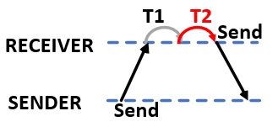
Motivation
While both traditional RPC and SNIA RDMA read-after-write mechanisms can solve the problem of remote data access persistence, this undirected and reactive approach has a large cost.
To RPC, the complex and expensive data processing, RDMA communication network and PCIe transaction operations are all on top of the critical path (T1+T2).
Notes:
From the above description, we can find that these RPCs all guarantee data persistence naturally.
If persistent memory is used for the receiver, the when the RPC is completed, the sender can validate that the data has been persisted by the receiver.
However, the costly RPC processing, RDMA networking, and PCIe operations are on the critical path of client applications.
They often significantly increase the end-to-end latency compared with a single RDMA primitive.

Slide 18
Outline
Background
Challenge
Motivation
Challenge
Challenge
Design
Evaluation
Conclusion
Notes:
Here is the challenge. (stop 3 seconds)

Slide 19
Challenge
In the NVM-RDMA architecture, the invisibility of remote persistence may cause data corruption in case of a system crash or a power failure.
Existing architectures do not provide an efficient method of persistent transmission.
Current RNIC hardware and firmware do not provide enough support for remote data persistence.
DDIO technology makes remote persistence more difficult to achieve in one-sided RDMA.
Existing RPC communication methods provide data persistence guarantee, but their complex and expensive processing and transmission process are tightly coupled.
Notes:
In the NVM-RDMA architecture, the invisibility of remote persistence may cause data corruption in case of a system crash or a power failure
Existing architectures do not provide an efficient method of persistent transmission, such as
Current RNIC hardware and firmware do not provide enough support for remote data persistence
DDIO technology makes remote persistence more difficult to achieve in one-sided RDMA
Existing RPC communication methods provide data persistence guarantee, but those RPCs require the remote server’s CPU to process the incoming data, and thus increase CPU load of the remote server, and also postpone the visibility of remote data persistence.

Slide 20
Challenge
RDMA NIC has some processing power and RDMA RC mode can bypass the remote CPU and can ensure reliable data transmission, it has a potential to achieve durable RDMA writes without involving the remote server’s CPUs.
Implementation of efficient remote persistence operations requires:
New design of RDMA primitives
Persistent transmission method based on new primitives
Notes:
Since the RDMA NIC has some processing power and RDMA RC mode can bypass the remote CPU and can ensure reliable data transmission, it has a potential to achieve durable RDMA writes without involving the remote server’s CPUs.
New design of RDMA primitives and Persistent transmission method based on new primitives are required to Implement an efficient remote persistence operations.

Slide 21
Outline
Background
Challenge
Design
Evaluation
Conclusion
Notes:
Next we talk about our detailed design.

Slide 22
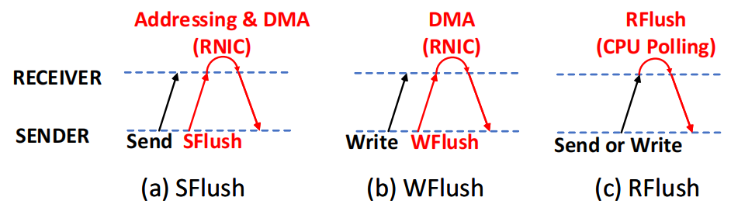
Design
Hardware-supported RDMA Flush primitives
  To reduce the end-to-end latency of durable RDMA operations, we design new RDMA Flush primitives and data persisting models.
  Features of new RDMA Flush primitives
  1.Classify them as sender-initiated (a)(b) and receiver-initiated (c) primitives.
  Sender-initiated RDMA Flush primitives are issued by the sender to verify the remote data persistence.
  Receiver-initiated Flush primitives are issued by the receiver to notify the completion of data persisting to the sender.
  2.Using other existing primitives to emulate the performance of RDMA Flush.
Notes:
To embrace the new PM, it is essential to design new RDMA primitives and more efficient RPCs to utilize PM in a distributed environment.
We classified the proposed RDMA Flush primitives into two categories: sender-initiated and receiver-initiated.
Sender-initiated RDMA Flush primitives are issued by the sender to verify the remote data persistence, while receiver-initiated Flush primitives are issued by the receiver to notify the completion of data persisting to the sender.

Slide 23
Design
Sender-initiated RDMA Flush primitives
  Sender-initiated RDMA Flush Primitives: SFlush and Wflush
  1. Using One-sided RDMA communication to achieve durable RDMA writes/sends without the involvement of remote CPUs.
  2. Can be used only in the RC mode, have to wait for ACKs from the remote RNIC.
  3. According to the hardware features of RDMA and PM, the implementations of the corresponding Flush primitive vary depending on the RDMA verbs.
Notes:
Sender-initiated RDMA Flush primitives are designed according to the hardware features of RDMA and PM.
One-sided RDMA communication mode bypasses OS kernels, and does not involve the remote server’s CPUs.
Also, future smart RNICs have a potential to directly flush data from their volatile cache to PM.
Thus, it is possible to achieve durable RDMA writes/sends without the involvement of remote CPUs.
Sender-initiated RDMA primitives can be used only in the RC mode, because these RDMA primitives have to wait for ACKs from the remote RNIC.
Here are two Sender-initiated RDMA Flush Primitives: SFlush and Wflush.
They are designed according to the hardware features of RDMA and PM
The implementations of the corresponding Flush primitive vary depending on the RDMA verbs.

Slide 24
Design
Sender-initiated RDMA Flush primitives: SFlush
  The design and API of RDMA SFlush Primitives
  1. A SFlush should be accompanied with an RDMA send primitive.
  2. To process the SFlush , the receiver NIC needs to locate the destination address first in order , and then DMA data for persistence.
Algorithm 1 Durable RDMA Write Using SFlush
1: procedure transmission_sender(config,size) 2: result = RDMA_Send(config, size); 3: if result ≠ success then 4: return error 5: end if 6: result = RDMA_SFlush (config); 7: if result ≠ success then 8: return error 9: end if 10: return success 11: end procedure 12: procedure transmission_receiver(config,addr) 13: RDMA_Recv (config, addr,&data_addr); 14: return success 15: end procedure
Notes:
(这章从上到下都有问题)
Let's first look at the implementation details of SFLUSH and how it is used
A SFlush should be accompanied with an RDMA send primitive.
Because RDMA send primitives rely on the receiver’s CPU to obtain the destination memory address and perform DMA operations, the CPU intervention increases software overhead.
We believe future smart RNICs can do the same job itself with our proposed SFlush primitive.
When the receiver’s RNIC receives a SFlush primitive, it should first parse the received data packet to get the remote memory address, and then performs the DMA operation to persist the data.
The algorithm on the right is the flow for persistent remote writes using Sflush. We provide API supply calls to enable efficient persistent write functionality.

Slide 25
Design
Sender-initiated RDMA Flush primitives: WFlush
  The design and API of RDMA WFlush Primitives
  1. A WFlush should be accompanied with an RDMA write primitive.
  2. To process the WFlush , the receiver NIC only needs to DMA data for persistence, since the RDMA write specifies the destination address.
Algorithm 2 Durable RDMA Write Using WFlush
1: procedure transmission_sender(config,addr,size) 2: result = RDMA_Write(config, addr, size); 3: if result ≠ success then 4: return error 5: end if 6: result = RDMA_WFlush(config,addr); 7: if result ≠ success then 8: result error 9: end if 10: return success 11: end procedure
Notes:
Corresponding to the features of RDMA write primitive , an RDMA WFlush primitive should be accompanied with an RDMA write primitive, as shown in Figure.
It is aware of the target address of the received data because the RDMA write primitive contains the remote memory address.
In this way, we can shorten the latency that the data persistence is visible to the sender.
The algorithm on the right is the flow for persistent remote writes using Wflush

Slide 26
Design
Receiver-initiated RDMA Flush primitives: RFlush
  Receiver-initiated RDMA Flush Primitives: RFlush
  1. Receiver’s NIC actively verifies the persistence of the transmission with RDMA writes/sends.
  2. Can be used in the ALL RDMA mode as general-purpose Flush primitives.
  3. Recent implementations rely on CPU polling, similar to traditional RPC.
Notes:
This Figure demonstrates durable RDMA send/write operations using RFlush.
Unlike sender-initiated RDMA Flush primitives, the receiver-initiated RDMA Flush primitive should actively flush the received data to PM by the receiver’s RNIC itself, without any involvement of the receiver’s CPU.
However, since current RNIC hardware does not support active data flushing, we rely on the receiver’s CPU to emulate RDMA RFlush primitives.
Although RFlush leads to a moderate CPU load, it can be used in all RDMA connection modes, such as UC/UD.

Slide 27
Design
Receiver-initiated RDMA Flush primitives: RFlush
  The design and API of RDMA RFlush Primitives
  1. A RFlush can be used with RDMA send or RDMA write primitive.
  2. To process the RFlush command, the receiver NIC needs to actively sensing and persisting data write operations.
Algorithm 3 Durable RDMA Send/Write Using Rflush (Taking RDMA Send as an example)
1: procedure transmission_sender(config,addr,size) 2: result = RDMA_Send(config, size); 3: RDMA_Recv_RFlsuh(config,&result); 4: if result ≠persist_success then 5: return error 6: end if 7: return success 8: end procedure 9: procedure transmission_receiver(config) 10: result = RDMA_RFlush(config,success); 11: if result ≠ success then 12: return error 13: end if 14: return success 15: end procedure
Notes:
A RFlush can be used with RDMA send or RDMA write primitive for persistence.
The receiver’s CPU polls the message buffer for incoming RDMA send/write operations, and issues an RDMA RFlush primitive to flush data to the PM.
Once the data has been persisted, the receiver’s CPU notifies the completion of data persisting to the sender immediately.
The algorithm on the right is the flow for persistent remote writes using Rflush.

Slide 28
Design
What can we do with RDMA Flush primitives？
  There are two ways to use the new flush primitive to develop its capabilities:
    1. Remote Data Persisting for Existing RDMA System
    2. Efficient Implementation of Durable RPC
Notes:
So, what can we do with RDMA flush primitives?
There are two ways to use the new flush primitive to develop its capabilities.
The first approach is to use it to provide remote persistence guarantees for existing RDMA systems
The second approach is to build an efficient durable RPC using the flush primitive
Let's start with the first one

Slide 29
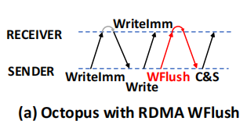
Design
Ensuring Remote Data Persisting for Existing RDMA Systems
  A few previous proposals store data to remote memory via RDMA write primitives. Unfortunately, these systems
  do not guarantee data persistence for RDMA write operations.
  RDMA-enabled PM systems can exploit the RDMA Wflush primitive to guarantee remote data persistence effectively.
Algorithm 4 Ensuring Remote Data Persisting for Existing RDMA Systems (Taking Octopus as an example)
1: procedure Octopus_sender(config, addr, size) 2: result = RDMA_writeImm(config, addr, size); 3: Get_RDMA_WriteImm(result); 4: result = RDMA_Write(config, addr, size); 5: if result ≠ success then 6: return error 7: end if 8: result = RDMA_WFlush(config,addr); 9: if result ≠ success then 10: return error 11: end if 12: RDMA_C&S(addr); 13: return success 14: end procedure
Notes:
A few previous proposals such as Tailwind , Octopus, and Clover store data to remote memory via RDMA write primitives.
Unfortunately, these systems do not guarantee data persistence for RDMA write operations.
Taking Octopus as an example, we illustrate how these RDMA-enabled PM systems can exploit the RDMA WFlush primitive to guarantee remote data persistence effectively, as shown in Figure (a).
In Octopus, the sender first obtains the destination memory address using a RPC implemented with RDMA write-IMM.
It then uses an RDMA write primitive to write the data to the PM.
To make the RPC in Octopus durable, we can use an RDMA WFlush primitive following the RDMA Write primitive.
The RDMA WFlush primitive guarantees that the received data is flushed to the PM when the sender receives the ACK of the RDMA WFlush.

Slide 30
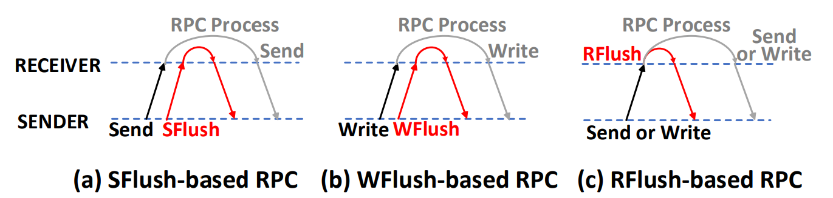
Design
Durable RPCs for Failure Recovery
We design durable RPCs using the aforementioned RDMA Flush primitive.
The Flush primitive allows the sender to know earlier that the RPC data has reached the receiver's PM area.
Unfortunately, destination address of RPC is usually a buffer or target memory, and there is no failure recovery capability.
Notes:
A second way to develop the capability of flush primitives is to build efficient durable RPCs
since previous RPC systems tightly couple the data persisting with the processing of RPCs, they should be also redesigned to allow the remote data persistence visible to the sender earlier.
aforementioned RDMA Flush primitive have the potential to make RPC durable with low latency.
We design durable RPCs using the aforementioned RDMA Flush primitive, as shown in Figure.
Unlike previous RPC designs, our durable RPCs can guarantee that the received data is stored in the receiver’s PM when the sender has received the ACK of RDMA Flush primitives.
As we know , Failure recovery is important for mission-critical enterprise applications.
In traditional communications, the destination address is usually a buffer or target memory, and there is no failure recovery capability.
Although the sender knows the persistence message with the RDMA Flush primitives, it still cannot send the next instruction in advance at this time, because in case of failure, the normal buffer or target memory cannot be recovered to get valid data, and the local has already considered the persistence finished

Slide 31
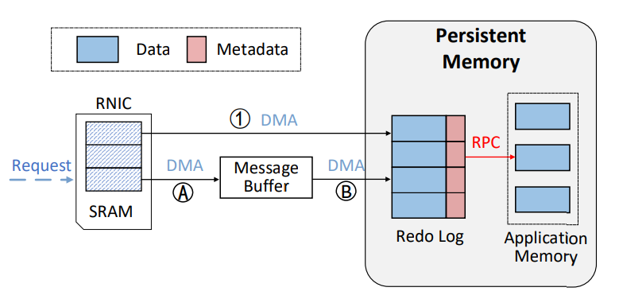
Design
Durable RPCs for Failure Recovery
RDMA Flush primitives guarantee that the data reaches the Redo Log.
WFlush makes the RNIC generate a DMA operation( 1 ) to store the data and the RPC operator in the log.
For RDMA Send, the data packet arrives in the message buffer first( A ), then SFlush puts the data to the redo log via another DMA( B ).
Notes:
So we let the data instructions be transmitted to the redo log first.
Figure 5 shows how durable RPCs are processed at the receiver side.
When the receiver’s RNIC receives RDMA requests, the data packets are cached in the volatile RNIC buffer (SRAM).
We maintain a ring buffer in the PM to store the redo log.
For each RDMA connection, the corresponding connection information is recorded in the log header.
A log entry contains the RPC operator and the data.
To guarantee failure atomicity, the data is always persisted before the RPC operator in the logging buffer.
Because the size of the RPC operator is very small, it can be persisted with an atomic write.
Once an RPC is successfully processed, the corresponding log entry is removed from the ring buffer.
For an RDMA WFlush-based RPC, the RNIC performs a DMA operation (○1 ) to store the data and the RPC operator in the log, and then notifies the completion of remote data persisting to the sender.
For an RDMA SFlush-based RPC, the data packet should be first stored in the message buffer for further processing (○A) because the RDMA send primitive does not contain the remote memory address.
With the RDMA SFlush primitive, we can immediately flush the data in the message buffer to the redo log via another DMA (○B)

Slide 32
Design
Durable RPCs for Failure Recovery
A separate thread can use the operation information from the redo log for RPC processing.
The persistent redo log guarantees failure atomicity during the processing of RPC.
Redo log also provides the ordering guarantee of RPC requests for data concurrency.
Durable RPC can query the number of available redo log entries to monitor packet traffic.
Notes:
After the packet reaches the Redo log area, a thread is created to handle the RPC requests.
Even when the following RPC requests would process the same data, they will be queued in the logging buffer and then processed in a FIFO order. The redo logging mechanism not only guarantees failure atomicity during the processing of RPC, but also provides the ordering guarantee of RPC requests for data concurrency.
On the other hand, the sender may send too many requests even when the receiver is under a high load. Thus, when the incomplete RDMA requests accumulated at the receiver side become larger than a given threshold, the receiver should notify the sender to slow down the speed of data transmission. The sender can simply throttle new RPC requests for a short while.

Slide 33

Design
Durable RPCs for Failure Recovery
Durable RPC design decouples the data persisting from the RPC processing via RDMA Flush primitives.
The sender can issue other RPC requests without waiting for the completion event of the RPC that is still being processed.
We exploit redo logging to achieve fast recovery of incomplete RPCs.
Notes:
Since our durable RPC design decouples the data persisting from the RPC processing via RDMA Flush primitives, the remote data persistence is visible to the sender much earlier than traditional RPCs.
With the redo logging mechanism, the sender can issue other RPC requests without waiting for the completion event of the RPC that is still being processed, because our design guarantees that the durable RPC can be processed eventually even when a system failure occurs.
Specifically, Once the receiver is recovered from a failure, the RPC can be re-executed with the operation log.
We exploit RDMA Flush primitives and redo logging to achieve fast recovery of incomplete RPCs, without re-sending the data from the client.

Slide 34
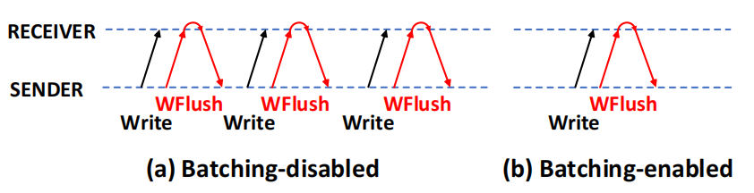
Design
Remote Data Persisting for Batching
In RPC systems, batching is often used to pack multiple operations to increase network throughput.
RDMA Flush primitives are applicable for batched RDMA operations.（a->b）
Experiments reveal that Durable RPCs achieve more significant performance gains than traditional RPCs.
Notes:
A number of RPC systems such as DaRPC, FaSST, and ScaleRPC perform a set of RDMA operations in a batch to improve the network throughput.
Our RDMA Flush primitives are also applicable for batched RDMA operations.
Taking RDMA WFlush as an example, Figure 6 shows the batched RDMA writes combining with RDMA WFlush primitives.
In a batching-disabled case, an RDMA WFlush is usually accompanied with an RDMA write operation to persist the data, as shown in Figure (a).
When the batching mechanism is enabled, the sender transfers a large message accompanying with an RDMA WFlush at a time, as shown in Figure (b).
The Results of the subsequent experiments reveal that Durable RPCs achieve more significant performance gains than traditional RPCs

Slide 35
Outline
Background
Challenge
Design
Evaluation
Conclusion
Notes:
Then we talk about our evaluation.

Slide 36
Evaluation
Setup
Component | Description
CPU | Two-socket Intel Xeon Gold 6230 2.10 GHz 20-core processors
Memory | 128 GB DRAM and 1 TB Intel Optane DCPMM
Network | Mellanox ConnectX4 40/56 GbE network controller
DDIO | OFF
Optane DCPMM | Intel ndctl driver App Direct Mode
  Compare system：L5, RFP, FaSST, Octopus, FaRM, ScaleRPC, DaRPC
  Micro-benchmarks：50K objects，300K times access，read/write ratio of 1:1，64KB default object size
    Performance
    Sensitivity: Object Sizes, Load of RDMA Networks, Concurrent access and other factors
  Macro-benchmarks ：YCSB，PageRank
Notes:
Here is the experimental setting.
We use micro-benchmark and marco-Benchmarks to test our durable RPCs , and compare with state-of-the-art systems.
In micro-benchmark, the sender first generates 50K objects in a remote server, and then reads/writes these objects for 300K times via different RDMA-based RPCs.
The default object size is 64 KB. The data access pattern follows a zipfian distribution with a read- /write ratio of 1:1.
We use 32 B, 1 KB, and 64 KB objects to evaluate the efficiency of our RPCs for typical message-passing systems, K-V stores, and file systems, respectively.
We use real-world applications such as compute-intensive PageRank and latency-sensitive YCSB benchmarks to evaluate the performance of different RPCs.
For the PageRank algorithm, we store the graph data in a remote server’s PM, and store the intermediate results of PageRank in the main memory of the computation node locally. The graph data are fetched via RPCs by the client node.
For YCSB benchmarks, we store 50K objects in a KV store system. The sizes of keys and values are 8 Bytes and 4 KB, respectively. Clients perform RPCs to access KV pairs in the remote PM, and maintain KV indexes in the main memory of clients locally. We perform KV operations 300K times in each test for different workloads.

Slide 37
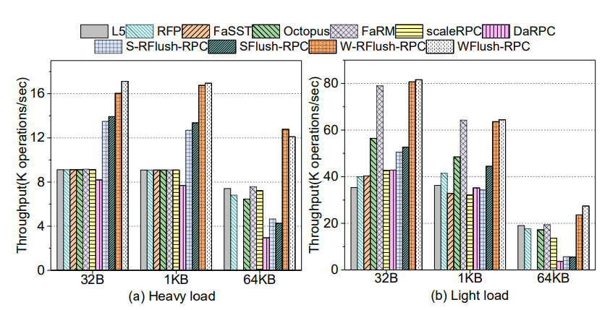
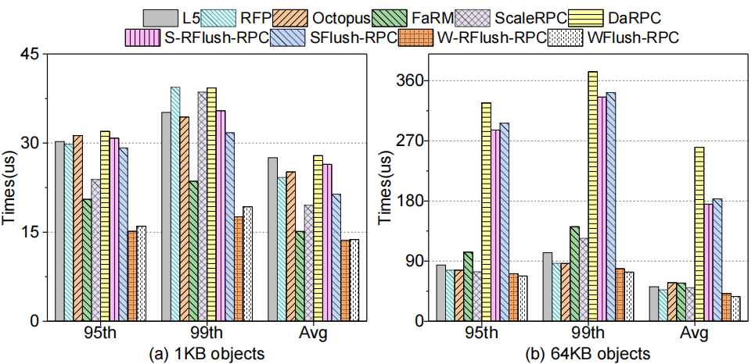
Evaluation
Micro-benchmark Performance
  For the light load case, our durable RPCs achieve moderate performance improvement compared with other RPCs for small objects. For large objects, the throughput of our durable RPCs is improved by 20%-90% compared with RPCs implemented with RDMA write primitives and the throughput of our durable RPCs is improved by 42% compared with RPCs which uses RDMA send primitives.
  For the heavy load case, our durable RPCs all achieve the best performance than other RPCs. The throughput of our durable RPCs is improved by 58%- 85% for all objects compared with other RPCs implemented with RDMA write primitives. Our durable RPCs improve the throughput by 43%-69% compared with RPCs which uses RDMA send primitives.
Notes:
For the light load case, our durable RPCs achieve moderate performance improvement compared with other RPCs for small objects. For large objects, the throughput of our durable RPCs is improved by 20%-90% compared with RPCs implemented with RDMA write primitives and the throughput of our durable RPCs is improved by 42% compared with RPCs which uses RDMA send primitives.
For the heavy load case, our durable RPCs all achieve the best performance than other RPCs. The throughput of our durable RPCs is improved by 58%- 85% for all objects compared with other RPCs implemented with RDMA write primitives. Our durable RPCs improve the throughput by 43%-69% compared with RPCs which uses RDMA send primitives.
The performance improvement is mainly attributed to decoupling the remote data persisting from costly RPC processing.

Slide 38
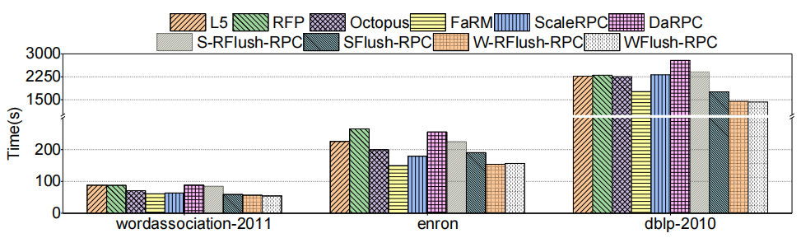
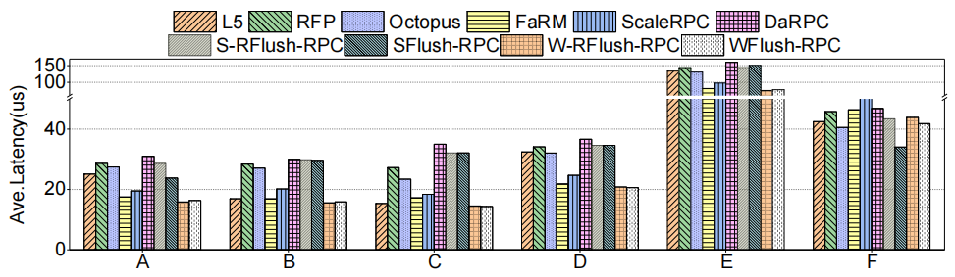
Evaluation
Macro-benchmark Performance
  Our durable RPCs can reduce the execution time by 8% and 30% compared with other RPCs using RDMA send primitive. Our durable RPCs can reduce the execution time by 8%-38% compared with other RPCs using RDMA write primitives.
  Since most YCSB workloads are read-intensive, our durable RPCs show moderate performance improvement compared with other RPCs of the same type. For workloads A and E, our durable RPCs reduce the average latency of RPCs by up to 50% compared with other RPCs using RDMA write primitives. Our durable RPCs also reduce the latency of remote read/write operations by 7% and 23% compared with other RPCs using RDMA send primitive.
Notes:
Figure 10 shows the execution time of PageRank using three datasets for different RPC systems. Our RPCs always shows the best performance for all cases. Particularly, S-RFlush-RPC and SFlush-RPC can reduce the execution time by 8% and 30% compared with DaRPC, respectively. W-RFlush-RPC and WFlush-RPC can reduce the execution time by 8%-38% compared with other RPCs using RDMA write primitives. As Pagerank is a computation-intensive application, the high CPU load at the client side has a non-trivial impact on RDMA transmission. However, our durable RPCs still achieves substantial performance improvement.
Figure 11 shows the average latency of RPCs in different YCSB workloads. Since most YCSB workloads are readintensive, such as workloads B, C, and D, our durable RPCs show moderate performance improvement compared with other RPCs of the same type. For workloads A and E, WRFlush-RPC and WFlush-RPC reduce the average latency of RPCs by up to 50% compared with other RPCs using RDMA write primitives. S-RFlush-RPC and SFlush-RPC also reduce the latency of remote read/write operations by 7% and 23% compared with DaRPC. These results demonstrate that our RDMA Flush-based durable RPCs are beneficial for real-world write-intensive workloads.

Slide 39
Evaluation
Summary：
Persistent RPC decouples data persistence from complex RPC processing, thus providing parallel processing for data transfer and expensive RPC processing. Persistent RPC can significantly improve RPC performance compared to traditional RPC, especially for write-intensive applications.
Persistent RPCs where the sender initiates a persistent acknowledgement have a greater impact on the RDMA network load because they require an additional RDMA primitive to flush the data in the RNIC cache. It is therefore recommended to use receiver-initiated RDMA Flush primitives for high RDMA network loads.
For complex and changing transmission requirements, it is recommended to build RPCs using single-sided RDMA primitives to obtain higher throughput and lower latency.
Notes:
+++++++++++用slide里内容全文或者替换成下面
Based on our experimental results, we summarize the features of different RPCs, as shown in Table 2. Our durable RPCs can decouple the data persisting from the RPC processing, and thus provide opportunities to overlap the RDMA transmission and the costly RPC processing. In this way, our durable RPCs can significantly improve the RPC performance compared with traditional RPCs, particularly for write-intensive applications. We also find that RPCs implemented with senderinitiated RDMA Flush primitives have a greater impact on the RDMA network load because the sender has to send an additional RDMA Flush primitive over the network. As a result, we advocate receiver-initiated RDMA Flush primitives for the scenario of high RDMA network load. Moreover, we advocate one-sided RDMA primitives rather than two-sided ones for higher throughput and lower latency

Slide 40
Outline
Background
Challenge
Design
Evaluation
Conclusion
Notes:
Finally, a summary of our work

Slide 41
Conclusion
We made an extensive study of existing RDMAbased RPCs. Based on the lessons learnt, we designed several hardware-supported RDMA Flush primitives to guarantee the persistence of RDMA update operations.
We also proposed durable RPCs based on the new RDMA Flush primitives for fast failure recovery. We compared our proposals with several state-of-the-art RPCs in a real testbed equipped with Intel Optane DCPMM and InfiniBand networks.
Experimental results show that the proposed RDMA Flush primitives and the corresponding RPCs can significantly improve the throughput and latency of durable RDMA transmission.
Notes:
In this paper, we made an extensive study of existing RDMAbased RPCs.
Based on the lessons learnt, we designed several hardware-supported RDMA Flush primitives to guarantee the persistence of RDMA update operations.
We also proposed durable RPCs based on the new RDMA Flush primitives for fast failure recovery.
We compared our proposals with several state-of-the-art RPCs in a real testbed equipped with Intel Optane DCPMM and InfiniBand networks.
Experimental results show that the proposed RDMA Flush primitives and the corresponding RPCs can significantly improve the throughput and latency of durable RDMA transmission.

Slide 42
Thanks !
Q&A
More questions, please feel free to contact us: zhduan@hust.edu.cn
PRDMA: https://github.com/CGCL-codes/PRDMA

