Slide 1



ZeRO-Infinity:
Breaking the GPU Memory Wall for Extreme Scale Deep Learning
Samyam Rajbhandari, Olatunji Ruwase, Jeff Rasley, Shaden Smith, Yuxiong He
deepspeed

Slide 2
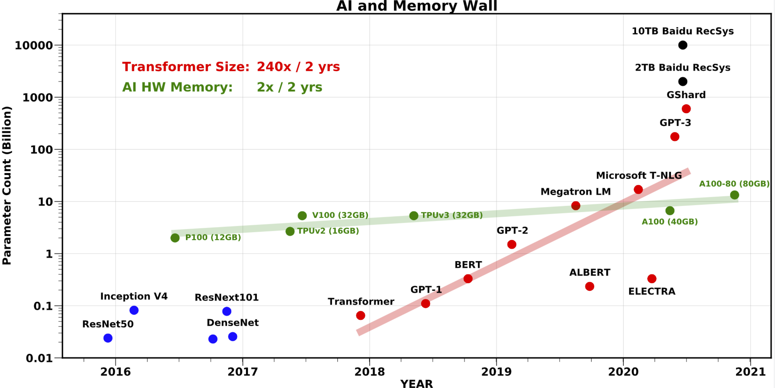
Large model training landscape
GPU Memory Wall
  1T (10T) params: 800 (8K) V100 GPUs
  How do we support the growth in model size?
Accessibility to large model training
  256 GPUs to fine-tune GPT-3
  Limited access to such resources
Model code refactoring
  Re-writing the model using 3D parallelism (tensor-slicing + pipeline parallelism)
  Painful and error prone
  *AI and Memory Wall. (This blogpost has been written in… | by Amir Gholami | riselab | Medium
Notes:
In the last two years, model sizes have increased by 240x while the amount of GPU memory has increased by merely 2x. It is no longer possible to fit large models on a single GPU device and DL training systems have evolved to combine multiple forms of parallelism such as tensor-slicing, pipeline parallelism and ZeRO to leverage aggregate GPU memory in a cluster to support training these large models.
Given this large model training landscape, three questions arises:
How do we sustain the growth in model size, when the aggregate device memory is no longer sufficient to fit large models for training?
Once large models are trained, how do we make them more accessible for fine-tuning?
Existing technology like 3D parallelism that uses tensor-slicing and pipeline parallelism requires major core refactoring which is error prone and painful. Is there a way to simply the pipeline for data scientist for large model training?
In the next slides I will talk about how we can address these challenges with ZeRO-Infinity. Let us at the GPU Memory wall

Slide 3
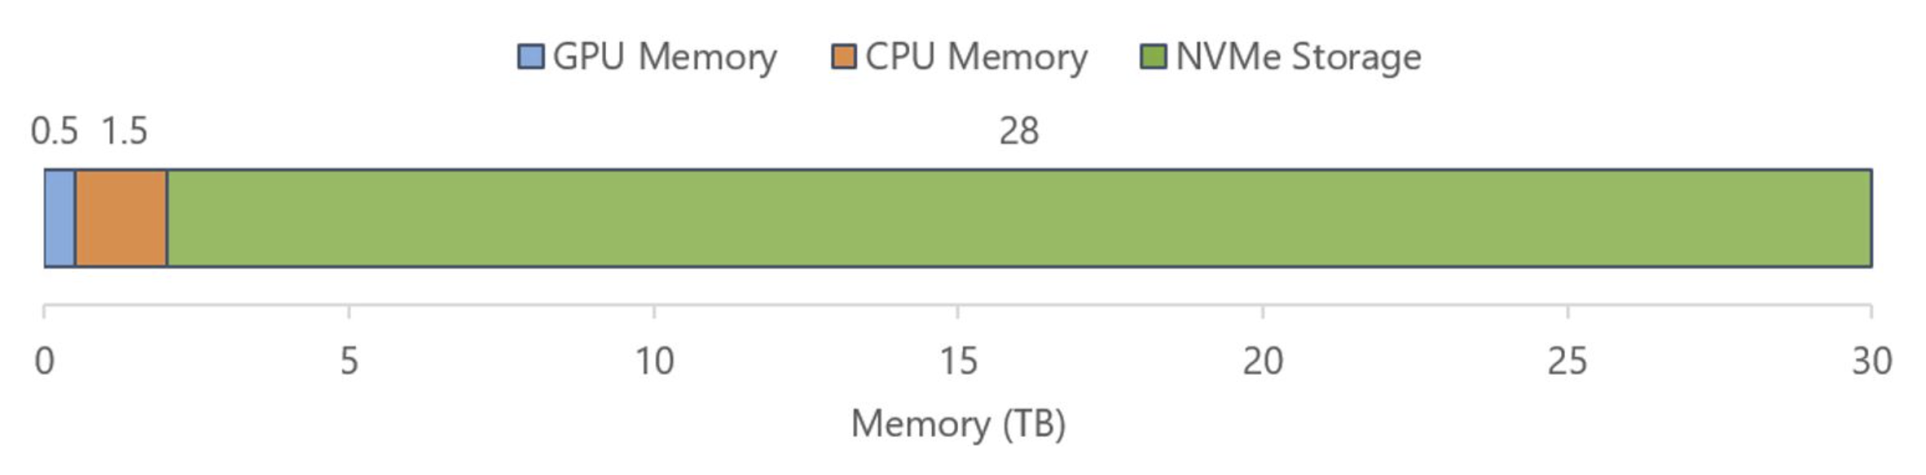
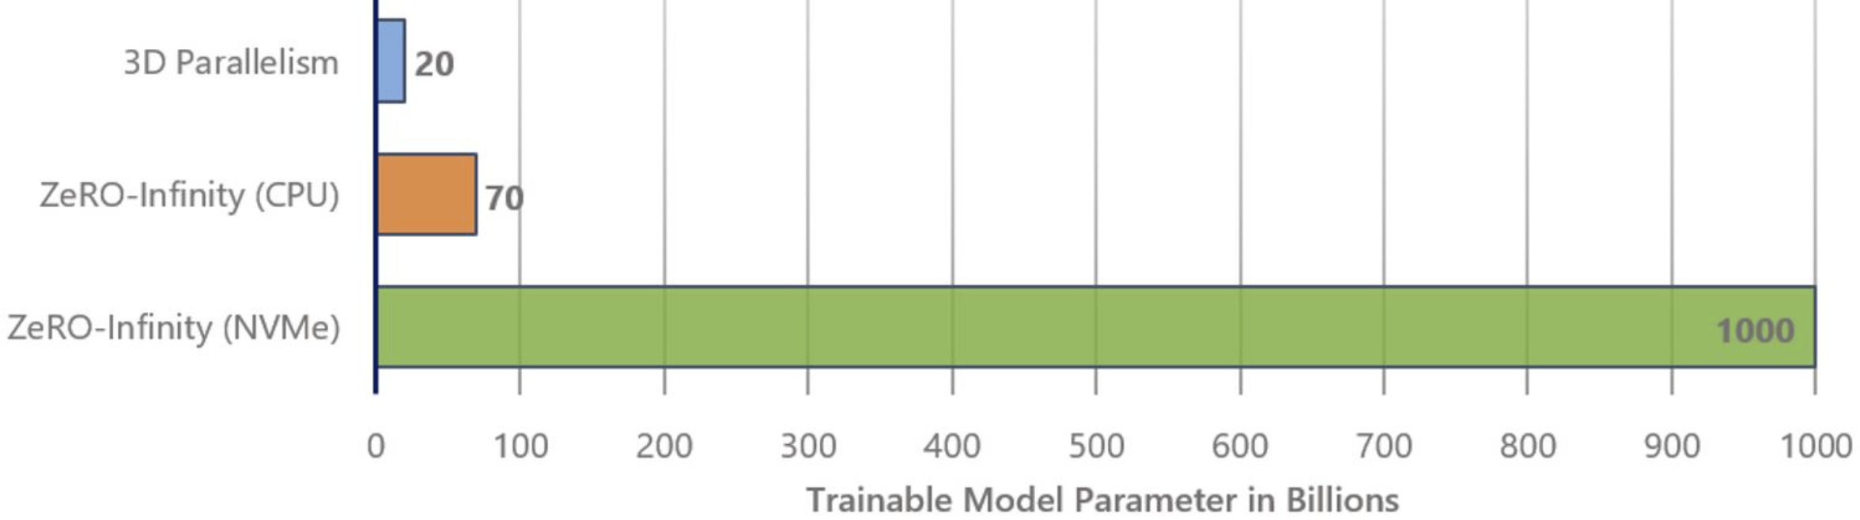
Beyond the GPU Memory
Modern clusters have heterogeneous memory systems.
GPU memory comprises a small fraction
Leverages GPU/CPU/NVMe memory
  32T params on 32 nodes
  1T params on a single node
GPT-3 can be fine-tuned on a single node
Memory available on a Single DGX-2 Node
Model Size on a Single DGX-2 Node
GPU Only
CPU + GPU
NVMe+CPU+GPU
Notes:
Actually, Modern clusters like the NVIDIA DGX-2 superpod have heterogeneous memory systems, where the aggregate GPU accounts for less than 2% of total storage/memory in the system.
From a memory perspective, a single DGX-2 node can support training a 20 billion parameter model with GPU only memory, but if we can leverage the available CPU and NVMe memory, it could support training a trillion parmaeter model.
A model like GPT-3 could be fine-tuned on a single node.

Slide 4
How to leverage non-GPU memory?
Can we extend an existing parallel training technology to use CPU/NVMe memory?
Data Parallelism : Replication causes memory explosion
Tensor-Slicing: Does not scale beyond a single node
Pipeline-Parallelism: Requires significant code refactoring
What about Zero Redundancy Optimizer (ZeRO)?
  Efficiently scale across nodes – trillions of parameters
  No model code refactoring necessary
Notes:
So how can we leverage non-GPU memory? Can we simply extend existing parallel technology to leverage CPU/NVME Memory? Lets take a look at our candidates:
Data parallelism replicated data across devices and is thus causes memory explosion due to redundancy
Tensor Slicing cannot scale beyond a single node even with data on GPU memory due to communication overhead
Pipeline parallelism can scale across nodes and offers great efficiency, but it also requires significant model code refactoring that defeats our goal to simplify large model training
But what about the ZeRO redundancy Optimizer?
It can not only scale efficiently across nodes to support trillions of parameters, but also does not require any model code refactoring. So ZeRO seems like a promising candidate. Lets do a quick recap of how it works

Slide 5
ZeRO: Zero Redundancy Optimizer
Memory efficient form of data parallelism
Each GPU stores a mutually exclusive subset of the parameters
Broadcast parameters from owner to all the GPUs as needed
GPU Interconnect
GPU Interconnect
GPU 0
GPU 1
GPU 2
GPU 0
GPU 1
GPU 2
Layer 0
Layer 0
Layer 0
Layer 0
Layer 1
Layer 1
Layer 1
Layer 1
Layer 2
Layer 2
Layer 2
Layer 2
Model States mapping in Data Parallel Training
Model States mapping in ZeRO Training
Notes:
ZeRO is a memory efficient form of data parallelism. In data parallel training each GPU stores a replica of all the model states. However, in ZeRO, each GPU only stores a mutually exclusive subset of parameters entirely removing the redundancy. During training, when a parameter is needed, it is broadcasted from the owner GPU of that parameter to all the other GPUs over the GPU interconnect like infiniband

Slide 6
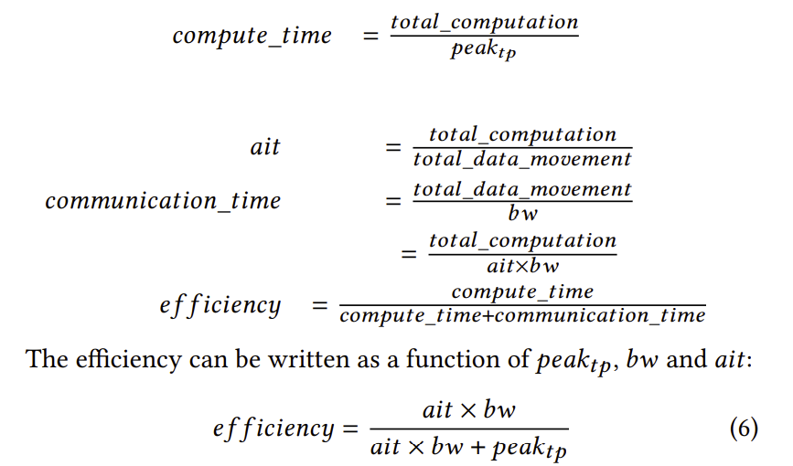
ZeRO with CPU/NVME Offload
Store in CPU/NVME instead of GPU
Send from CPU/NVMe to GPU
Broadcast or reduce as ZeRO
Is NVME←→ GPU bandwidth sufficient?
  Efficiency analysis based on
  bandwidth
Notes:
So how can we extend ZeRO to use non-GPU memory? Can we by simply offload the model states to CPU/NVMe memory and move them to GPU only when they are needed.
In theory this would take us beyond the GPU memory wall, but to be practically useful, it is also necessary for the system to achieve good training efficiency or thoughput. To understand the impact of this offloading strategy on throughput we perform an analysis that measures the impact of the bandwidth between GPU and NVME/CPU memory on efficiency.
For our analysis, we define a simple efficiency metric as the ratio between compute time and compute and communication time.
The compute time is estimated as a function of total computation during each iteration of training, and peak achievable thoughput achievable in the absence of any communication.
The communication time is estimated as a function of total data movement and the slowest data movement bandwidth in the critical part.
We can re-write the total data movement as a function total_computation and arithmetic intensity wrt to different data used in the training, and obtain efficiency as a function of the data type, communication bandwidth, achievable peak throughput and arithmetic intensity for a given set of model and training parameters

Slide 7
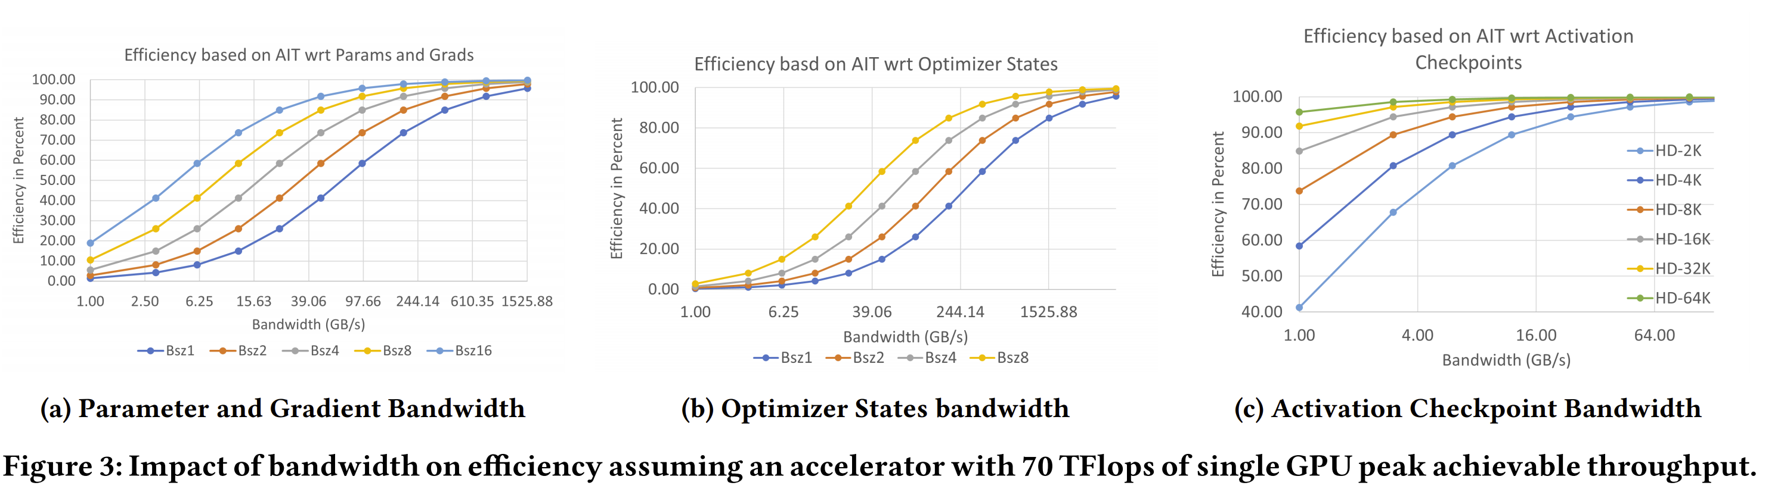
Efficiency as a function of bandwidth
Data Type | Overlap | Requirement
Params/Grads | Yes | 60 GB/s
Optimizer States | No | 1500 GB/s
Activations | Yes | 4 GB/s
Batch Size 2K tokens per GPU
Notes:
With our efficiency formulation, we can plot efficiency as a function of bandwidth for different data used during the training such as parameter, gradients, optimizer states and activations, for different batch sizes. These plots can tell us for a given data type, and batch size, how much bandwidth is necessary for ZeRO with CPU/NVMe offload to remain efficient.
For example, for the training with ZeRO to be efficient on a DGX-2 system where each GPU can achieve about 70 TFlops in real performance without communication, we need 60 GB/s offload communication bandwidth to read and write parameter and gradients, 1.5TB/s bandwidth for optimizer states, and 4 GB/s for activations if we use a batch size of 2K tokens per GPU.

Slide 8
ZeRO with CPU/NVME Offload
Example: Training using ZeRO with Offload on 64x DGX-2 nodes.
ZeRO with non-GPU memory
GPU Interconnect
GPUs | Data Type | Required | NVMe memory | CPU Memory
1024 | Params/Grads | 60 GB/s | 12 GB/s | 12 GB/s
1024 | Optimizer States | 1500 GB/s | 1792 GB/s | 4096 GB/s
1024 | Activations | 4 GB/s | 1.75GB/s | 4GB/s
GPU 0
GPU 1
GPU 2
PCIe
NVME
NVME
NVME
Layer 0
Layer 0
Layer 1
Layer 2
Is CPU/NVME←→ GPU bandwidth sufficient?
  Params/grads: PCIe bottleneck 12 GB/s
  Optimizer States: More than needed
  Activations: CPU Memory bandwidth sufficient
Notes:
Given these requirements, lets consider training a massive model on 1K GPU 64 nodes DGX-2 cluster with ZeRO where parameters, gradients, optimizer states and activations are all offloaded to CPU or NVME memory.
The NVMe peak bw on a DGX-2 system is about 28GB/s, while the CPU memory bandwidth is a couple of hundreds of GB/s.
For parameters and gradients, since each parameter is owned by a unique GPU in ZeRO, the bandwidth from NVMe/CPU is limited by the PCIe link bandwidth between that GPU and the NVMe memory which is only about 12 GB/s. This severely restricts efficiency of ZeRO compared to running it directly from GPU memory.
Optimizer states on the other hand are updated in parallel across all nodes in ZeRO. Therefore, the required data movement can occur in parallel across all nodes, achieving an aggregate the NVMe bandwidth 1.7 TB/s bandwidth across 64 nodes. This is more than sufficient to achieve good efficiency.
Furthermore, while activation memory bandwidth from NVMe is insufficient, the bandwidth from CPU memory is sufficient to achieve good efficiency.
In summary, our analysis shows that ZeRO with CPU/NVMe Offload can enable offloading of optimizer states to NVMe, and activations to CPU memory but requires parameters and gradients to stay in GPU memory. While this is very encouraging, leaving parameters and gradients in GPU memory still creates a GPU memory bottleneck. Can we do better and offload everything to completely transcend the GPU memory wall while still remaining efficient?
This was one of the main motivations behind the design of ZeRO-Infinity.

Slide 9
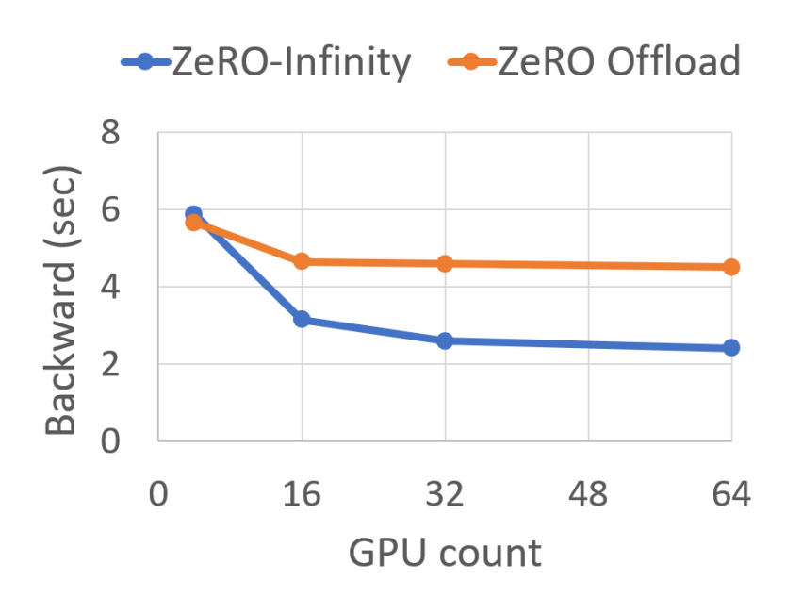
ZeRO-Infinity
GPU Interconnect
GPU 0
GPU 1
GPU 2
PCIe
Layer 0
Layer 0
NVME
NVME
NVME
Layer 1
  Partition each parmaeter across GPUs
  Send from NVMe to GPU in parallel
  Allgather and Reduce-Scatter
  Bandwidth Increases linearly with devices
    #gpus x host-to-device bandwidth
    CPU -> GPU: 64 GB/s – 4 TB/s (1-64 nodes)
    NVMe -> GPU: 28 GB/s – 1.8 TB/s (1-64 nodes)
  Limited by GPU←→GPU bw
    min (#gpus x host-device bw, gpu-gpu bw)
    70 GB/s
Layer 2
ZeRO Infinity
GPUs | Data Type | Required | NVMe memory | CPU Memory
1024 | Params/Grads | 60 GB/s | 70 GB/s | 70 GB/s
1024 | Optimizer States | 1500 GB/s | 1792 GB/s | 4096 GB/s
1024 | Activations | 4 GB/s | 1.75GB/s | 4GB/s
Weak Scaling:
ZeRO Infinity vs ZeRO Offload
Notes:
One of the core differences between ZeRO and ZeRO Infinity is in data partitioning and communication strategy. ZeRO Infinity partitions each individual parameter across all data parallel GPUs before offloading it to NVMe. When a parameter is needed during training, each of its partition is moved to the owner GPUs using multiple PCIe links in parallel. Then to reconstruct the full-parameter on each GPU, it uses an all-gather operation instead of a broadcast. My colleague Tunji will show this in action shortly.
Note that this remapping of data allows the NVMe to GPU bandwidth to increase linearly with the number of data parallel GPUs. On a single DGX-2 we can achieve near peak NVMe bandwidth of 28GB/s and on a 64 node cluster, a massive 1.8 TB/s bandwidth, far beyond what is needed to offload parameters and gradients.
The impact of this linear increase in bandwidth is demonstrated with the figure in the bottom showing weak scaling of ZeRO-Infinity and ZeRO-Offload. Note that both of them have similar performance on a single GPU, but ZeRO-Infinity gets over 2x faster with larger number of nodes due to the increased aggregate NVMe bandwidth. In fact, at scale ZeRO-Infinity is no longer bottlenecked by the NVMe or CPU bandwidth but rather by the GPU-GPU bandwidth of the Allgather.
Next my colleague, Tunji will show ZeRO-Infinity in action and provide a deeper dive into optimizations and performance of ZeRO-Infinity.

Slide 10

ZeRO-Infinity in Action
Notes:
Let’s see an animation of ZeRO-Infinity in action during the forward, backward and optimizer stages of training. Each rank fetches a partitionof each model layer from NVMe storage and performs an all-gather in the infinband network to assemble the full layer. It computes the full layer to generate activations for subsequent layers and for the backward pass. During the backward pass, layer partitions are fetched and assembled similarly in the infiniband network to generate gradients which are offloaded to NVMe storage. During the optimizer phase, layer partitions and corresponding gradients are fetched into CPU memory to perform parameter updates and the updated paramaters are sent to NVMe to process the next training input.

Slide 11
Powerful Optimizations in ZeRO-Infinity
Overlap Centric Design
  GPU computation
  GPU ←→ CPU, NVME ←→ CPU communication
  GPU ←→ GPU communication
Infinity Offload Engine
  Pinned Memory Management Layer
  DeepNVMe
  Can be used as an independent library
Layer i
Computing
GPU
Prefetching
Layer i+1
CPU
Prefetching
Layer i+2
NVME
Overlapped layer prefetching during forward pass
Notes:
ZeRO-Infinity employs powerful optimizations to achieve good training efficiency. One such optimization is the overlap centric design which ensures that data communication across NVMe, CPU, and GPU memories are overlapped with GPU computation to effectively hide the communication latencies. This means that layers are prefetched ahead of use, and the prefetching overlaps the computation of earlier layers. For example, the figure shows that the computation of layer i during the forward pass is overlapped with the prefetching of layer i+1 from CPU into GPU, and the prefetching of layer i+2 from NVMe into CPU. The overlap centric design is implemented using the Infinity Offload Engine of ZeRO-Infinity. The Infinity Offload Engine manages the pinned memory buffers for NVMe data transfers and utilizes the DeepNVMe module for fast NVMe data transfers. The Infinity Offload Engine can be used as an independent library for offloading data to CPU/NVMe memories.

Slide 12

Ease Inspired Implementation
Automatic Data Movement
  Auto registration of all parameters
  Intercept parameter access to automate communication
Automatic Model Partitioning during Initialization
  Initializing models that are larger than GPU/CPU memory
  Automatically partitioning parameters as they are created
Notes:
ZeRO-Infinity enables easy integration into models by automating data movement and model partitioning. ZeRO-Infinity provides automatic data movement by registering parameters so that it can materialize the parameter before use and release memory after use. ZeRO-Infinity also enables initialization of models that are larger than available GPU/CPU memory by automatically partitioning the model parameters at creation. Both these features are enabled by wrapping the model creation logic in the ZeRO-Infinity context manager as shown in the figure.

Slide 13
Evaluation

Slide 14
Massive model scale
Notes:
ZeRO-Infinity enables massive scaling of models, thus making it possible to train models with hundreds of trillions of parameters on a few hundred DGX-2 nodes. In particular, ZeRO-Infinity fits a trillion-parameter model on a single DGX-2 node, and scales model size linearly with node count. In comparison, the SOTA 3D parallelism cannot scale models to such massive sizes.

Slide 15

Excellent Efficiency
Notes:
ZeRO-Infinity can match the training efficiency of SOTA 3D parallelism for largest model sizes (500B parameters) that are trainable by the existing techniques. For larger models, ZeRO-Infinity achieves good training efficiency until 20T parameters, where a noticeable efficiency drop is observed due to small batch sizes. Activation offloading to NVMe could help to boost efficiency at this extreme scale.

Slide 16
Super-linear Scalability
Notes:
ZeRO-Infinity achieves super-linear scalability when training a 1 trillion parameter model on 4 nodes to 32 nodes. This is a weak scaling result where batch size per node is kept constant as we increase node count. ZeRO-Infinity exceeds linear scaling by exploiting the increasing PCIe and NVMe bandwidth.

Slide 17
Democratizing Large Model Training
Notes:
ZeRO-Infinity democratizes model training by significantly reducing the hardware requirements for large models. With ZeRO-Infinity, model scientists can now train or finetune models with up to 1 trillion parameters in one dgx-2 node.

Slide 18
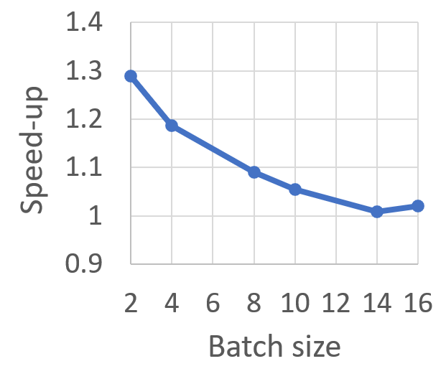
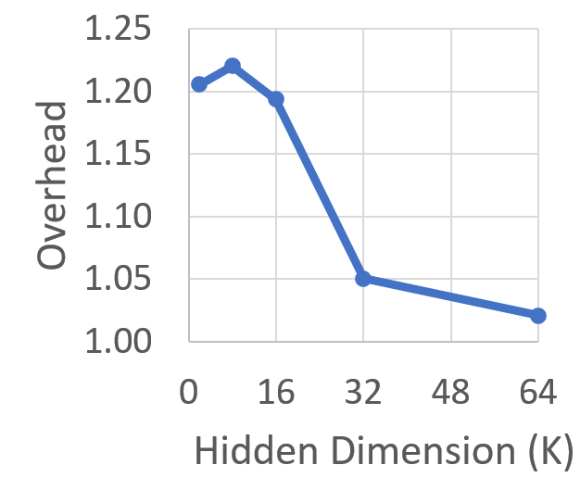
Impact of System Features on Performance
Prefetching and Overlapping
Offloading activation checkpoints to CPU
8B model on 64 GPUs
More effective for smaller batch sizes
Overhead is negligible for large hidden dims
Notes:
We round up the evaluation by briefly examining the impact of two ZeRO-Infinity features on performance.
The figure on the left shows the impact of prefetching and overlapping for different batch sizes. We observe that prefetching and overlapping improve performance for small batch sizes by hiding communication latencies. On the other hand, larger batch sizes have sufficient computation to hide communication latencies by themselves and so do not benefit from this feature.
The figure on the right shows the overhead of offloading activation checkpoints to CPU memory for different hidden dimensions. The results show that this overhead is negligible for large hidden dimensions that found in the massive models that require this feature. The smaller hidden dimensions with higher overheads are found in smaller models which don’t need this feature anyway.

Slide 19
Large model training landscape today
GPU Memory Wall
  1T (10T) params: 800 (8K) V100 GPUs
  How do we support the growth in model size?
Accessibility to large model training
  256 GPUs to fine-tune GPT-3
  Limited access to such resources
Model code refactoring
  Re-writing the model using 3D parallelism (tensor-slicing + pipeline parallelism)
  Painful and error prone
  *AI and Memory Wall. (This blogpost has been written in… | by Amir Gholami | riselab | Medium
Notes:
We now return to our original 3 questions regarding how ZeRO-Infinity affects the large model training landscape: (1) GPU Memory Wall, (2) Accessiblity to large model training, and (3) Model code refactoring.

Slide 20
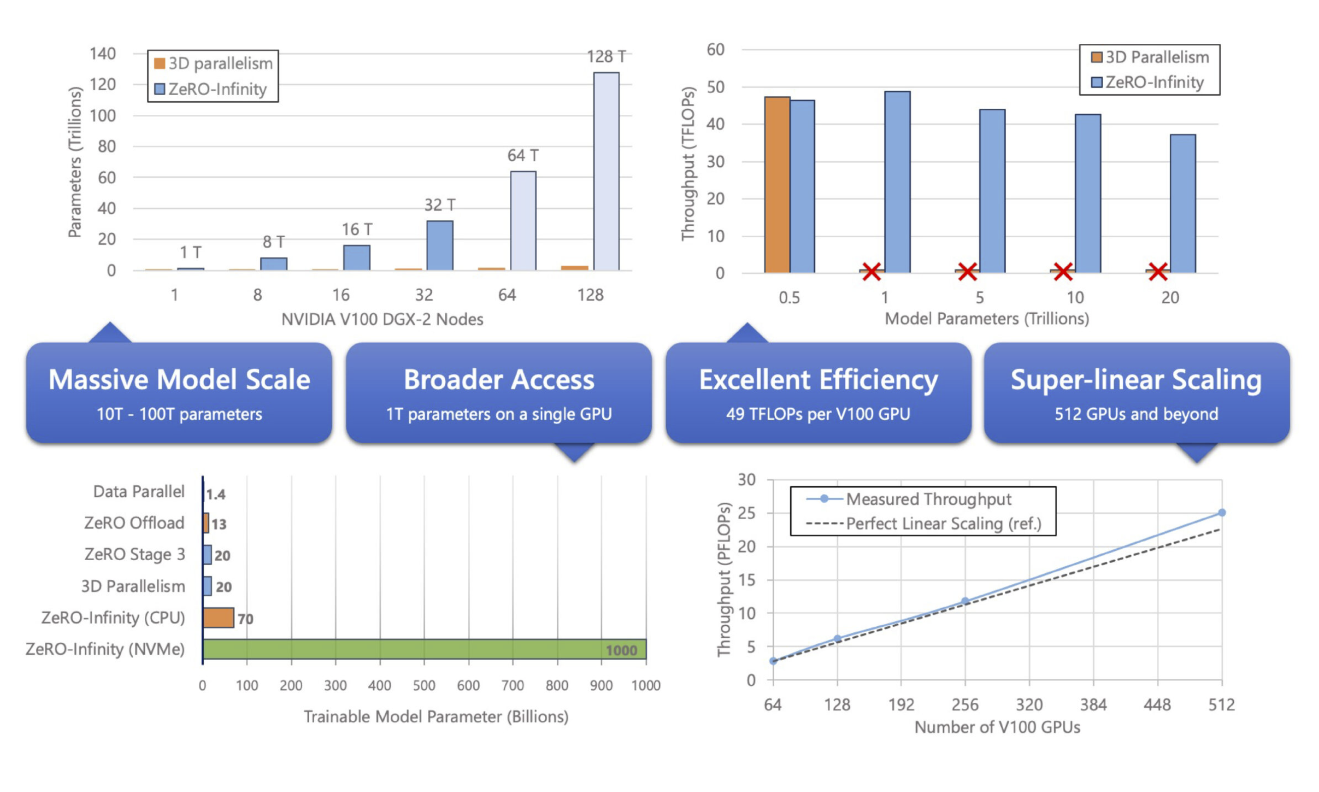
Redefining the landscape with ZeRO-Infinity
  Beyond GPU Memory
    50x larger models
    32T params on 512 GPUs (instead of 25K)
  Broader access to large model training
    GPT-3 sized fine-tuning on a single node/GPU (instead of 16 nodes)
  Excellent Throughput and Scalability
    Comparable to 3D-parallelism
  Ease of Use
    No model refactoring necessary
Notes:
We see that ZeRO-Infinity has a positive impact on all three questions.
First, ZeRO-Infinity enables model scaling beyond the limitations of GPU Memory sizes, such as enabling models that are 50X larger. For example, a 32T parameter model can be trained on 512 GPUs instead of 25K GPUs.
Second, ZeRO-Infinity provides broader access to large model training, for example enabling finetuning a GPT-3 size model (175B) on a single node rather than 16 nodes.
Third, ZeRO-Infinity is easy to use because it does not require model refactoring.

Slide 21
Thank You!
www.deepspeed.ai
Currently hiring
engineers & researchers

Slide 22
Evaluation

Slide 23
Powerful Optimizations in ZeRO-Infinity
Layer i
Computing
Overlap Centric Design
  GPU computation
  GPU ←→ CPU, NVME ←→ CPU communication
  GPU ←→ GPU communication
Infinity Offload Engine
  DeepNVMe
  Pinned Memory Management Layer
  Can be used as an independent library
GPU
Prefetching
i+1
CPU
Prefetching
Prefetching
i+2
NVME
Overlapped layer prefetching during forward pass

